Slide 1
Inspection Planning in the Marine Sector: a Case Study of a Hydrogen-Fueled Fishing Vessel
Leonardo Giannini – 27/04/2023

Slide 2




OMAE 2023 – 42nd International Conference on Ocean, Offshore & Arctic Engineering
Melbourne Convention and Exhibition Centre, Melbourne, Australia [1]
June 11-16, 2023
Notes:
This is an extended version of the pres. For OMAE – where is it – first time – suggestions are appreciated

Slide 3




Structure of the presentation
1. Introduction: why this study?
2. A hydrogen-fuelled fishing vessel
3. Risk-Based Inspection for hydrogen technologies
4. Results and Discussion

Slide 4

Structure of the presentation
1. Introduction: why this study?
2. A hydrogen-fuelled fishing vessel
3. Risk-Based Inspection for hydrogen technologies
4. Methodology
5. Results and Discussion
Notes:
Just talk about the structure point by point

Slide 5



Introduction: why this study?
Hydrogen implementation on fishing vessels:
Reduction of
GHG emissions
Improvement of fishermen working conditions
Less volume/weight than batteries
Notes:
Just read

Slide 6
Introduction: why this study?
Hydrogen implementation on fishing vessels:
Shipping, including fishing, contributed to 2.89% of global greenhouse gas (GHG) emissions in 2018 [2]. In 2021, the Norwegian fishing fleet emitted approximately 855,000 tons of GHGs, which accounts for 1.3% of the total pollutant emissions in Norway [3].
Notes:
Environmental relevance

Slide 7
Introduction: why this study?
Hydrogen implementation on fishing vessels:
Drastic noise and vibrations reduction on board with respect to conventional combustion engines [4].
Notes:
Improve of conditions on fishing vessels

Slide 8
Introduction: why this study?
Hydrogen implementation on fishing vessels:
Batteries weight, occupied volume, relatively high costs, and limited energy storage capacity are critical downsides. Moreover, fishing vessels are often designed and optimized to achieve the best possible load capacity, which could drastically be reduced by the presence of batteries [4].
Notes:
Comparison with batteries

Slide 9
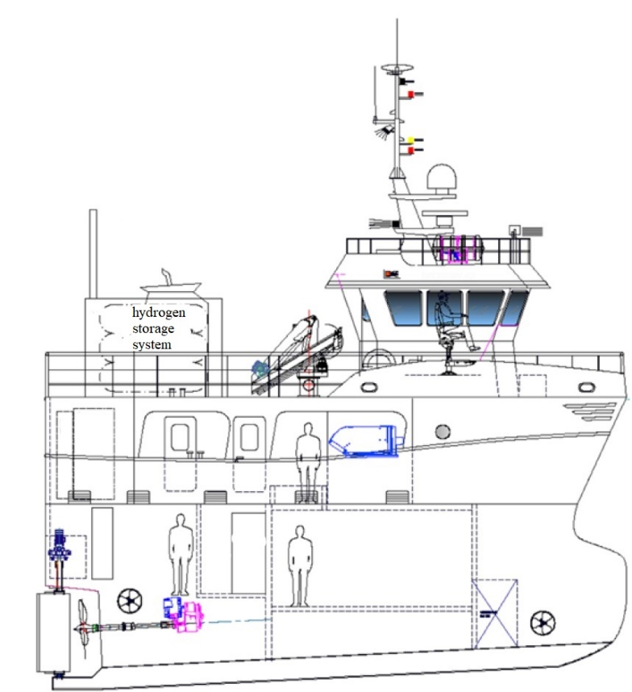
A hydrogen-fuelled fishing vessel
Project led by SINTEF Ocean [4], where technical, economic, and environmental aspects related to the utilization of hydrogen and ammonia-fed fuel cells onboard a fishing vessel were studied.
Characteristics:
13 m fishing vessel
Hydrogen-fed fuel cells for power
160 kg of hydrogen
18 h working session
3 h: Time required for steaming to the fishing areas
12 h: Time required for fishing
3 h: Time required to return to the port area
Figure 1: Qualitative description of the fishing boat, adapted from [4] and illustrated by GOT Skogsøy AS
Notes:
Talk about the case study – sintef ocean – techno-economical and environmental analysis – characteristics of the vessel

Slide 10
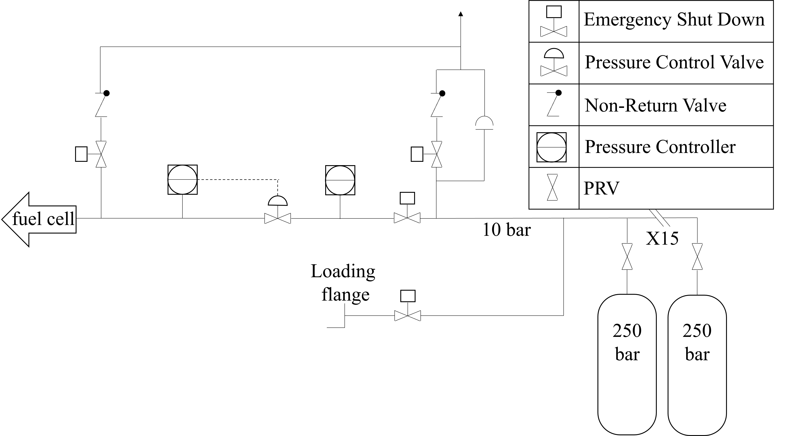
A hydrogen-fuelled fishing vessel
Figure 2: Hydrogen storage systems and piping from [4]
Notes:
This is a P&ID of the storage system of hydrogen – talk about the element – say that the pressure is important before moving on – for the sake of brevity we chose the hydrogen cylinders

Slide 11



A hydrogen-fuelled fishing vessel
$H_{2}$ molecule
Steel structure
Van der Waals forces – Physisorption [5]
Molecular dissociation – Chemisorption [5]
Diffusion - Absorption
$$H_{ads}$$
$$H_{ads}$$
Notes:
Pressure driven hydrogen uptake – explain the steps

Slide 12


Risk-Based Inspection
RBI provides a vehicle for continuously improving the inspection of facilities and systematically reducing pressure boundary failures [6]
Risk Assessment and Ranking
RBI
Starting point
Data Gathering
Inspection Plan
Mitigation Activities and Reassessment
Notes:
Before showing the results, explain what RBI is – definition – maybe of you already know so I’ll keep it short.

Slide 13
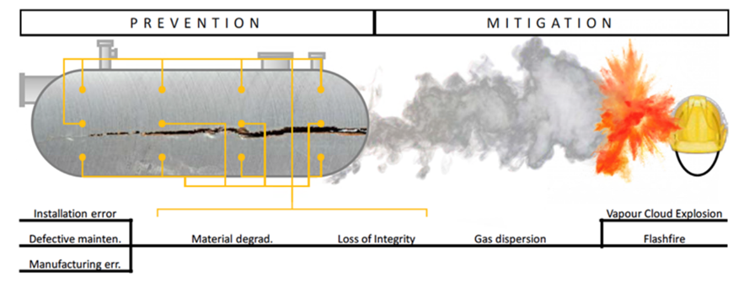
Risk-Based Inspection
Data Gathering
Risk Assessment and Ranking
Inspection and Mitigation Activities
Environmental Conditions
Operative Conditions
Equipment Age and History
Probability of Failure
Consequence of Failure
Maintenance
Substitutions
Planning of Future Inspections
Notes:
Talk about the points

Slide 14
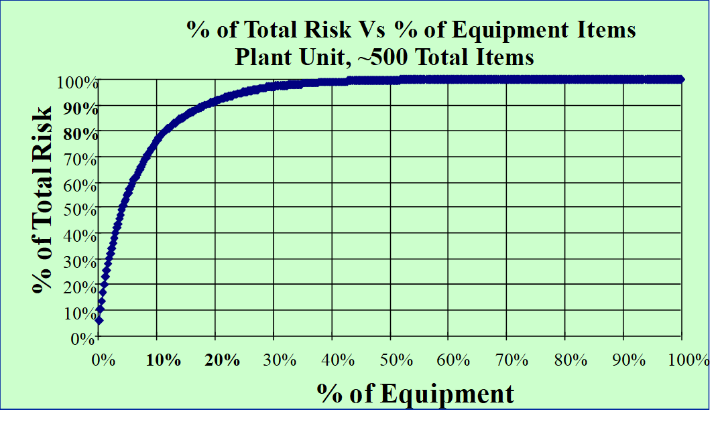


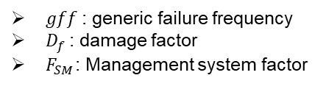
Risk-Based Inspection
Risk Assessment and Ranking
Probability of Failure
Consequence of failure
Example of consequence categories. Notice that ranges need to be adjusted for the considered plant or unit.
$P_{f}(t)=gff ∙ D_{f}(t)∙ F_{SM}$
Probability of Failure
Consequence of Failure
$gff$: generic failure frequency
$D_{f}$: damage factor
$F_{SM}$: Management system factor
$$R=\sum_{i=1}^{n}{R_{i}(t)=\sum_{i=1}^{n}{P_{f_{i}}(t) ∙ C_{f_{i}}}}$$
Notes:
Element of the formula – The GFF of a component type is estimated using records from all plants within a company or from various
plants within an industry, from literature sources, and from commercial reliability databases - FSM is an adjustment factor that accounts for the influence of the facility’s
management system on the mechanical integrity of the plant equipment -

Slide 15

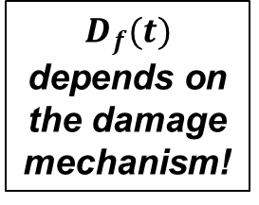
Risk-Based Inspection
The Role of Hydrogen in API RBI 581 [7]
Damage Mechanisms API581 |  | Hydrogen
1 | Thinning | NO
2 | Component Lining | NO
3 | SCC – Caustic Cracking | NO
4 | SCC – Amine Cracking | NO
5 | SCC – Sulfide Stress Cracking | YES
6 | SCC – HIC/SOHIC-H2S | YES
7 | SCC – Alkaline Carbonate Stress Corrosion Cracking | NO
8 | SCC – Polythionic Acid Stress Corrosion Cracking | NO
9 | SCC – Chloride Stress Corrosion Cracking | NO
10 | SCC – Hydrogen Stress Cracking-HF | YES
11 | SCC – HIC/SOHIC-HF | YES
12 | External Corrosion – Ferritic Component | NO
13 | Corrosion Under Insulation—Ferritic Component | NO
14 | External Chloride SCC—Austenitic Component | NO
15 | External Chloride SCC Under Insulation—Austenitic Component | NO
16 | High Temperature Hydrogen Attack | YES
17 | Brittle Fracture | NO
18 | Low Alloy Steel Embrittlement | NO
19 | 885 °F Embrittlement | NO
20 | Sigma Phase Embrittlement | NO
21 | Piping Mechanical Fatigue | NO
$P_{f}(t)=gff ∙ D_{f}(t)∙ F_{SM}$
$$D_{f}(t)$$
depends on the damage mechanism!
Notes:
Talk about the D mechanisms In API RBI 581

Slide 16


Risk-Based Inspection
Damage Mechanisms API581
1 | SCC – Sulfide Stress Cracking
2 | SCC – HIC/SOHIC-H2S
3 | SCC – Hydrogen Stress Cracking-HF
4 | SCC – HIC/SOHIC-HF
5 | HTHA - High Temperature Hydrogen Attack
HTHA:
Decarburization process at high temperatures
SCC:
Stress corrosion cracking
SCC is a form of HSC resulting from the absorption of atomic hydrogen that is produced by the corrosion process on the metal surface [7]
$$4H+MC ↔ {CH}_{4}+M$$
$$T>200 ℃$$
Steel structure
Notes:
Difference between HTHA and SCC, talk about why we chose SCC and not HTHA. The reason for the hydrogen uptake is different (corrosion process) but there is an uptake of atomic hydrogen in the material. Different magnitude of consequences, different time dependency of the phenomena but at the end of the day is still dissolved atomic hydrogen combined with stress of the material that causes failure.

Slide 17
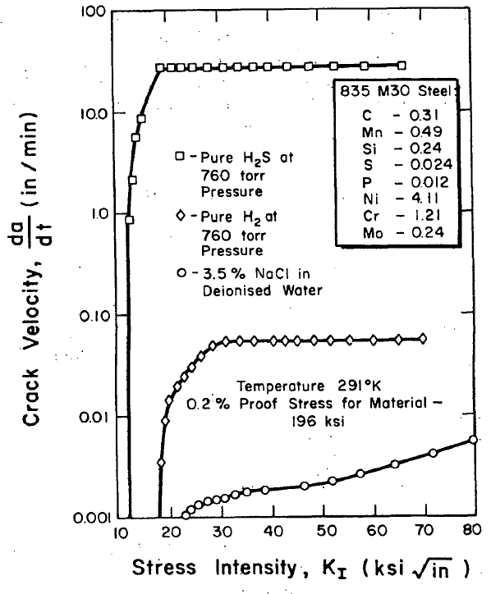
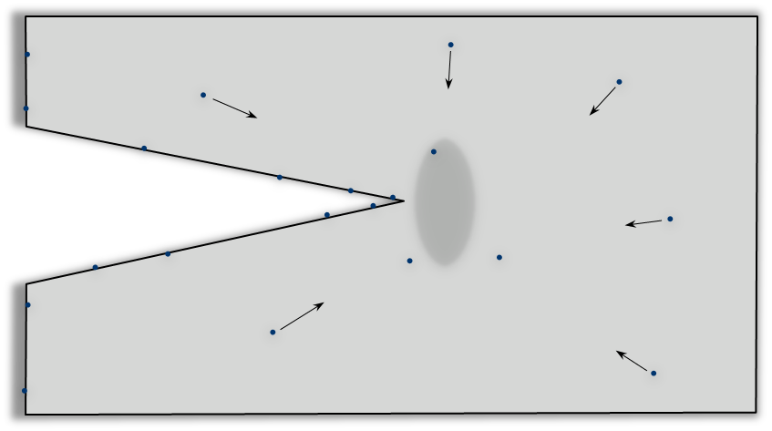



Risk-Based Inspection
Damage Mechanisms API581
1 | SCC – Sulfide Stress Cracking
2 | SCC – HIC/SOHIC-H2S
3 | SCC – Hydrogen Stress Cracking-HF
4 | SCC – HIC/SOHIC-HF
5 | HTHA - High Temperature Hydrogen Attack
$$K_{I }=Yσ\sqrt{a π}$$
$$H_{ads}$$
$$H_{ads}$$
Effect of atomic hydrogen production at a crack tip for different environments [9]

Slide 18


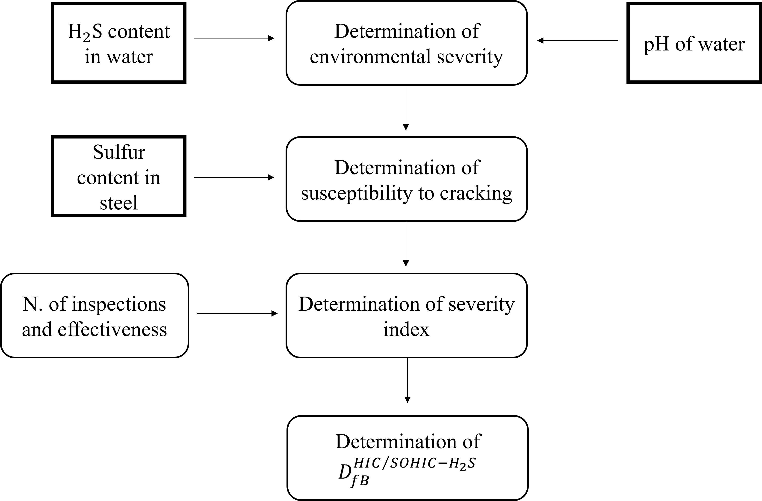

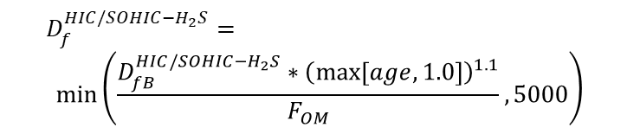

Methodology
Synergi Plant RBI [8] – developed by DNV
SCC – HIC/SOHIC-H2S
Probability of Failure
$P_{f}(t)=gff ∙ D_{f}(t)∙ F_{SM}$
Damage Factor
$$D_{f}^{HIC/SOHIC−H_{2}S}=$$
$$min\left(\frac{D_{fB}^{HIC/SOHIC−H_{2}S}∗{\left(\max\left[age,1.0\right]\right)}^{1.1}}{F_{OM}},5000\right)$$
Notes:
Talk about synergi. Talk about PoF calc.

Slide 19
Methodology
Synergi Plant RBI [8] – developed by DNV
SCC – HIC/SOHIC-H2S
Input for CoF - Screening Procedure for hydrogen release
NFPA Flammability | 4/4 | Extremely flammable
NFPA Toxicity | 0/4 | Not Toxic
Personnel Injury | 5/5 | Any fatality or significantly public minor injury possible
Environmental Consequence | 5/5 | Any fatality or significantly public minor injury possible
Business Impact | 5/5 | More than 5 days production loss plus maintenance costs
Operating Pressure Range | ≥ 40 bar
Operating Temperature Range | ≤ 38 °C
Mass Release | ≤ 450 kg
Consequence of Failure
Notes:
Talk about CoF calc in synergi. The quantitative approach requests the setting of a series of parameters not assessable at a preliminary design stage (number of injuries, casualties, business loss, etc.).

Slide 20
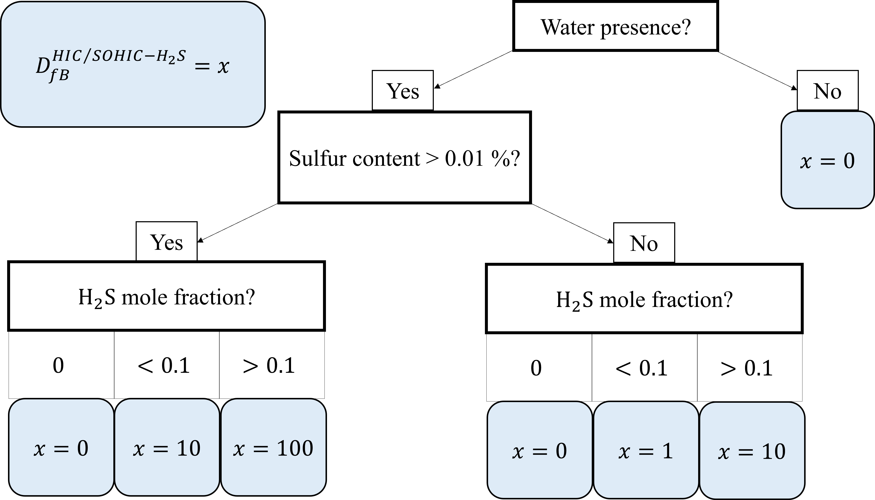
Results and Discussion
SCC – HIC/SOHIC-H2S
Probability of Failure
$P_{f}(t)=gff ∙ D_{f}(t)∙ F_{SM}$
Damage Factor
$$D_{f}^{HIC/SOHIC−H_{2}S}=$$
$$min\left(\frac{D_{fB}^{HIC/SOHIC−H_{2}S}∗{\left(\max\left[age,1.0\right]\right)}^{1.1}}{F_{OM}},5000\right)$$
Notes:
These are the result if we consider SOHIC for our hydrogen cylinders.

Slide 21
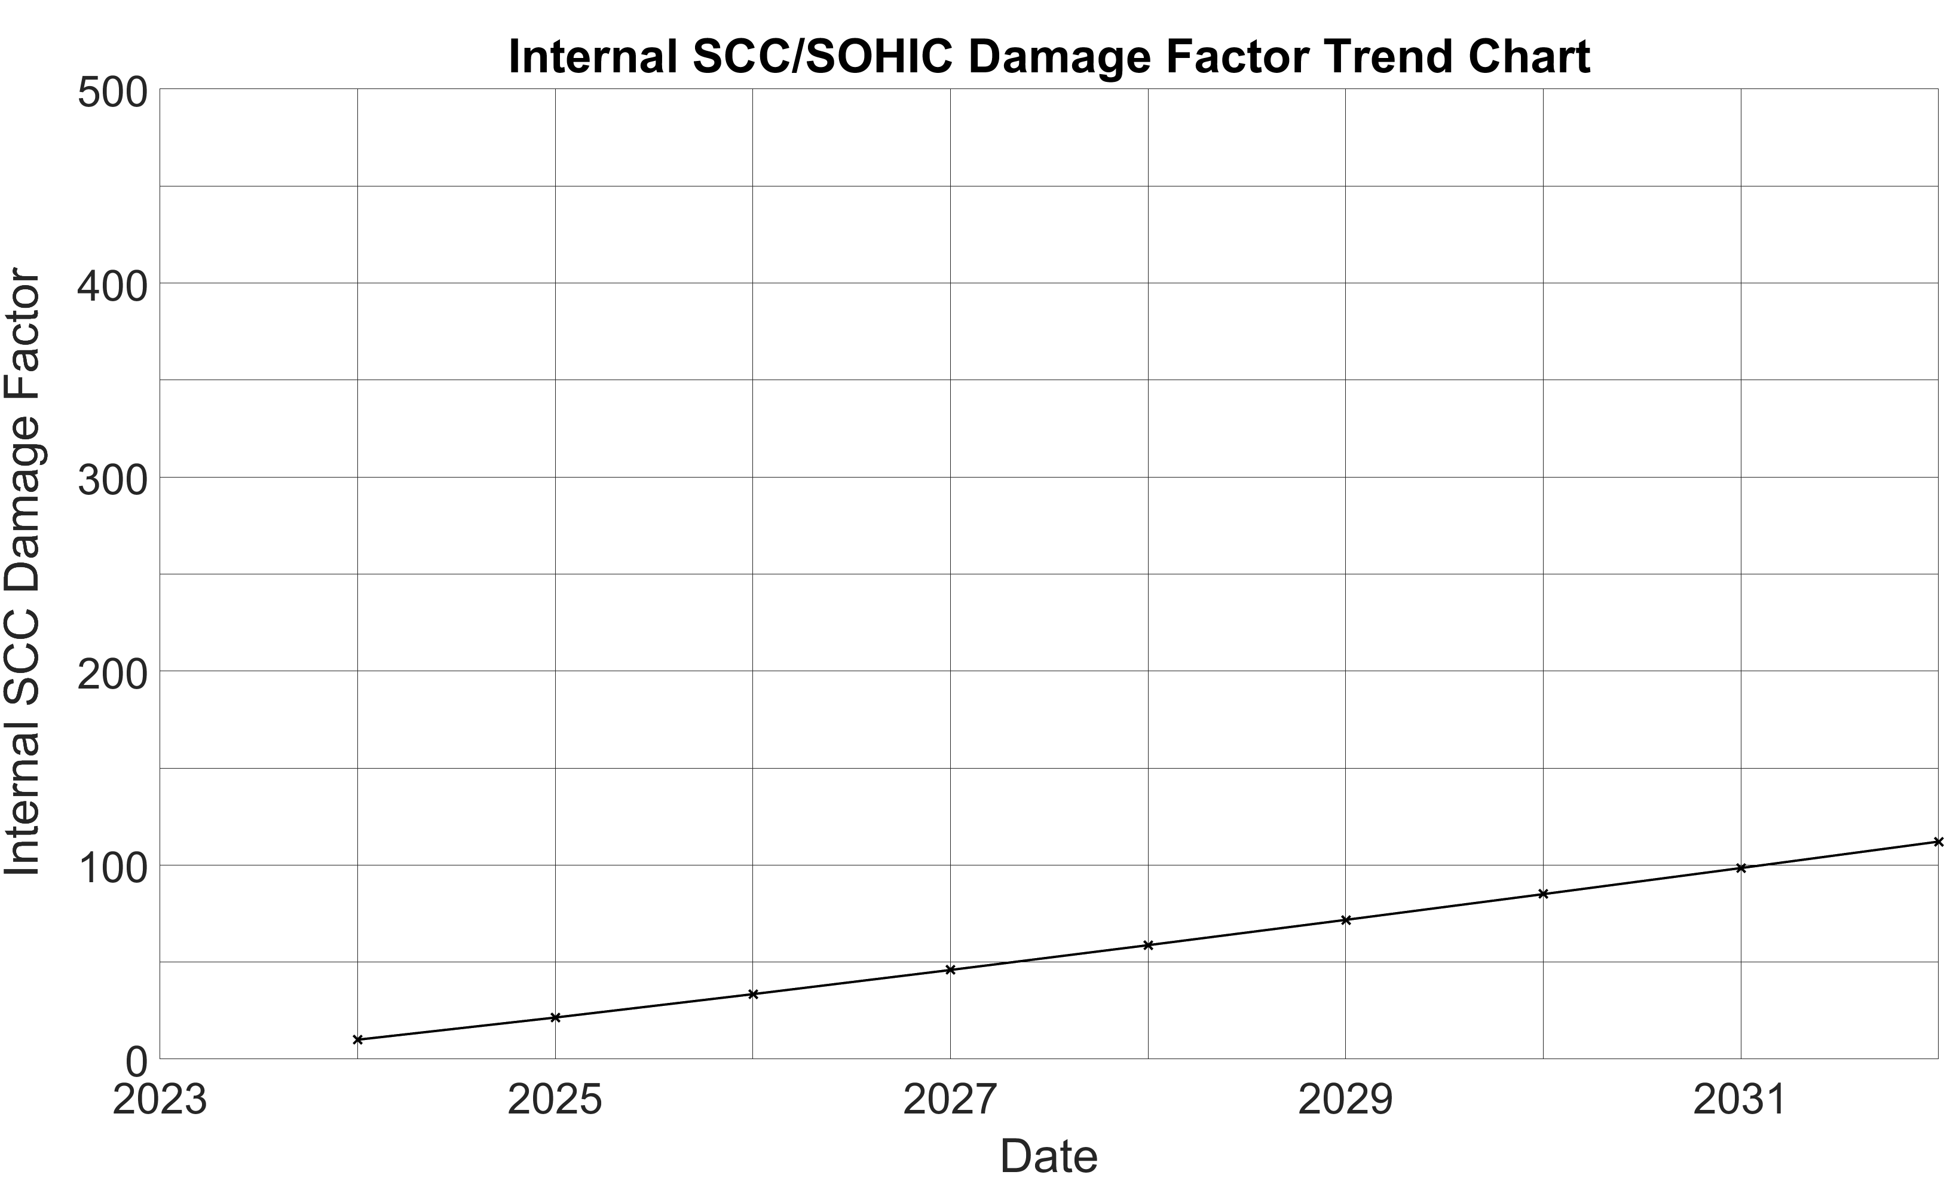
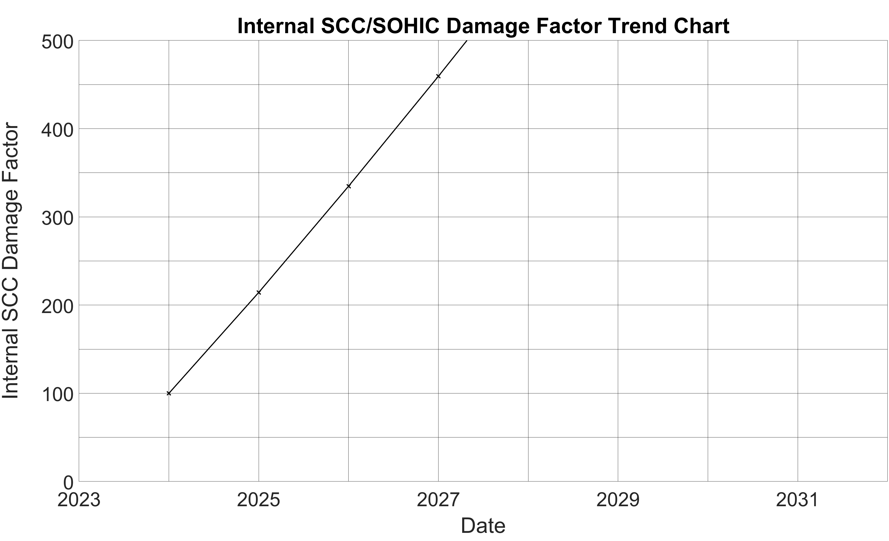

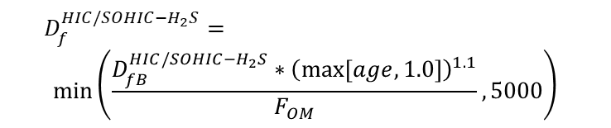
Results and Discussion
SCC – HIC/SOHIC-H2S
Damage Factor
$$D_{f}^{HIC/SOHIC−H_{2}S}=$$
$$min\left(\frac{D_{fB}^{HIC/SOHIC−H_{2}S}∗{\left(\max\left[age,1.0\right]\right)}^{1.1}}{F_{OM}},5000\right)$$
Probability of Failure
$P_{f}(t)=gff ∙ D_{f}(t)∙ F_{SM}$
$D_{f}^{HIC/SOHIC−H_{2}S}$evaluation considering medium susceptibility
$D_{f}^{HIC/SOHIC−H_{2}S}$evaluation considering high susceptibility
Notes:
Bypass of the environmental conditions

Slide 22
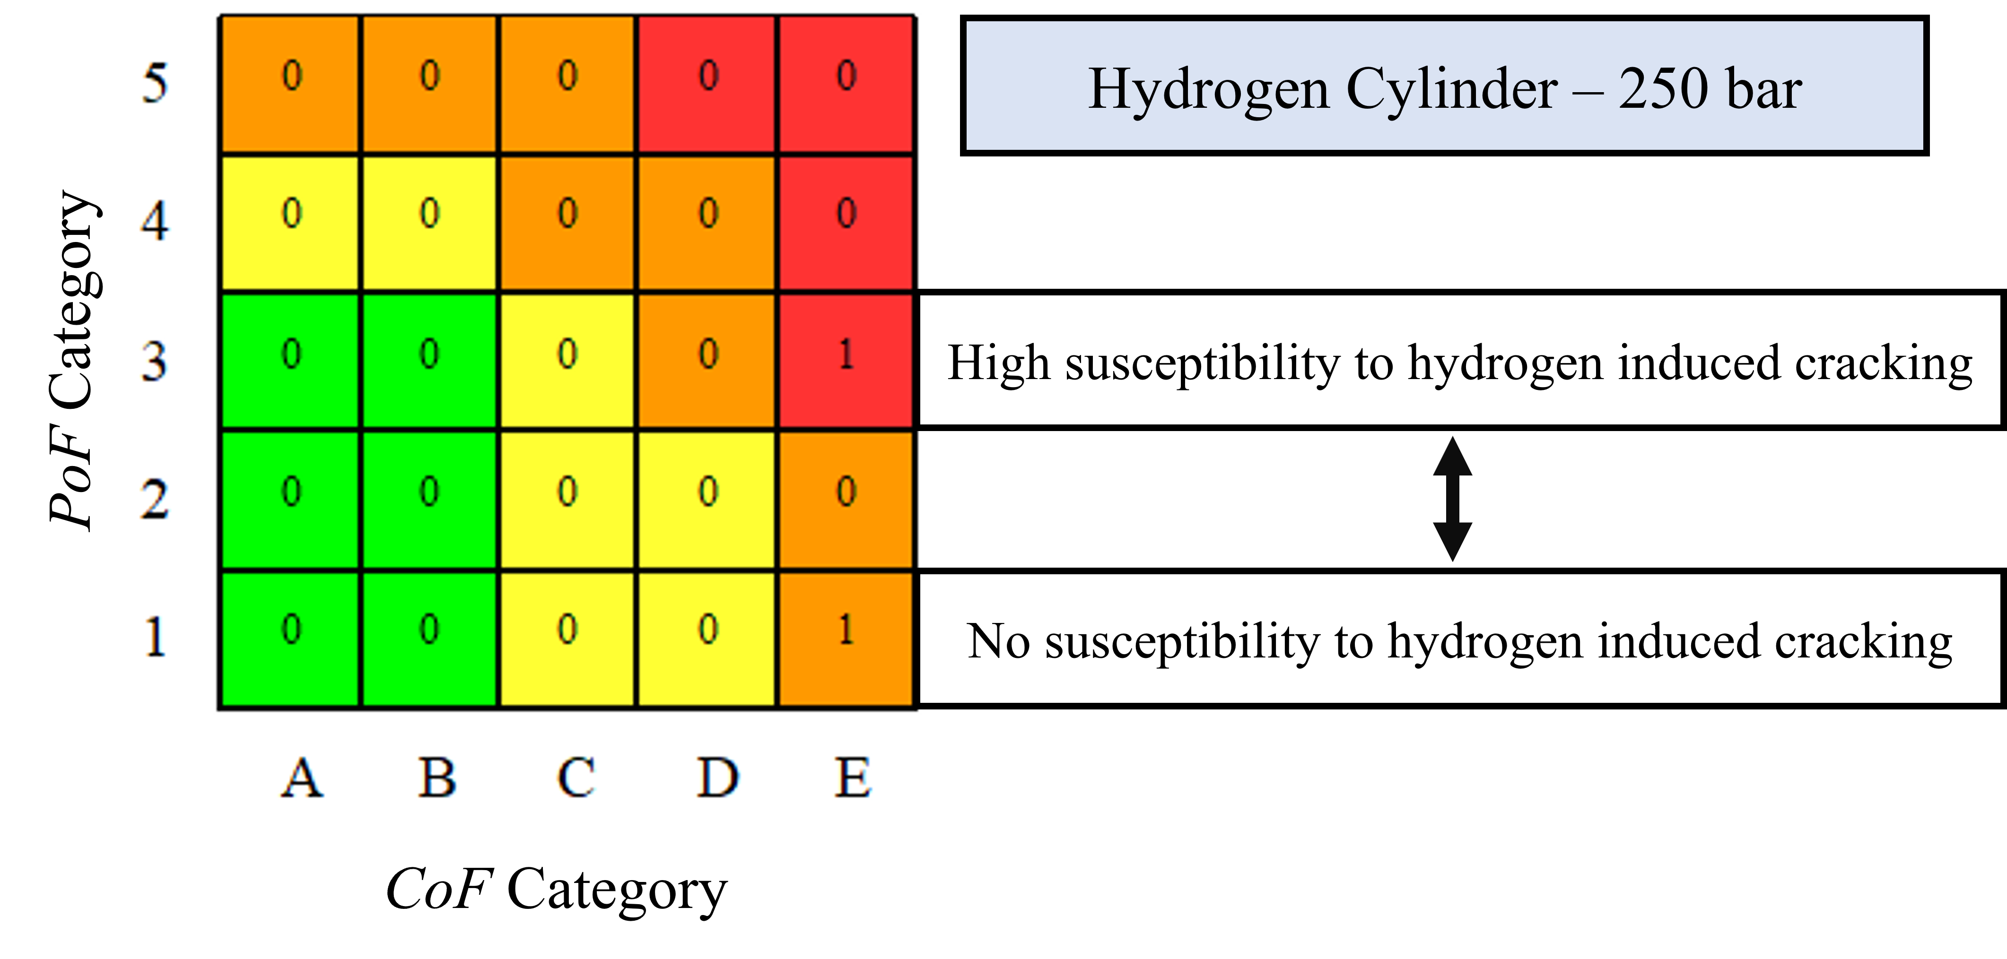

Results and Discussion
$$R=\sum_{i=1}^{n}{R_{i}(t)=\sum_{i=1}^{n}{P_{f_{i}}(t) ∙ C_{f_{i}}}}$$
HE is enhanced at higher pressures
Steel structure
Notes:
Recap.

Slide 23
Conclusions
Inspection Planning in the Marine Sector: a Case Study of a Hydrogen-Fueled Fishing Vessel
The application of the existing RBI 581 [7] procedures as they are to hydrogen technologies can lead to a risk underestimation.
The output of these procedures mainly rely on the expertise of the user.
The damage mechanisms involving hydrogen in RBI 581 are not suitable for equipment working in pure hydrogen environments.
Specific RBI methodology should be developed for these systems.

Slide 24

Thank you for your attention!
For further details please contact me:
Leonardo Giannini: leonardo.giannini@ntnu.no
OMAE 2023 – 42nd International Conference on Ocean, Offshore & Arctic Engineering
Melbourne Convention and Exhibition Centre, Melbourne, Australia
June 11-16, 2023

Slide 25
Bibliography
OMAE 2023, 42nd International Conference on Ocean, Offshore & Arctic Engineering, https://event.asme.org/OMAE
International Maritime Organization, Fourth IMO GHG report, IMO, 2020, https://www.imo.org/en/OurWork/Environment/Pages/Fourth-IMO-Greenhouse-Gas-Study-2020.aspx
Statistics Norway, Emissions to air (Table 09288: Greenhouse gases from Norwegian economic activity, by industry, pollutant, contents and year), https://www.ssb.no/en/statbank/table/09288/tableViewLayout1/
Sepideh Jafarzadeh et al., Electrification of the coastal fishing fleet using batteries and fuel cells (Elektrifisering av kystfiskeflåten ved bruk av batterier og brenselceller), Sintef Ocean, 2021, https://www.fhf.no/prosjekter/prosjektbasen/901640/.
A. Alvaro. “3D cohesive modelling of hydrogen embrittlement in the heat affected zone of X70 steel”. PhD thesis. 2014. ISBN: 978-82-326-5575-5.

Slide 26
Bibliography
American Petroleum Institute, Risk-Based Inspection, API Recommended Practice 580, 2016.
American Petroleum Institute, Risk-Based Inspection Methodology, API Recommended Practice 581, addendum 1, 2019
DNV, Synergi Plant RBI, https://www.dnv.com/services/rbi-software-risk-basedinspection-synergi-plant-4666.
R.P. Gangloff, “Hydrogen Assisted Cracking of High Strength Alloys”, In: Comprehensive Structural Integrity 6, 31-131 (2003).

