Slide 1


Self Presentation
RAMS Seminar
ESPINOSA Tom
11/05/2023

Slide 2



Introduction

Slide 3
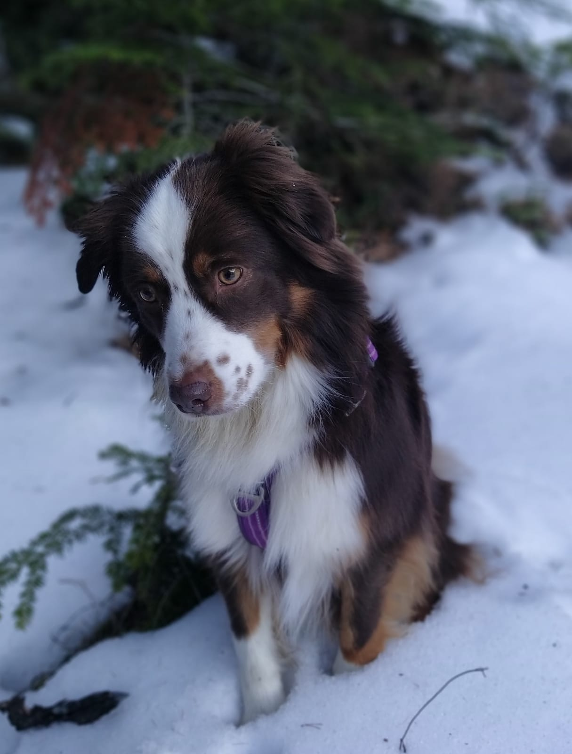
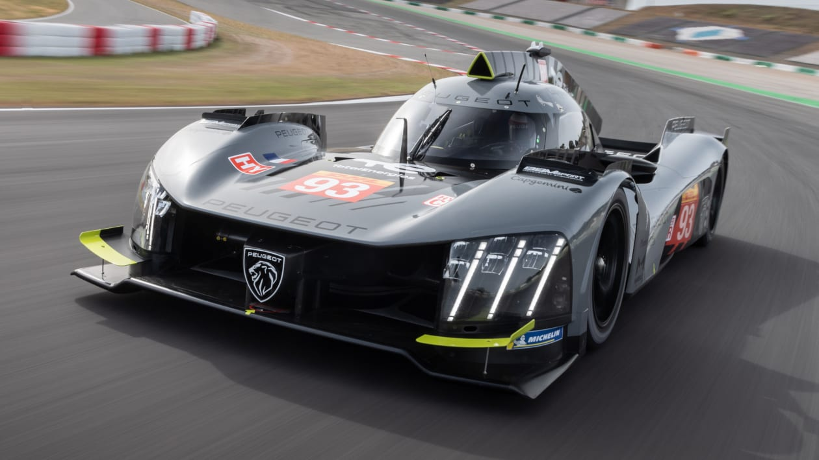
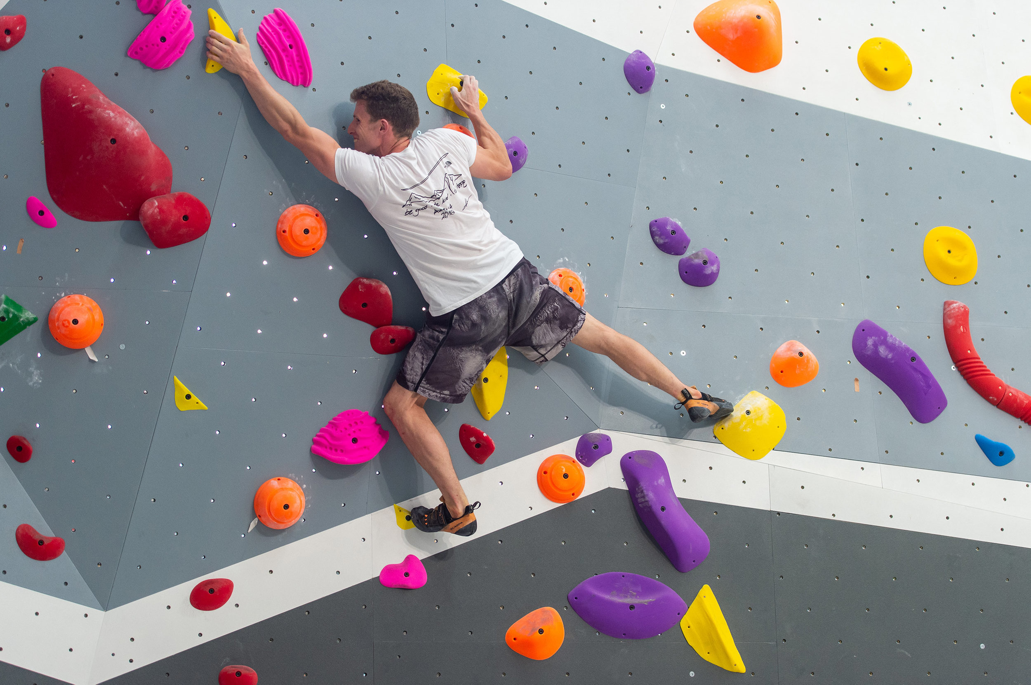
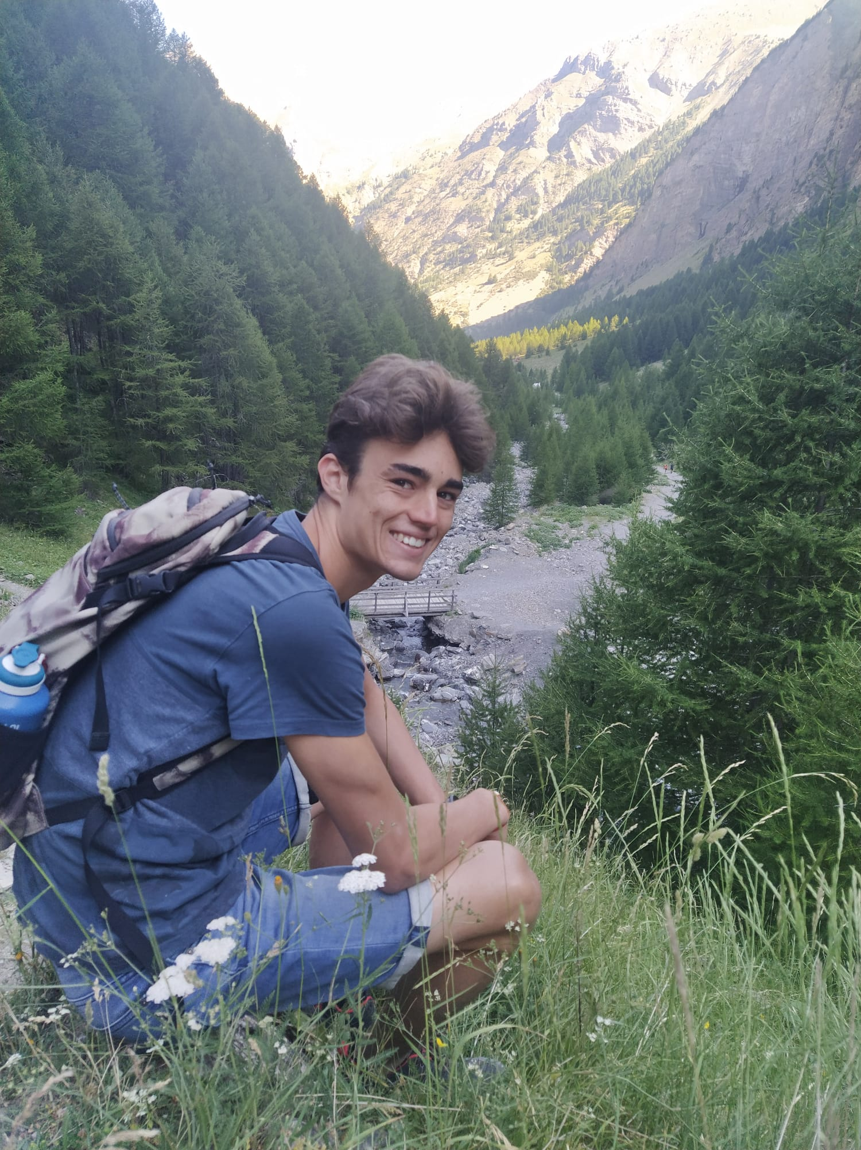
Introduction
Automotive and its evolution
Bouldering
Hiking
My dog

Slide 4
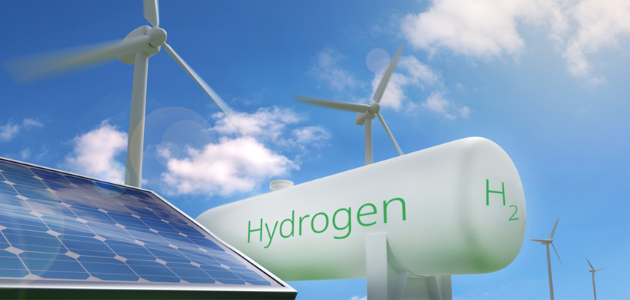


Background
Bachelor’s degree
STI2D energy and environment
Master’s degree
Energy and Environmental Engineering
4th years INSA Lyon

Slide 5
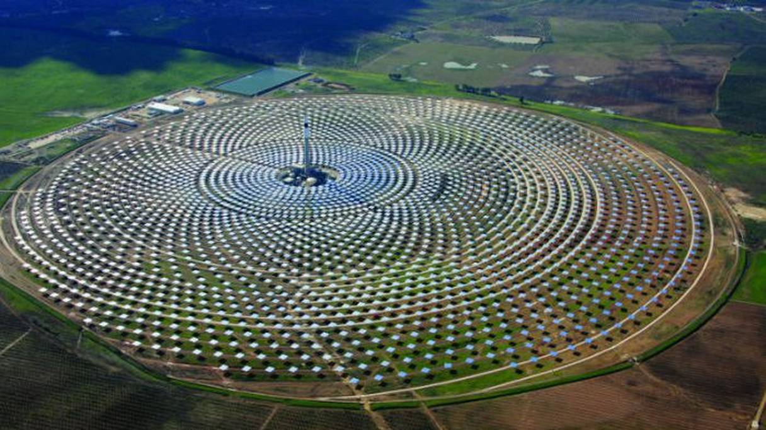
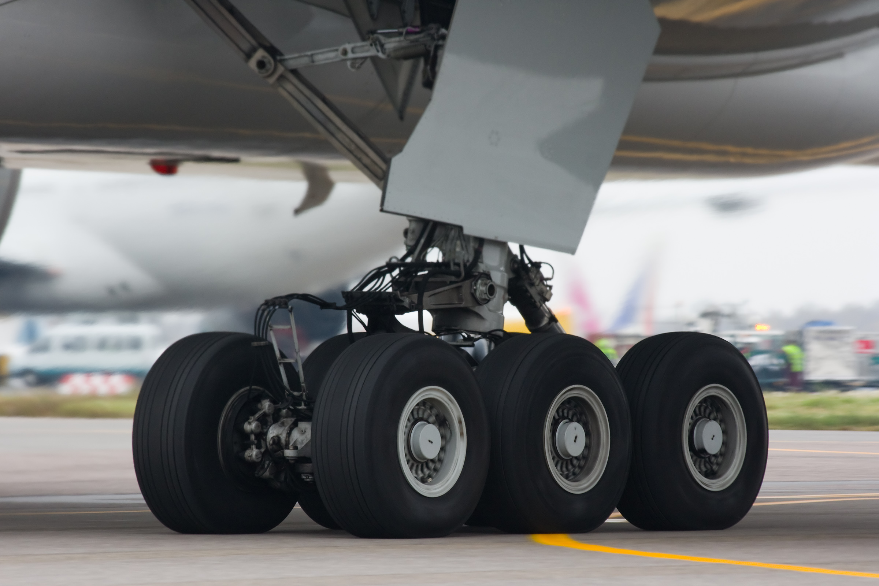



Experience
Energy Team Projects
-sizing of a solar power plant
-simulation of the heating of the brake discs of a landing aircraft
Internships
-In several french engineering offices

Slide 6


Internship NTNU
Safety protocol for the reuse of existing pipeline for the transport of hydrogen
Predicting the behaviour of steel in hydrogen
Literature review and experimental analysis
Focus on the effect of hydrogen embrittlement on FCGR

Slide 7
Thank you for the attention
ESPINOSA Tom
taespino@stud.ntnu.no
+337 68 39 18 69

