Slide 1
Well Safety. Risk Control in the well drilling phase: BOP system reliability assessment (M05_051)
Norwegian University of Science and Technology
Knowledge for a better world
Presented by Geir-Ove Strand
Co-authored by Prof. Mary Ann Lundteigen
Many thanks to our reviewers: Dr. Per Holand, Prof. Anne Barros and Abraham Almaw Jigar

Slide 2
Background & Objectives
Probabilistic risk assessments (PRA) vital in risk management of low probability-high consequence activities (NUREG 1855, 2009)
  However;
    Failure of change management systems to upkeep risk indicators, i.e. upkeep a well PRA, is noted in recent well blowout investigation reports (e.g., Macondo 2010, Gullfaks 2010, Montara 2009, Snorre 2004)
The blowout preventer (BOP) may be regarded as a dynamic system
  Different usage scenario and transitions of the BOP into degraded states of operation
  Existing BOP quantitative analysis is “static”
    Primarily based on FT analysis (e.g., Holand reports)
    Analysis based on dynamic BBN demonstrated converting Holands FTA models (Cai et al. 2013)
Can we make improvements to the quantitative assessment of BOP systems safety for the activities?

Slide 3
Approach & Limitations
Approach:
  Review of methods for modelling dynamic and degradable systems
  Review of regulations, standards, papers and industry experience data as basis for model of BOP systems:
    Alternative (and better) method(s)? For example, to account for waivers on BOP element repairs sometimes given by the authorities.
Main limitation
  Study only the technical side of BOP system
    ‘the push of the button’, human error, is being worked as separate issue.

Slide 4
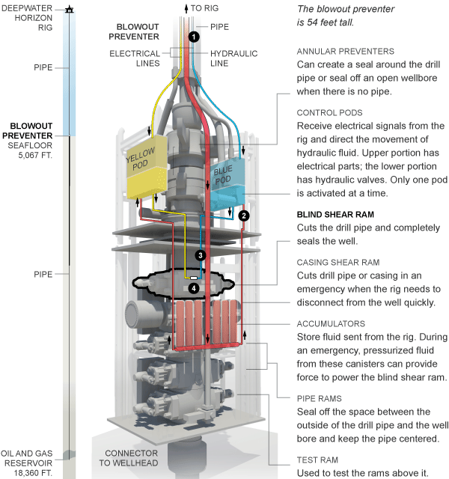
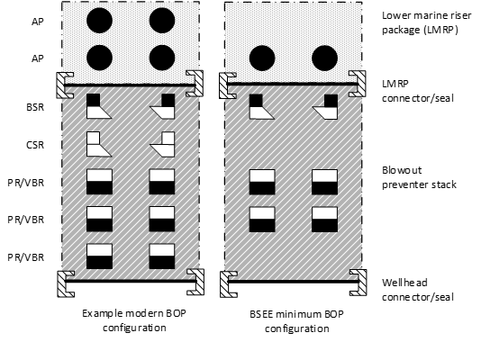
Model basis - design
  Design
    ~20m high and ~400 ton
    Redundant, order of 2++ for main subsystems
  Usage
    7 – 14 - 21 - 30 days testing. 3-5 yr overhauls
    Repair upon failure detection (pull to surface)
    Typically used ~60 days per well
    Source;

Slide 5
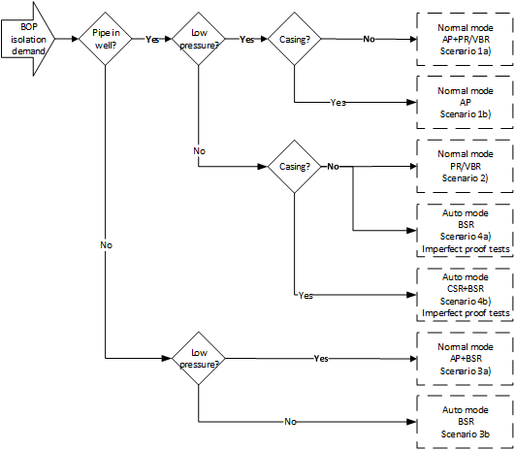
Model basis - usage
  Safety functions primarily activated by drilling crew (manual)
  Many different well isolation scenario exist:
    Auto or manual mode
    Type of pipe through BOP, if any
    Low or high pressure loads (detection)

Slide 6
Model basis – experience data
  Critical BOP experience data show:
    Individual element failures
    Common cause failures
Table 1 Overview of critical subsea BOP system failure modes with relevant reliability data based on (Holand, 1999, Holand and Awan, 2012)
Item and failure mode | MTTF* (BOP days) | MTTF* (Item days)
Wellhead connector - External leakage (2of) | 11128 | 11128
LMRP connector - Spurious disconnect (2of) | 11128 | 11128
LMRP connector - Failure to disconnect on command (3of) | 7419 | 7419
Control system - Total loss of BOP control (by the main control system) (7of) | 3179 | 3179
Control module ('POD'), single - Total loss of POD functions (20of) | 1113 | 2226
Control PODs (2of) - Simultaneous loss of one function in both PODs (6of) | 3709 | 3709
BSR - Leakage in closed position (4of) | 5564 | 6276
BSR - Failure to close on command (1of) | 22256 | 25104
BSR - Failure to shear pipe in LMRP disconnect situation (1of) | NA | NA
BSR - Spurious closure (1of) | 22256 | 25104
PR/VBR - Leakage in closed position (7of) | 3179 | 8613
PR/VBR - Failure to close on command (2of) | 11128 | 30147
PR/VBR - Failure to open on command (2of) | 11128 | 30147
AP - Leakage in closed position (11of) | 2023 | 3704
AP - Failure to close on command (1of) | 22256 | 40748
Isolation valve on choke and kill line out-let - External leak (1of) | 22256 | NA
Choke and kill line - External leaks (Note; presumably downstream the isolation valves on BOP stack outlet) (13of) | 1712 | NA
Flexible joint (item is located above LMRP, and not part of well barrier envelope) - External leakage (2of) | 11128 | 11128

Slide 7
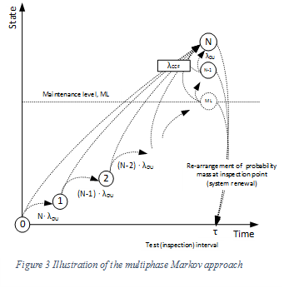
Proposed new BOP reliability assessment model
  Recursive multiphase Markov model
    N total redundant elements
    Repair at #ML or higher detected element failures
  ‘Ordinary’ Markov property between BOP inspections
  Primarily for BOP stack with several redundant elements
  Can be solved by numerical methods

Slide 8
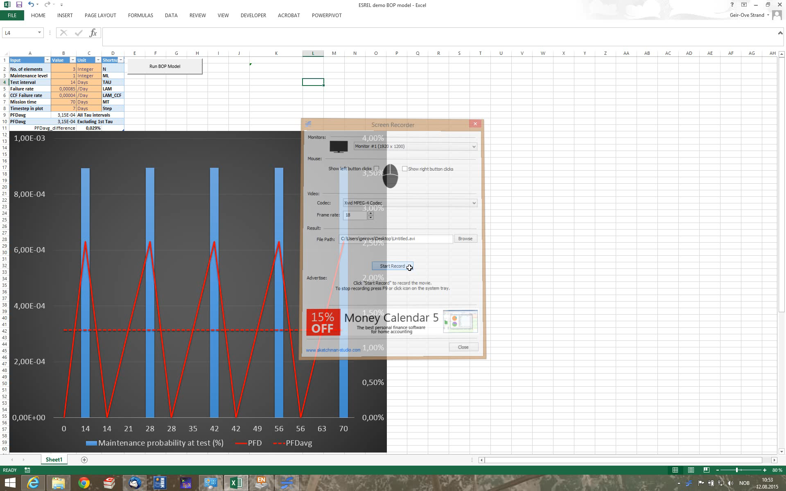
BOP reliability assessment model results

Slide 9
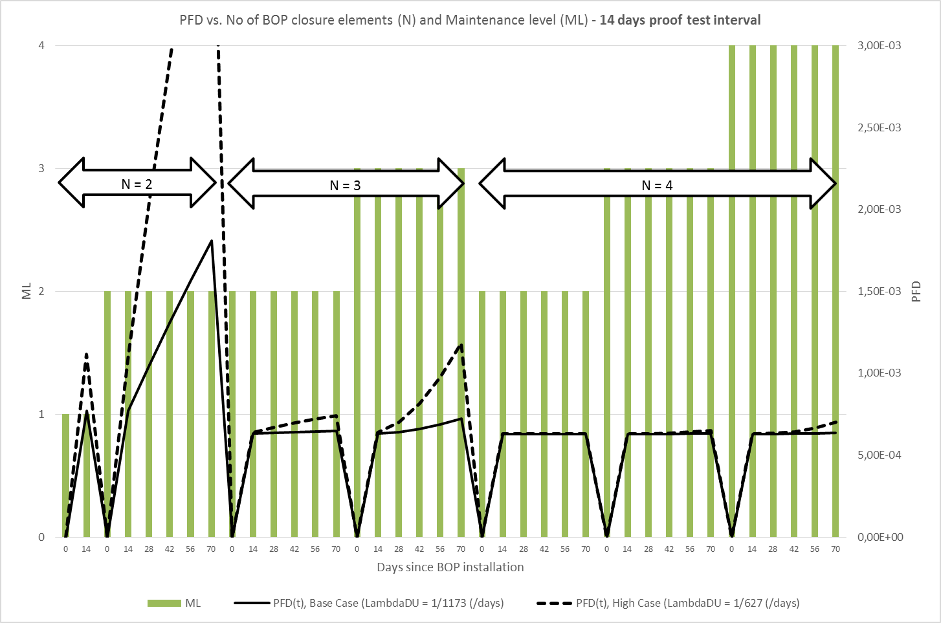
BOP reliability assessment model results cont’d
  Example summary overlay to compare various BOP case study results

Slide 10
Summary
New model for BOP system reliability assessment presented
  Models BOP stack with best precision, but may also represent entire BOP system, including typical control system common cause failures
Allows more efficient explicit trade-off analysis (over existing FTA / BBN);
  the effect of different maintenance strategies evaluated against typical safety availability targets like for instance NOGA-070 (2004) on the use of IEC 61508/61511 in Norway.
Note to paper:
  ∆t ≤ 0.01 days in numerical calculations typically produce <1% difference when including first transient test period in PFDavg calculation. This is ‘insignificant’ versus the >10% difference produced with a larger ∆t as noted in the last paragraph of Chapter 5.

Slide 11
Selected main references
ACOSTA, C. & SIU, N. 1993. Dynamic event trees in accident sequence analysis: application to steam generator tube rupture. Reliability Engineering & System Safety, 41, 135-154.
API 2004a. API Spec 16A / ISO 13533. Specification for Drill Through Equipment. American Petroleum Institute.
API 2004b. Api Spec 16D. Specification for Control Systems for Drilling Well Control Equipment and Control Systems for Diverter Equipment Second Edition. American Petroleum Institute.
API 2012. API Std 53. Blowout Prevention Equipment Systems for Drilling Wells, Fourth Edition. American Petroleum Institute.
BSEE 2004. TAR report no. 455 - Review of Shear Ram Capabilities. West Engineering Services.
BSEE. 2006. TAR project no. 540 - Risk Assessment of surface vs. subsurface BOP’s on MODU's. Texas A&M University.
BSEE 2013. Blowout Preventer (BOP) Failure Event and Maintenance, Inspection and Test (MIT) Data Analysis, 2650788-DAS-C1: American Bureau of Shipping and ABSG Consulting Inc. .
BSEE 2014. Code of Federal Regulations. http://www.bsee.gov/: Bureau of Safety and Environmental Enforcement.
CAI, B., LIU, Y., ZHANG, Y., FAN, Q. & YU, S. 2013. Dynamic Bayesian networks based performance evaluation of subsea blowout preventers in presence of imperfect repair. Expert Systems with Applications, 40, 7544-7554.
ČEPIN, M. & MAVKO, B. 2002. A dynamic fault tree. Reliability Engineering & System Safety, 75, 83-91.
DISTEFANO, S. & PULIAFITO, A. 2009. Reliability and availability analysis of dependent–dynamic systems with DRBDs. Reliability Engineering & System Safety, 94, 1381-1393.
HASSAN, M. & ALDEMIR, T. 1990. A data base oriented dynamic methodology for the failure analysis of closed loop control systems in process plant. Reliability Engineering & System Safety, 27, 275-322.
HOLAND, P. 1998. Evaluation of the Need for an Acoustic Backup Control System for the Snorre II BOP - Unrestricted version (2011). SINTEF report no. A21194.
HOLAND, P. 1999. Reliability of subsea BOP systems for deepwater application, phase II DW - unrestricted version. SINTEF report no. STF38 A99426.
HOLAND, P. & AWAN, H. 2012. Reliability of subsea BOP and kicks unrestricted version - final ver 2. ExproSoft report no. ES 201252/02.
HOLAND, P. & RAUSAND, M. 1987. Reliability of Subsea BOP systems. Reliability Engineering, 19, 263-275.
HOLAND, P. & SKALLE, P. 2001. Deepwater kicks and BOP performance - unrestricted version. SINTEF report no. STF38 A01419.
IEC 2010. 61508. Functional safety of electrical/electronic/programmable electronic safety-related systems. International Electrotechnical Commission.
JORGE, N. D. M. On the reliability and risk analysis of subsea blowouts preventers with focused attention on DP rigs. 24th International Conference on Offshore Mechanics and Arctic Engineering, 2005 Halkidiki, Greece, June 12–17. ASME 2005 24th International Conference on Offshore Mechanics and Arctic Engineering.
JORGE, N. D. M., WOLFRAM, J. & CLARK, P. Reliability assessment of subsea blowout preventers International Conference on Offshore Mechanics and Artic Engineering, 2001 Rio de Janeiro.
LU, J.-M. & WU, X.-Y. 2014. Reliability evaluation of generalized phased-mission systems with repairable components. Reliability Engineering & System Safety, 121, 136-145.
NOGA 2004. Norwegian Oil and Gas Association (NOGA): 070 – Norwegian Oil and Gas Application of IEC 61508 and IEC 61511 in the Norwegian Petroleum Industry, Rev. 2.
NORSOK 2012. D-001. Drilling facilities (Ed. 3, December 2012).
NORSOK 2013. D-010. Well integrity in drilling and well operations. Rev. 4, June 2013.
PSA 2014a. Regulations relating to conducting petroleum activities (The activities regulations). http://www.psa.no/activities/category399.html: The Petroleum Safety Authority Norway.
PSA 2014b. Regulations relating to design and outfitting of facilities, etc. in the petroleum activities (The facilities regulations). http://www.psa.no/facilities/category400.html: The Petroleum Safety Authority Norway.
QUILICI, M., ROCHE, T., FOUGERE, P. & JUDA, D. 1998. Risk Assessment of a BOP and Control System for 10,000' Water Depths. Offshore Technology Conference. Houston, USA: Society of Petroleum Engineers.
RASMUSSEN, J. 1997. Risk management in a dynamic society: a modelling problem. Safety Science, 27, 183-213.
RAUSAND, M. 2014. Reliability of Safety Critical Systems - Theory and Applications, John Wiley & Sons.
RAUSAND, M. & ENGEN, G. 1983. Reliability of Subsea BOP Systems. Offshore Technology Conference. Houston, USA: Society of Petroleum Engineers.
RAUSAND, M. & HØYLAND, A. 2004. System Reliability Theory Models, Statistical Methods, and Applications, John Wiley & Sons, 2nd edition.
SATTLER, J. & GALLANDER, F. 2010. Just How Reliable Is Your BOP Today? Results From a JIP, US GOM 2004–2006, Presented at the IADC/SPE Drilling Conference and Exhibition, New Orleans, 2–4 February. SPE-128941-MS.
SIU, N. 1994. Risk assessment for dynamic systems: An overview. Reliability Engineering & System Safety, 43, 43-73.
THE DEEPWATER HORIZON STUDY GROUP, D. 2011. Final Macondo investigation report. Retrieved from http://ccrm.berkeley.edu/pdfs_papers/bea_pdfs/dhsgfinalreport-march2011-tag.pdf.

