Slide 1

Weekly Meeting
February 12th 2018
NTNU SmallSat

Slide 2
NUTS
Totally changing what they’re doing
Bipsat
Going to an approach which allows them to do the whole life cycle, but not launching
  From scratch and development
  Through mission design
  Three weeks on the first Bipsat
Doing parallel development on a CubeSat

Slide 3
Agenda
Status on project
Status per team
  @Joao F. Fortuna and @Sivert Bakken (update on test in Hopavågen + algorithm processing status)
  @Julian Veisdal (HW status)
  @Gara Quintana Diaz (communication status)
Update on action items

Slide 4
Status on project
Satellite bus update
  R(ough) O(rder) of M(agnitude) offers
    Goal: informal clarifications done and help to us to make requirements
  Status
    OpenCosmos: provided
    GOMSpace: old provided w/o details – communication and clarification ongoing
    ISISpace: not yet received – communication and clarification ongoing
    ClydeSpace: not yet received – communication ongoing
  Public tender
    Documentation started
    Establishing timeline critical

Slide 5
Signal Processing Algorithm + tests
Signal processing algorithm
  Still some things not working as expected
  Focusing mostly on acquisition and making the camera driver work
Need to do test before Hopavågen test to determine optimal optical settings
  26th of February to 2nd of March?
Hopavågen test:
  https://docs.google.com/document/d/1rc6SpT-ktzktNB5gXv63KKreA92iZJNiXefU5Vc27v4/edit
SOI test:
  Probably not much we can see at that test with our camera
  Pointless to go?
  This is the California test in May – but will require lots of preparation from Joao and others
Our own test:
  Maybe include Milica’s students?

Slide 6
Communication Status
Ground station
  UHF: 430 MHz. VHF: 148 MHz
  Now only RX: fix problema (something up with the time signals)
  Buy S-band
Comm. parameters and implications
  Diagram
Frequency allocation
  Roger sent an email but no reply
  Egil has some ideas
Discussions
  What to buy/develop
  Frequency bands: S-band /UHF/VHF

Slide 7
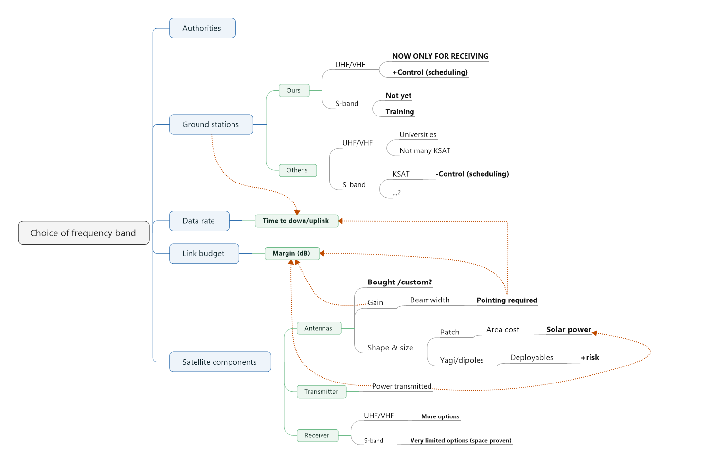

Slide 8
S-band/UHF
 | S-band | UHF
Ground station | We will be more married to KSAT | More university partners
FPGA | Uplink of FPGA possible | Need to find the size of our FPGA image
Receivers | Not sure if available or level
Uplink transmission We need sizes of what we would like to uplink Update of data model size Update of camera parameters size Update of the whole FPGA image size (ask Milica) Other software upgrades to the satellite size General TT&C (telemetry and telecommand) (ask Gara)

Slide 9
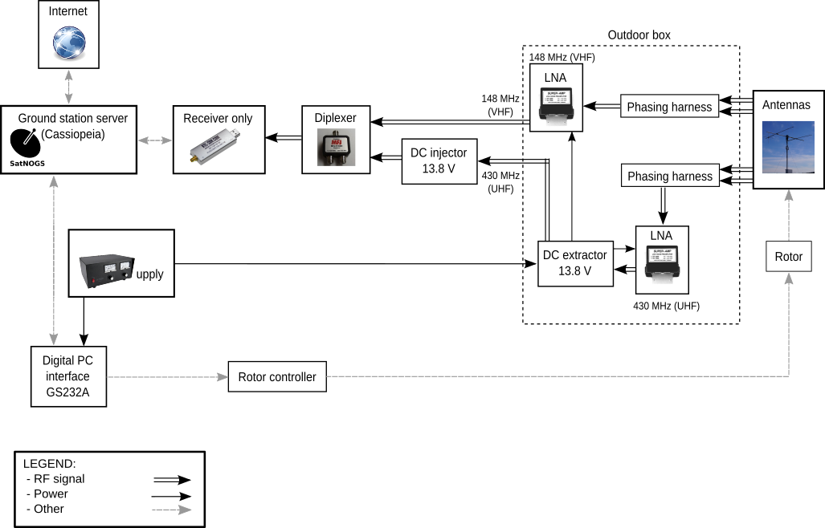

Slide 10
Other tech stuff
Trade-off between UHF/VHF and S-band
Need an optics student to do sensitivity analysis
  Functional
  Thermal
  Vibrational
  NUTS could assist in finding someone, but we have to follow them up
  Evelyn will specify the idea and NUTS will help with posters and stuff (Idea by February 19th)
Agree on when we’re doing risk analysis workshop
  https://studntnu-my.sharepoint.com/personal/rogerbi_ntnu_no/Documents/Prosjekt/NTNU%20Small%20Satellite%20Lab/meetings/02%2018%20-%20Kick-off/Risk.xlsx?web=1
  I’ll make a doodle for one of the working days
Stabilization gimbal for balloon test
  Let’s discuss!
    What’s the expected motion of the balloon?
    There might be some stabilization for the yaw motion of the balloon
  Buy two (one for balloon and one for drone)
  Mariusz will look into this (update February 19th)
Decide which camera to fly
  Hopavågen:
    V5
  Balloon
    V5 – need another?

Slide 11
Decide which camera to fly in balloon test
Parameter | 4-design | 5-design
Ground spatial resolution | 250 m x (52 m x 580) | 750 m x (52 m x 580)
Spectral resolution | 5 nm | 5 nm
SNR | Low | Low (higher than 4.0)
Raw resolution | 2048 x 1088 pixels | 1920 x 1088 pixels
Swath width | 32 km | 32 km
Camera details:
https://docs.google.com/document/d/1pXu_MR5qYoPUbXwZSqaXh4vVTrPOrztB458SUCosvvE/edit
SNR calculation (is this correct)?: https://docs.google.com/spreadsheets/d/1RgCwiGEdVNkJ3f5z2xFiGTeL2aYWC6Te1awuzD5BMoU/edit#gid=391444026

