Slide 1
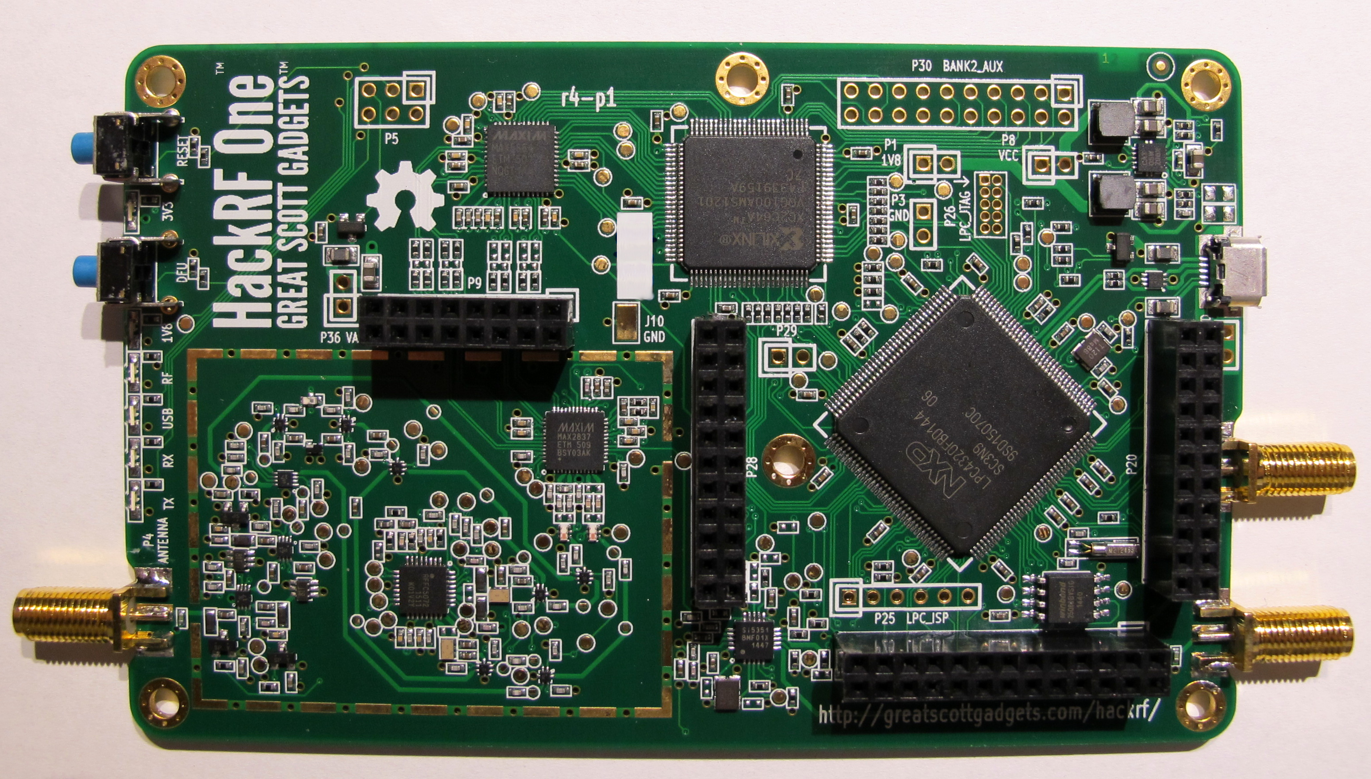
Software-Defined Radios platforms
Gara Quintana Díaz
PhD candidate - SmallSat Lab

Slide 2
Table of Contents
GomSpace SDR
USRP E310
USRP N210
LimeSDR-USB
LimeSDR-mini
RTL-SDR
SWIFT-UTX
SWIFT-SLX
SWIFT-WRX
FunCube Dongle Pro
FunCube Dongle ProPlus
ASTROSDR
EPIQ solutions Matchtiq
EPIQ Matchtiq S10-S12
EPIQ Bitshark Express Rx
BladeRF
HackRF One

Slide 3
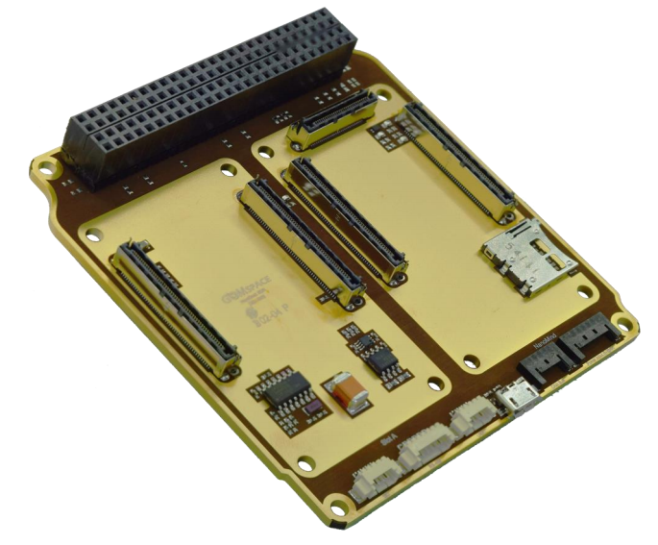
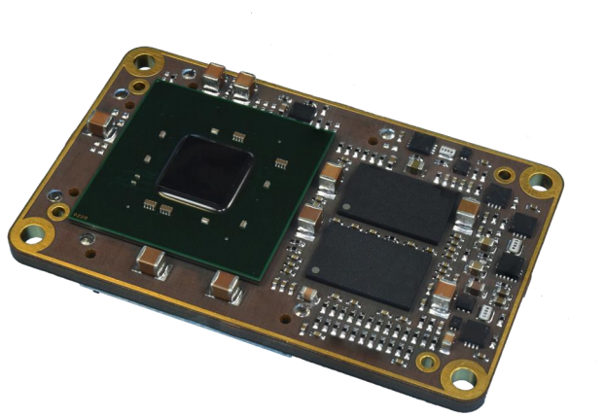
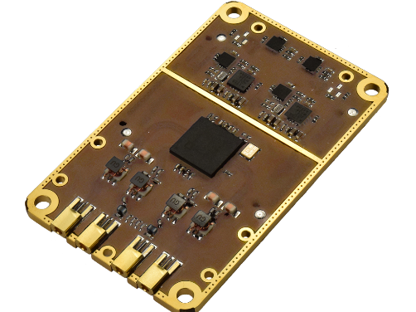
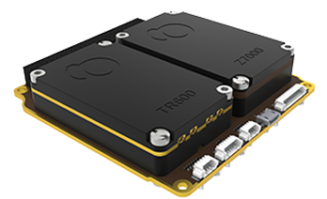
1. GomSpace
NanoDock SDR
NanoMind Z7000: FPGA module
NanoCom TR-600: transceiver
General specifications
Cost: 30 000 €
Dim.: 0.3U
Weight: 100 g
Power: 3 W idle
Space proven
GomSpace SDR

Slide 4
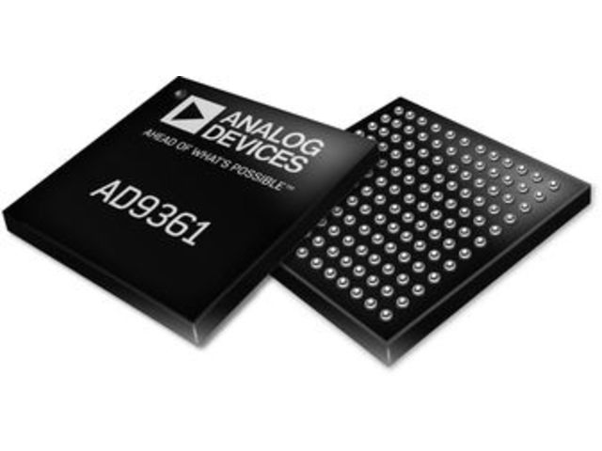
1. GomSpace
NanoDock SDR
NanoMind Z7000: FPGA module
NanoCom TR-600: transceiver
Processing
RF capabilities
Centralized 40 MHz clock
Fits standard PC104
MicroSD card connector
USB to UART console
Op. temp.: -20°C to +60°C
Mass: 74.2 g
Xilinx Zynq 7030 SoC
Dual ARM Cortex A9 MPCore up to 800 MHz
FPGA– 125K logic cells
1 GB DDR3 RAM
32 GB storage
Freq: 70 MHz to 6 GHz
Up to 56 MHz bandwidth
2 x TX/RX channels
Chip: AD9361
  TX: 47-70 MHz
  RX:70 M-6 GHz
  TDD, FDD
  F=2 dB at 800 MHz LO
Software/framework
Linux OS

Slide 5
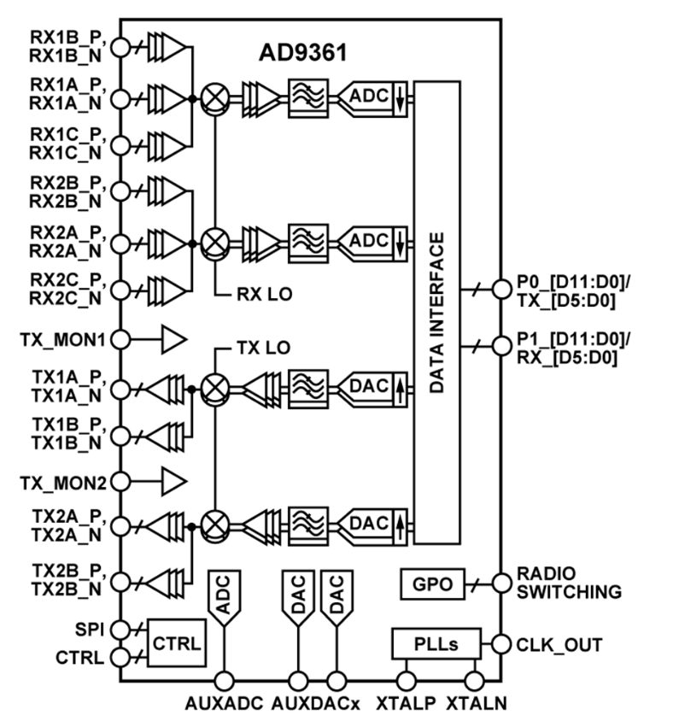
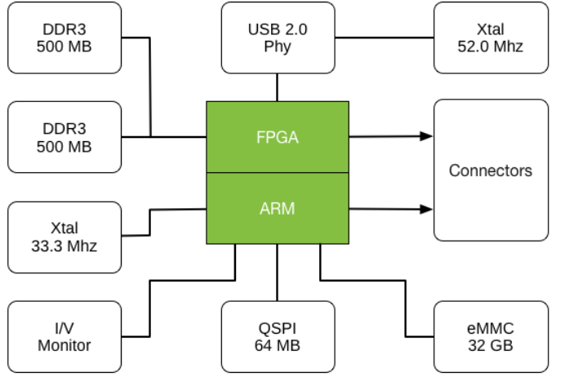
1. GomSpace
NanoDock SDR
NanoMind Z7000: FPGA module
NanoCom TR-600: transceiver

Slide 6
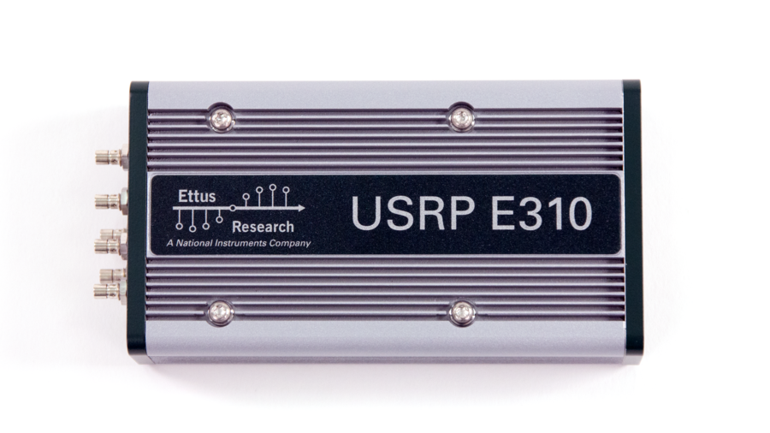
2. USRP E310
General specifications
Cost: 3 000€
Dim.: 133 x 68 x 26.4 mm
Weight: 375 g
Power: 2-6 W
Not space proven
Processing
RF capabilities
Software/framework
RF capabilities
Software/framework
Xilinx Zynq 7020 SoC ¹
ARM Cortex A9 866 MHz dual-core
7 Series FPGA
1 GB DDR3 RAM for ARM
512 MB DDR3 RAM for FPGA
Up to 10 MS/s to ARM
Freq: 70 MHz to 6 GHz
Up to 56 MHz bandwidth
2 RX, 2 TX
Filter banks
Chip: AD9361²
  TX: 47-70 MHz
  RX:70 M-6 GHz
  TDD, FDD
  F=2 dB at 800 MHz LO
UHD version 3.8.0/+
RFNOC
GNU Radio
C/C++
Python
¹ -Aerospace & Michigan
-Surrey
² -Surrey

Slide 7
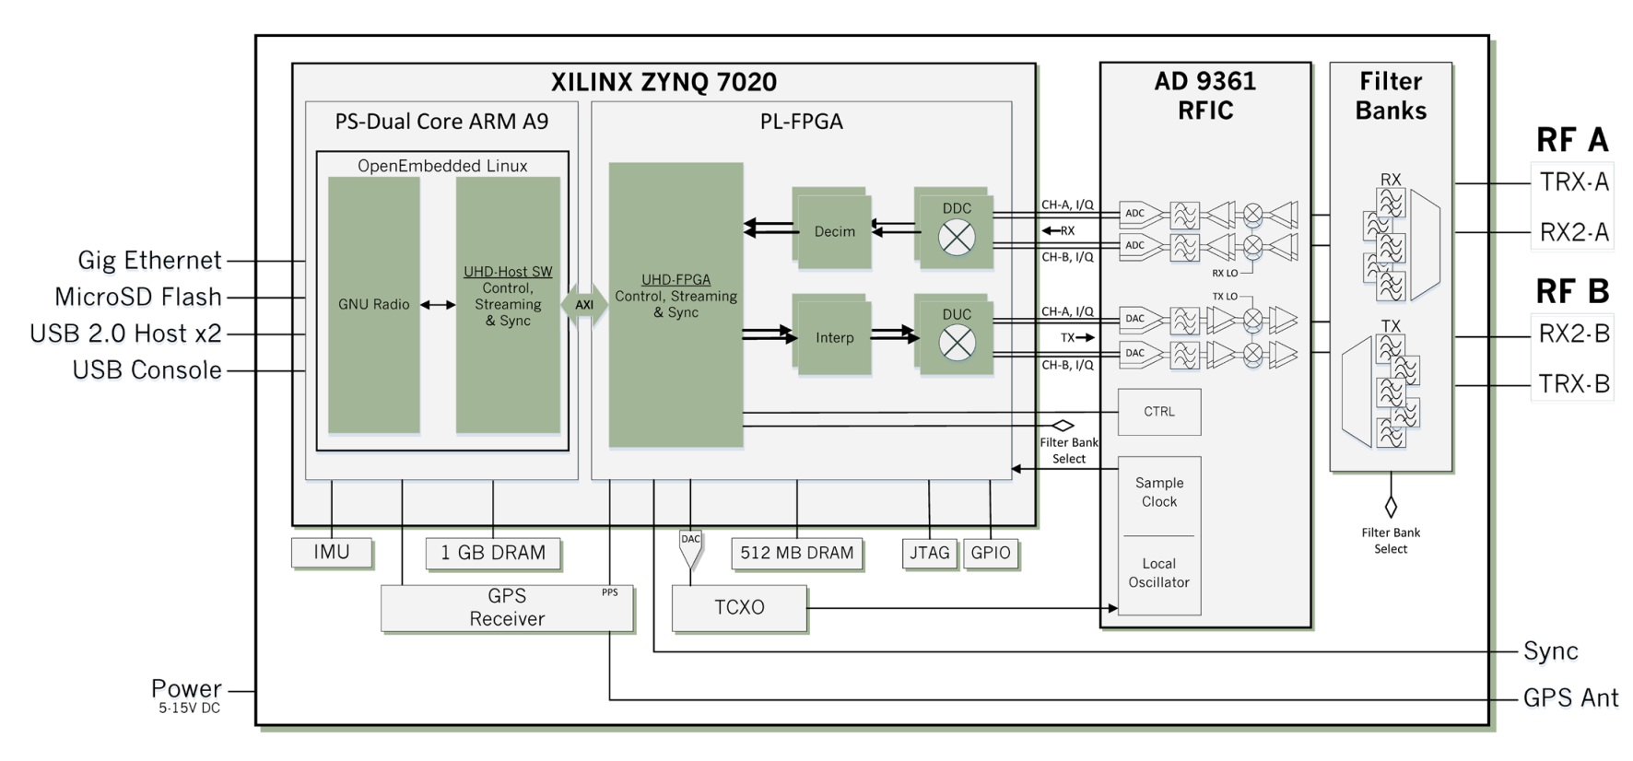
2. USRP E310

Slide 8
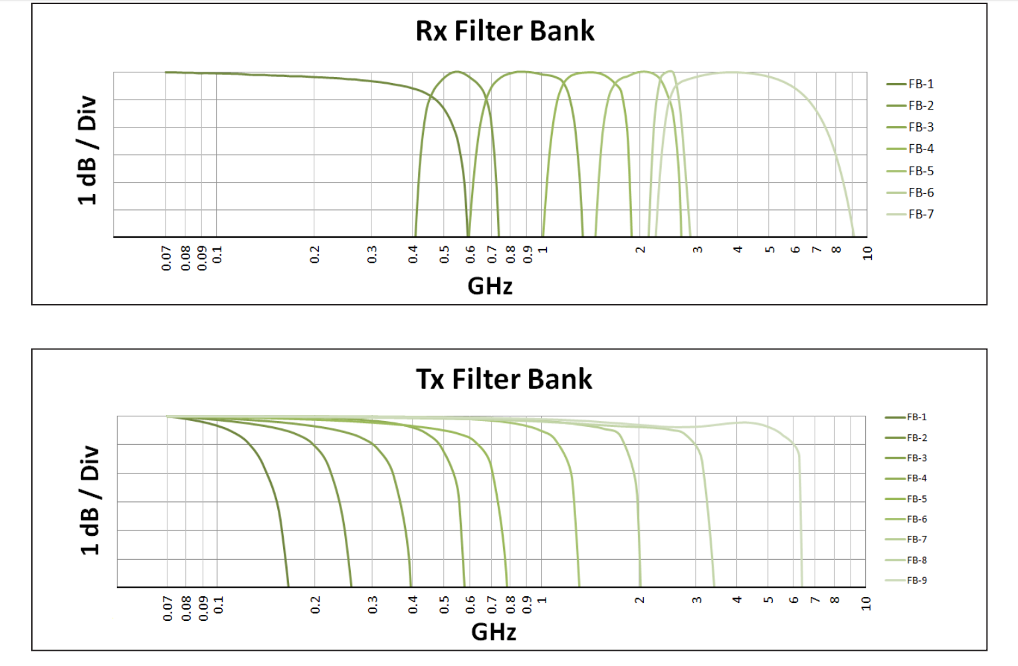
2. USRP E310

Slide 9
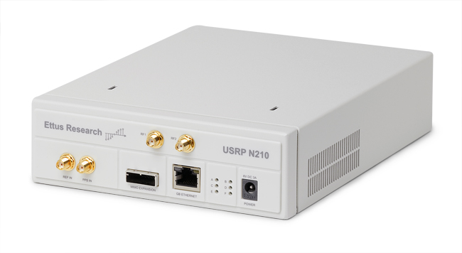
3. USRP N210
General specifications
Cost: 1 600 €
Dim.: 220 x 160 x 50 mm
Weight: 1 200 g
Current consump.: 1.3 A
Not space proven
Processing
RF capabilities
Software/framework
Spartan 3A¹-DSP 3400 FPGA
Microblaze and picoblaze cores
1 MB High-Speed SRAM
DDC/DUC with 25 mHz Resolution
Freq: DC to 6 GHz
Dual 100 MS/s, 14-bit ADC
Dual 400 MS/s, 16-bit DAC
w/WBX Daughter board
  Power output: 15 dBm
  IIP3: 0 dBm
  RX noise figure: 5 dB
GNU Radio
LabVIEW™
Simulink™
-Carolina & North Dakota
-Warsaw
-Bologna
¹ Worcester

Slide 10
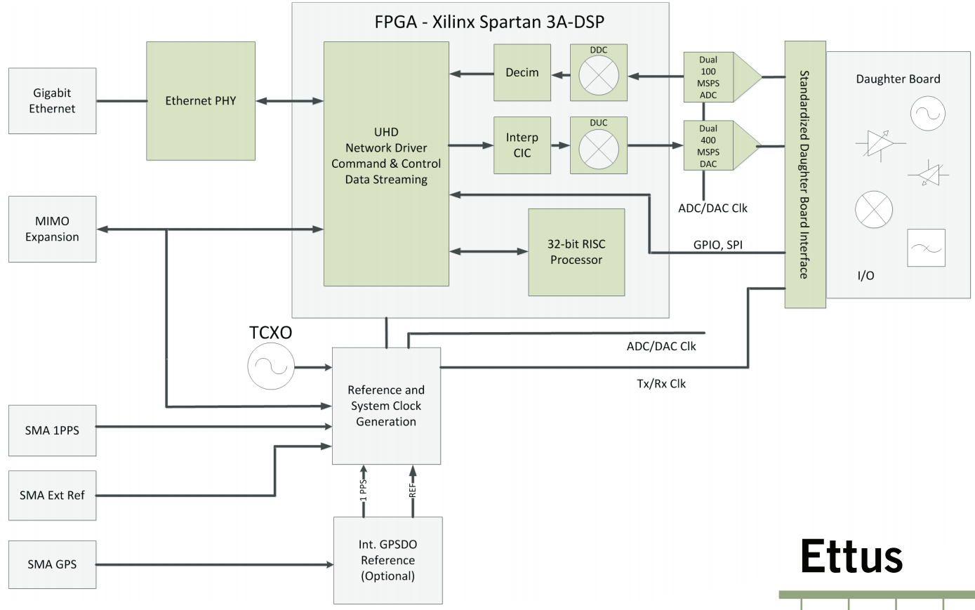
3. USRP N210

Slide 11
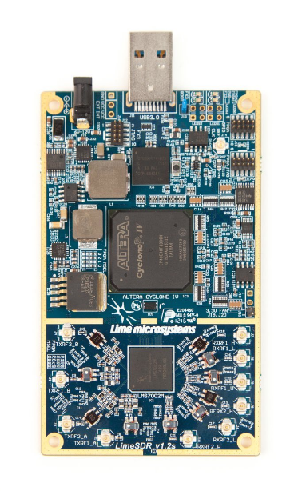
4. LimeSDR-USB
General specifications
Cost: 200 €
Dim.: 60 x 100 mm
Weight: 100-200 g
Power:
Not space proven
Processing
RF capabilities
Software/framework
Altera¹ Cyclone IV EP4CE40F23C8N
256 MBytes DDR2 SDRAM
Freq: 0.1 MHz to 3.8 GHz
Up to 61.44 MHz bandwidth
2 TX x 2 RX channels
DAC: 640 MHz
ADC: 160 MHz
Power output: up to 10 dBm
Chip: LMS7002M FPRF
  Noise figure: 2-3.5 dB
  RX control gain: 70 dB
GNU Radio
¹ Istanbul

Slide 12
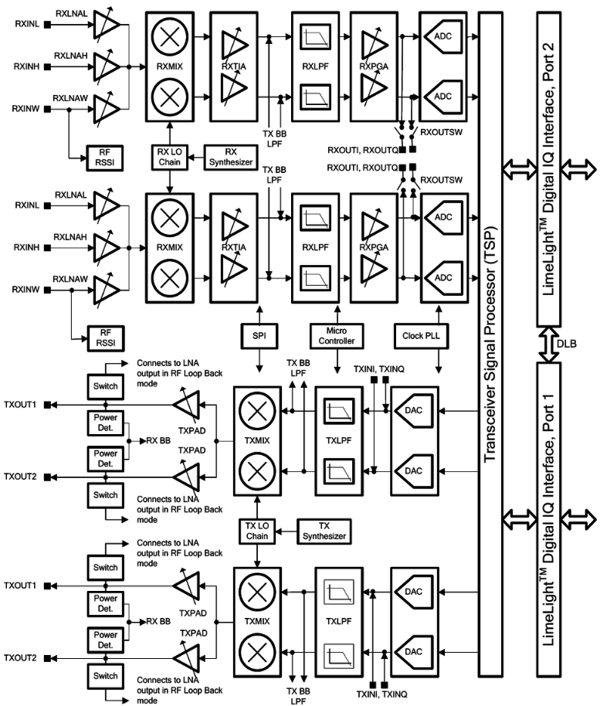
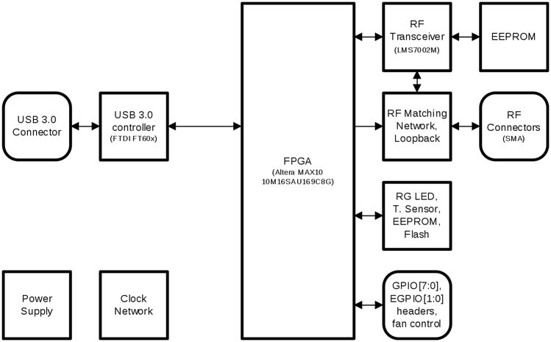
4. LimeSDR-USB

Slide 13
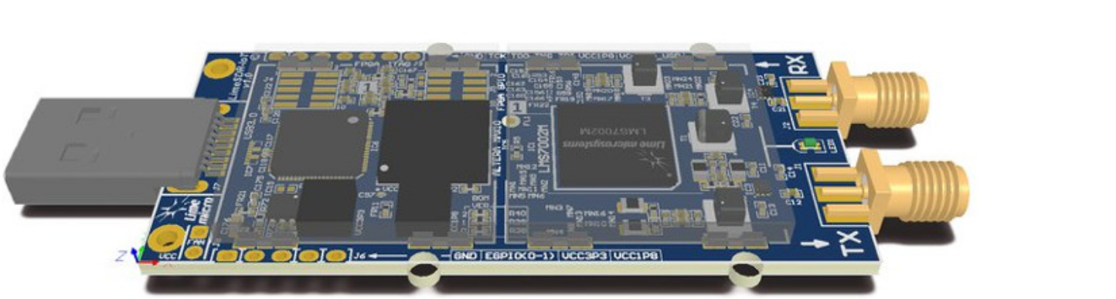
5. LimeSDR-mini
General specifications
Cost: 84 €
Dim.: 69 x 31.4 mm
Weight:
Power:
Not space proven
Differences
FPGA
Frequency
BW
Sample rate
No. Channels
No. Logic gates
Size
Price
SMA connections
Processing
RF capabilities
Software/framework
FPGA: Altera MAX 10 (10M16SAU169C8G)
EEPROM memory: 2 x 128 KB for RF
1 x 4 MB flash memory
Freq: 0.01 MHz to 3.5 GHz
Up to 30.72 MHz bandwidth
1 TX x 1 RX channels
DAC: 640 MHz
ADC: 160 MHz
Power output: up to 10 dBm
Chip: LMS7002M FPRF
  Noise figure: 2-3.5 dB
  RX control gain: 70 dB
GNU Radio

Slide 14
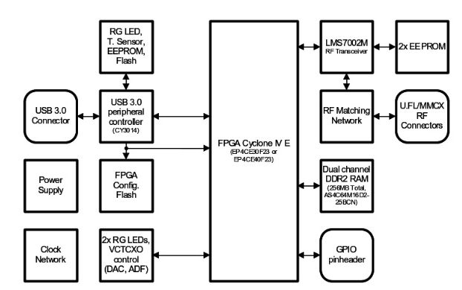
5. LimeSDR-mini

Slide 15
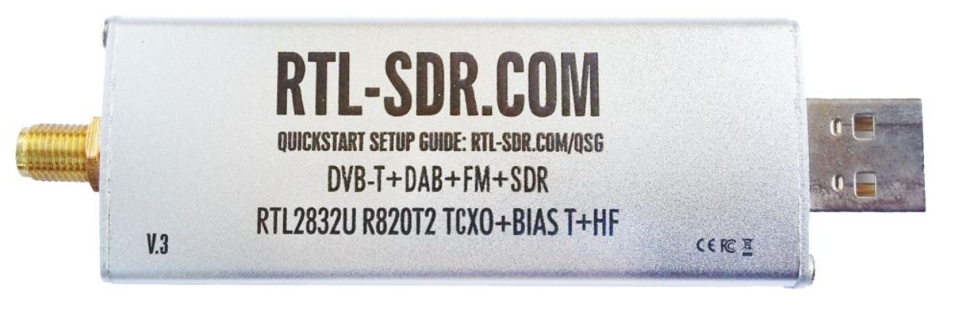
6. RTL-SDR Blog V3
General specifications
Cost: 26 €
Dim.: 45 x 55 x 15 mm
Weight:
Power: Not space proven
Processing
RF capabilities
Software/framework
Freq: 0.5 MHz to 1.766 GHz
Up to 2.4 MHz bandwidth
DVB-T, DAB, FM, SDR
Chip: R820T2
  Noise figure: 3.5 dB
Compatible with most OS
GNU Radio
UPCatalunya

Slide 16
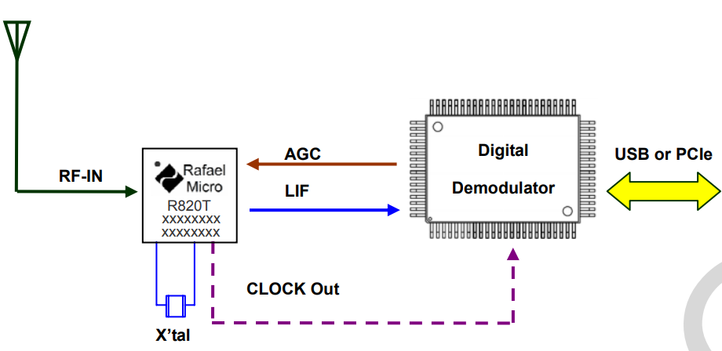
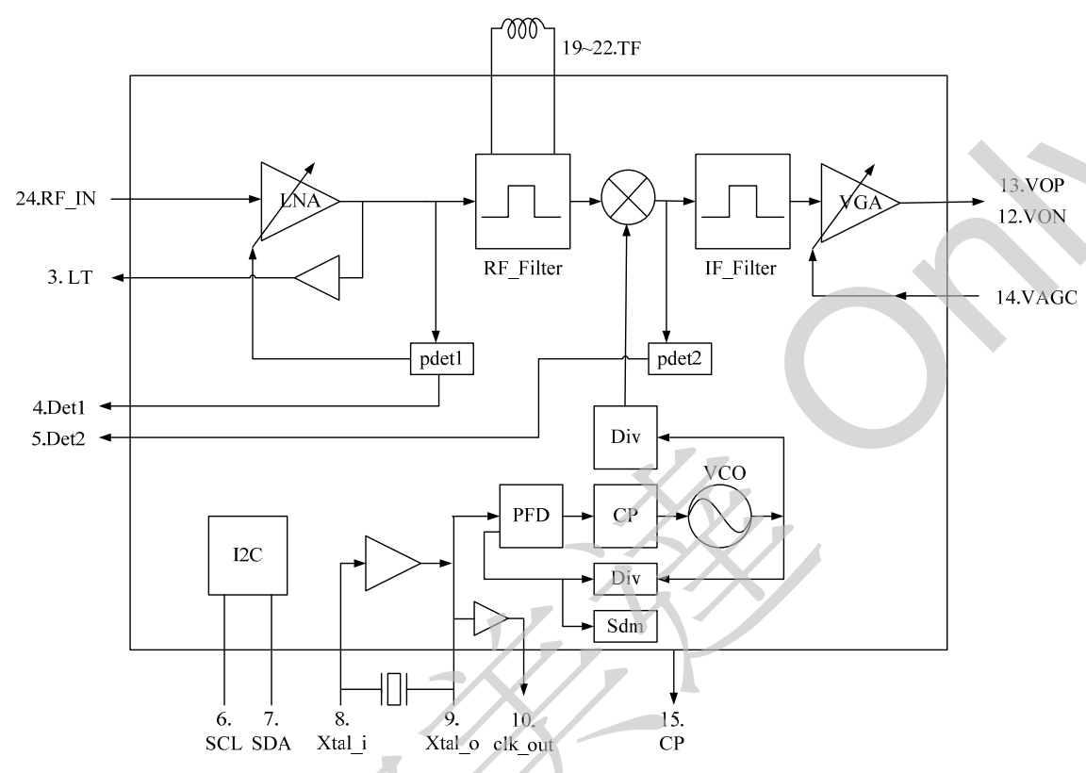
6. RTL-SDR Blog V3

Slide 17
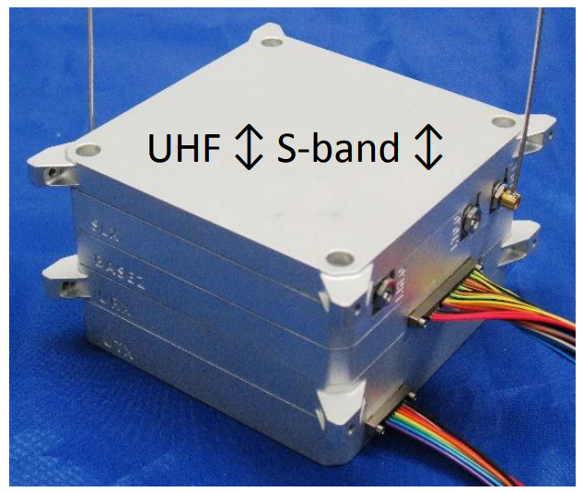
7. SWIFT-UTX
General specifications
Cost: Dim.: 86 x 45 mm (0.25U)
Weight:
Power: 7.5-40 W
Not space proven (designed for CubeSats)
Lacking information
Processing
RF capabilities
Software/framework
Freq: 200 – 500 MHz,
7 MHz bandwidth
SWIFT-LINK: link-layer SW

Slide 18
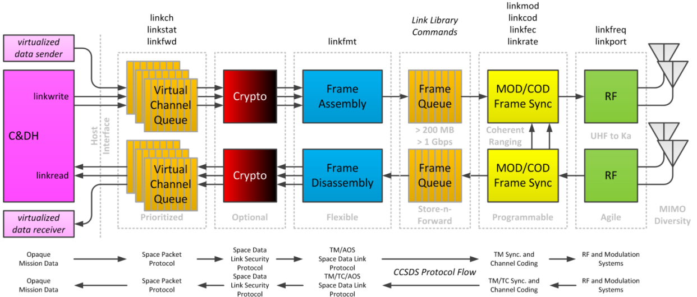
7. SWIFT-UTX

Slide 19
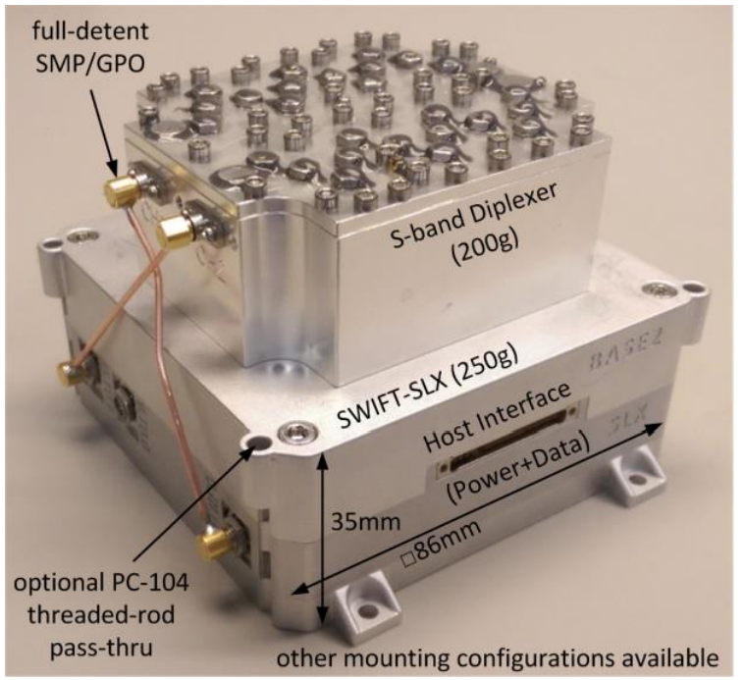
8. SWIFT-SLX
General specifications
Cost:
Dim.: 86 x 25-35 mm (0.25U)
Weight: 200-250 g (excluding diplexer)
Power: 2.5-15 W (modes)
Designed for pico and nanosats
Lacking information
Processing
RF capabilities
Software/framework
Freq: 1.5 – 2.5 GHz (TX), 1 -4 GHz (RX)
Up to 56 MHz bandwidth
2 TX and 4 RX
Noise figure: 0.75 dB
Optional diplexer for full-duplex
SWIFT-LINK

Slide 20
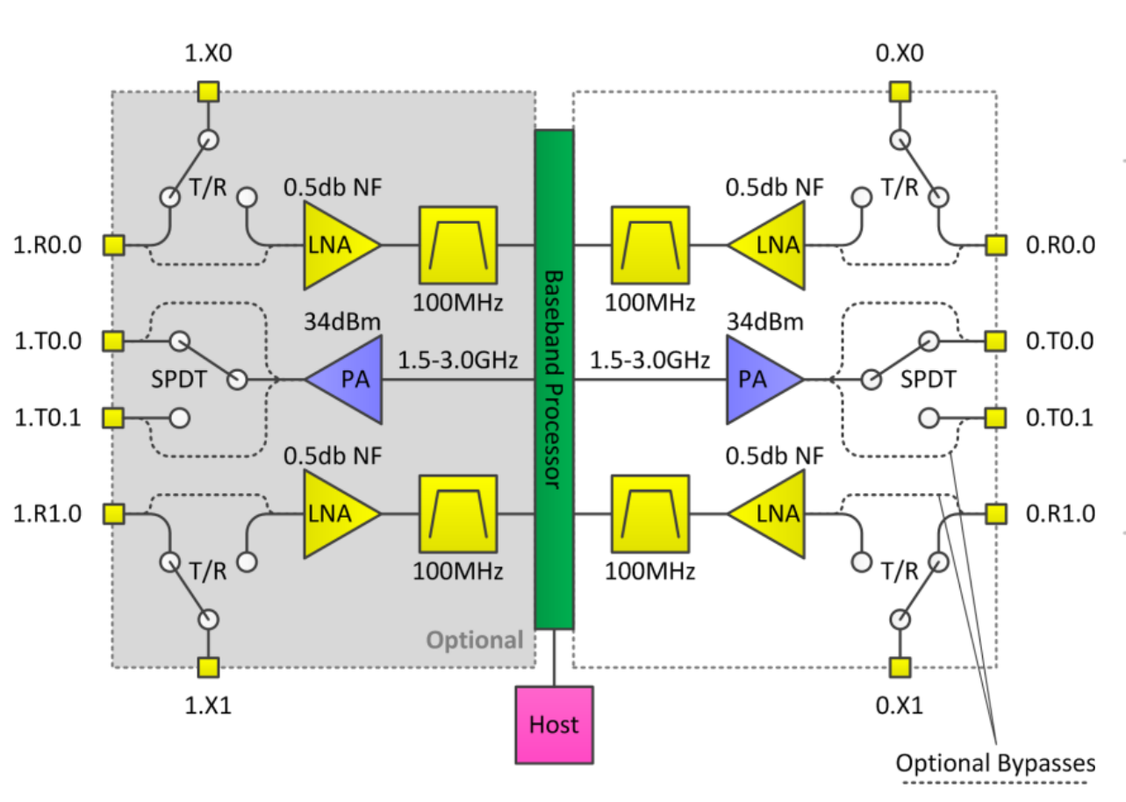
8. SWIFT-SLX

Slide 21
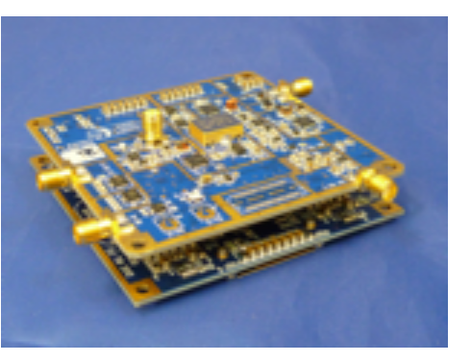
9. SWIFT-WRX
General specifications
Cost:
Dim.:
Weight:
Power:
Designed for CubeSats
Lacking information
Processing
RF capabilities
Software/framework
Freq: 50 MHz to 7 GHz

Slide 22
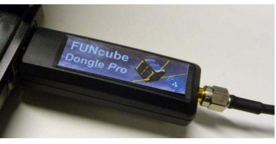
10. FunCube Dongle Pro
General specifications
Cost: 135 €
Dim.:
Weight:
Power:
Not space proven
Processing
RF capabilities
Software/framework
PIC24FJ32GB002 processor
Freq: 0.64 MHz-1.1 GHz (TX), 1.27 - 1.7 GHz (RX)
Up to 96 KHz bandwidth
Sample rate: 96 KHz
Flexible IF amplifier and channel filter
USB Dongle powered by PC’s USB port
Compatible with most OS
Controlled by its own µC and OS
Programmed by PC

Slide 23
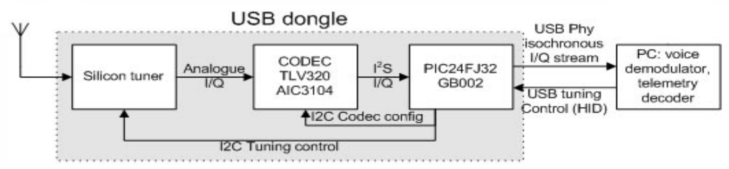
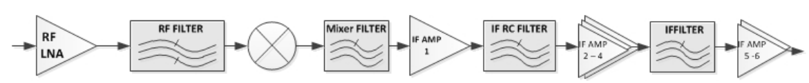
10. FunCube Dongle Pro

Slide 24
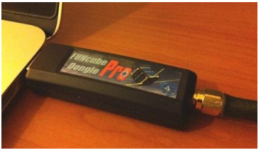
11. FunCube Dongle Pro+
General specifications
Cost: 167 €
Dim.:
Weight:
Power: Not space proven
Processing
RF capabilities
Software/framework
Freq: 150 - 260 GHz (TX), 410 – 2.15 GHz (RX)
Up to 56 MHz bandwidth
Sample rate: 192 KHz

Slide 25
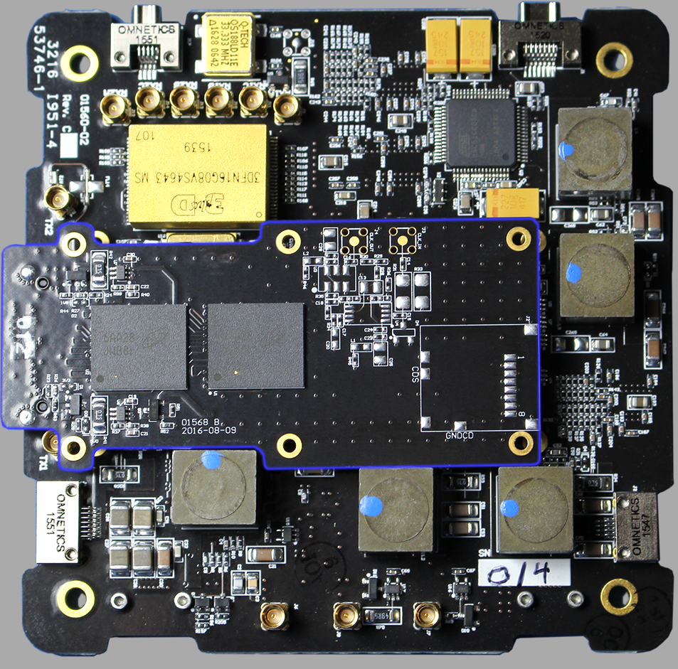
12. ASTROSDR
General specifications
Cost:
Dim.: 90 x 90 mm
Weight: 95 g (without heatsink or daughter card
Power: 4-40 W
Space Plug-and-Play
Processing
RF capabilities
Software/framework
Xilinx Zynq Z-7045
Dual-core ARM Cortex A9 with NEON, up to 800 MHz
Kintex-7 FPGA
512 Mbyte DDR3 RAM
2 GByte Flash
Freq: 70 MHz to 6 GHz
56 MHz (single) and 25 MHz (dual) bandwidth
Dual RX and dual TX
Chip: AD9361
  TX: 47-70 MHz
  RX:70 M-6 GHz
  TDD, FDD
  F=2 dB at 800 MHz LO
Embedded linux

Slide 26
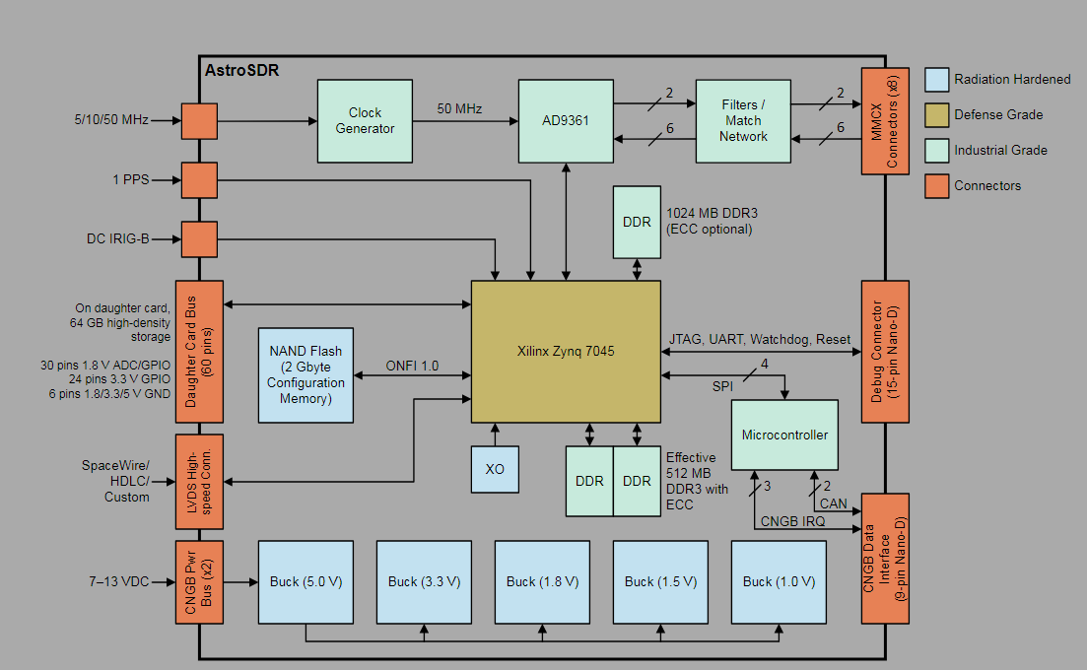
12. ASTROSDR

Slide 27
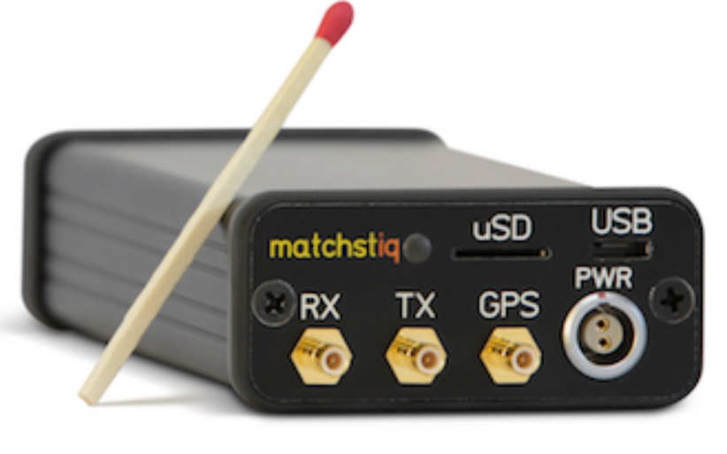
13. EPIQ Solutions Matchstiq
General specifications
Cost: 3 900 €
Dim.: 112 x 50.8 x 36.3 mm
Weight: 142 g
Power: < 3 W
Not space proven
Processing
RF capabilities
Software/framework
Xilinx Spartan®6 LX45T FPGA
Quad-core ARM Cortex A9 CPU
32 GB non-volatile memory
512 MB LPDDR2 RAM
Freq: 70 MHz to 6 GHz
1.5-28 MHz bandwidth
Zero-IF (direct conversion)
Sampling rate: Up to 40 MHz
Output power: 10 dBm
Noise figure: < 8 dB
SDK available
Runs Linux
Max 10

Slide 28
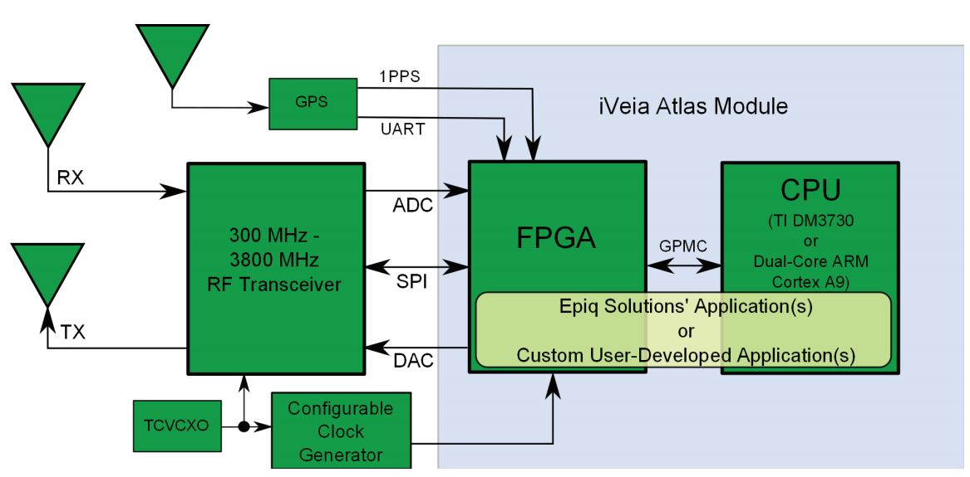
13. EPIQ Solutions Matchstiq

Slide 29
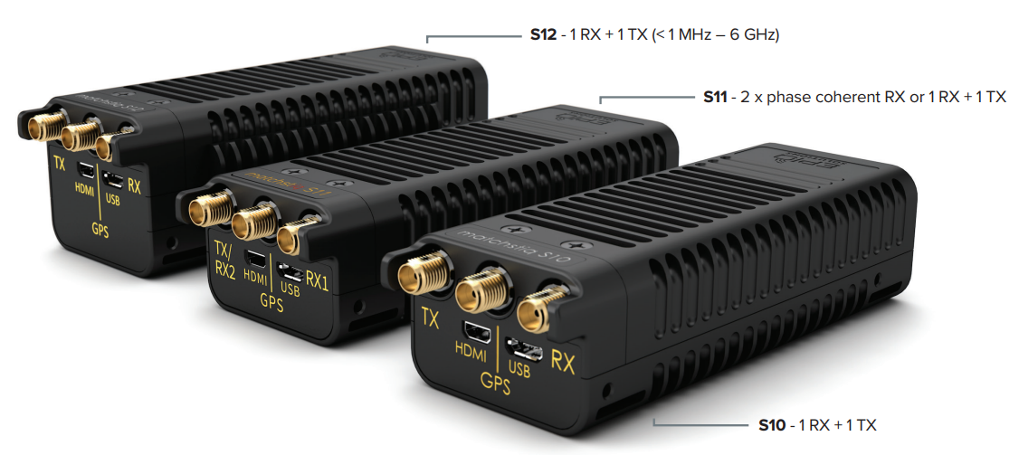
14. Matchtiq S10-S12
General specifications
Cost: 3 900€
Dim.: 112 x 50.8 x 36.3 mm
Weight: 160-215 g
Power: 2-6 W
Not space proven
Processing
RF capabilities
Software/framework
Xilinx Zynq 7020 SoC
ARM Cortex A9 866 MHz dual-core
1 GB RAM
2 GB FLASH
Freq: 1-70 MHz to 6 GHz
Up to 50 MHz bandwidth
Output power: 10-13 dBm
Sampling rate: Up to 61.44 MSps
Chip: AD9361
  TX: 47-70 MHz
  RX:70 M-6 GHz
  TDD, FDD
  F=2 dB at 800 MHz LO
Runs Linux

Slide 30
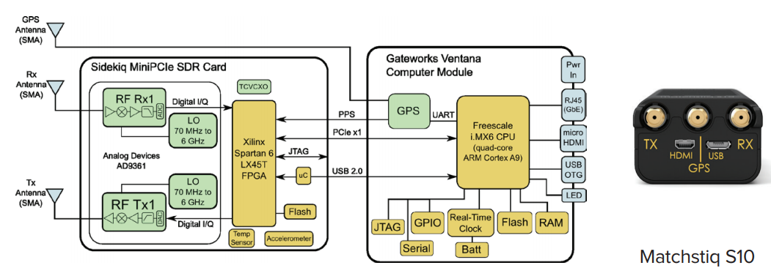
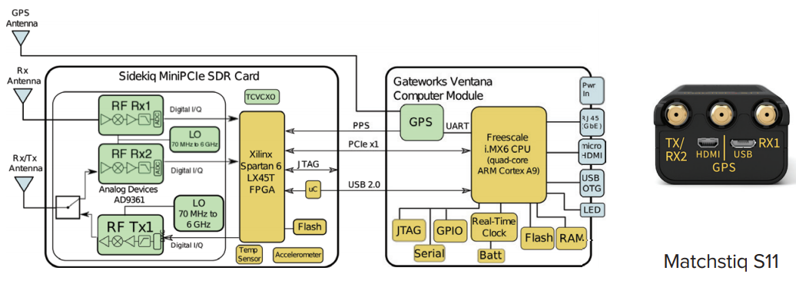
14. Matchtiq S10-S12

Slide 31
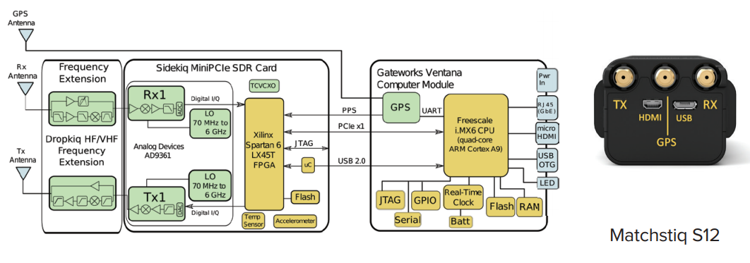
14. Matchtiq S10-S12

Slide 32
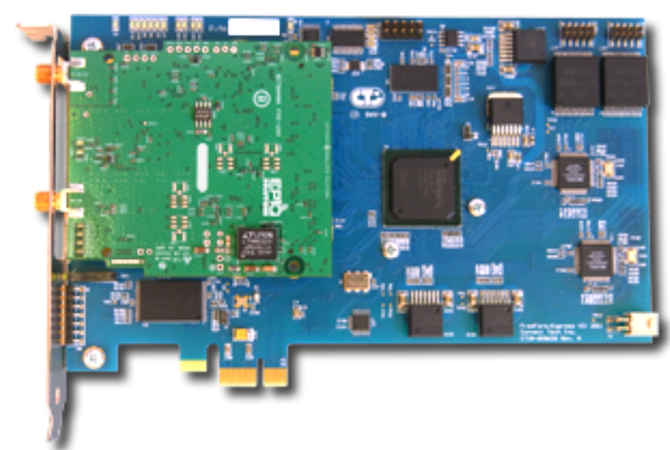
15. EPIQ Bitshark Express Rx
General specifications
Cost: 3 650 – 5320 €
Dim.:
Weight:
Power:
Not space proven
Processing
RF capabilities
Software/framework
Xilinx® Spartan®-6 LX45T FPGA
128MB DDR3 Memory
Freq: 300 MHz to 4 GHz
Up to 50 MHz bandwidth
Smapling rate 105 MSps
Windows and Linux compatible

Slide 33
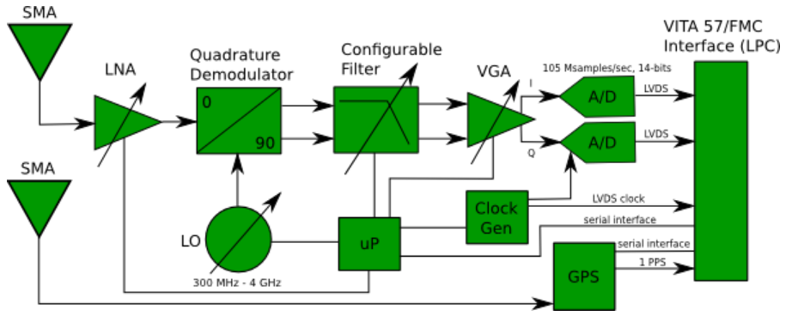
15. EPIQ Bitshark Express Rx

Slide 34
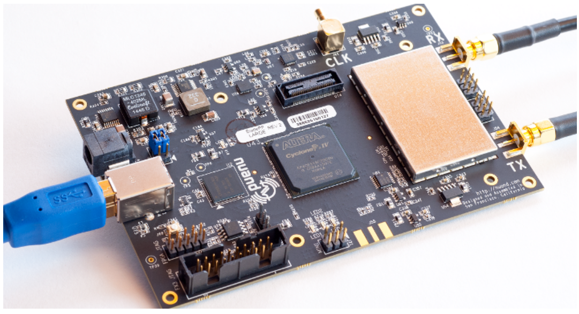
16. BladeRF
General specifications
Cost: 360 €
Dim.: 87 x 131 x 18 mm
Weight:
Power:
Not space proven
Processing
RF capabilities
Software/framework
Altera Cyclone IV
ARM926EJ-S
Freq: 300 MHz to 3.8 GHz
Output power: 6 dBm
Chip: LMS6002D
  TX: 47-70 MHz
  RX:70 M-6 GHz
  BW: Up to 28 MHz
  TDD, FDD
  F=3.5-10 dB
GNU Radio
Compatible with most OS

Slide 35
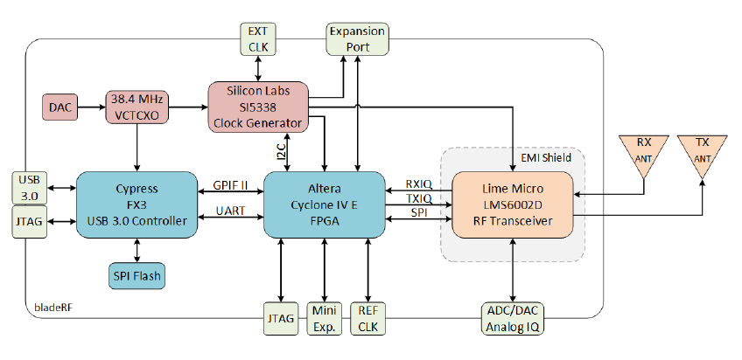
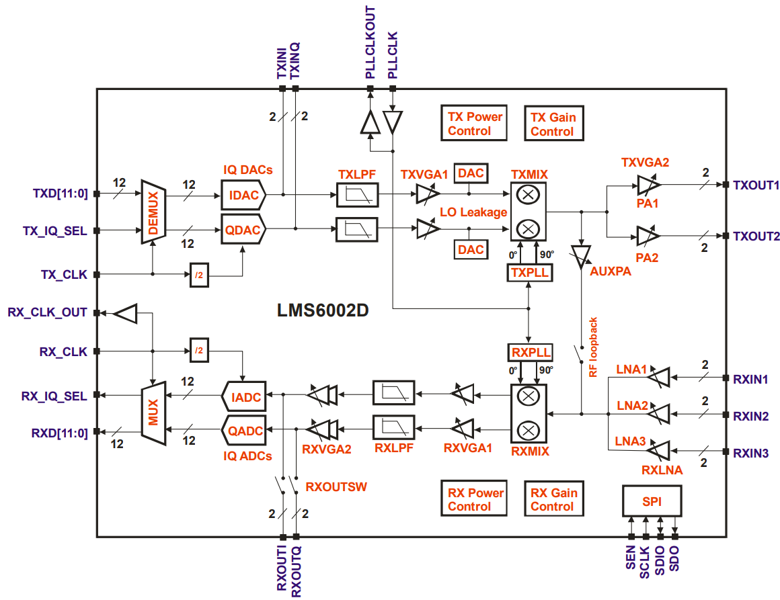
16. BladeRF

Slide 36
17. HACKRF One
General specifications
Cost: 280€
Dim.: 120 x 75 mm
Weight:
Power:
Not space proven
Processing
RF capabilities
Software/framework
LPC43xx ARM Cortex-M4 µC
Freq: 1 MHz to 6 GHz
1.75 – 28 MHz bandwidth
Sample rate: 2-20 Msps
Output power: -10 to 15 dBm depending on freq.
Chip: MAX2837 transceiver
  2.3 - 2.7 GHz
  Noise figure: 2.3 dB
GNU Radio

Slide 37
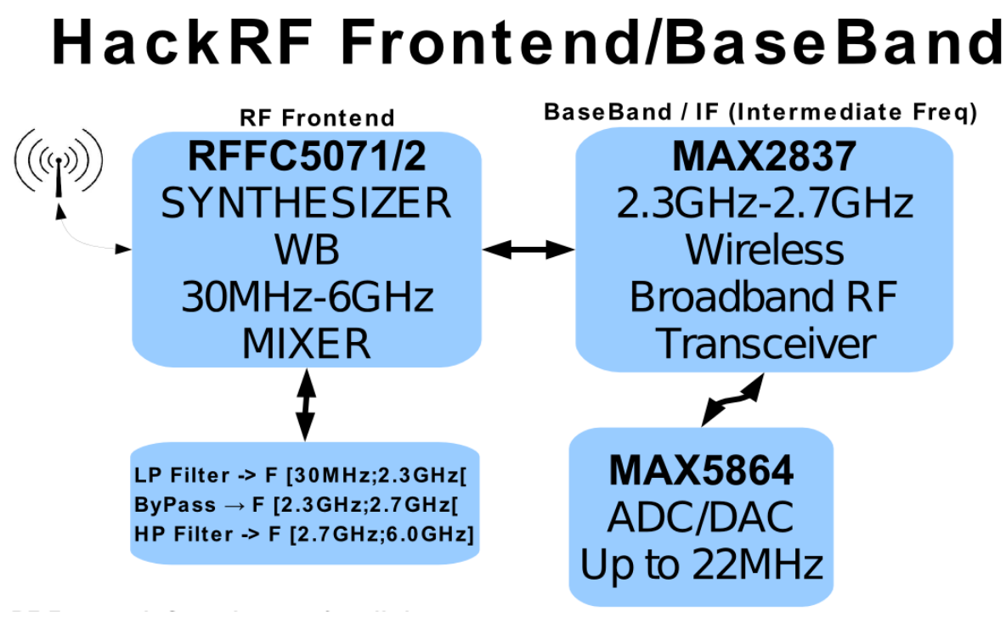
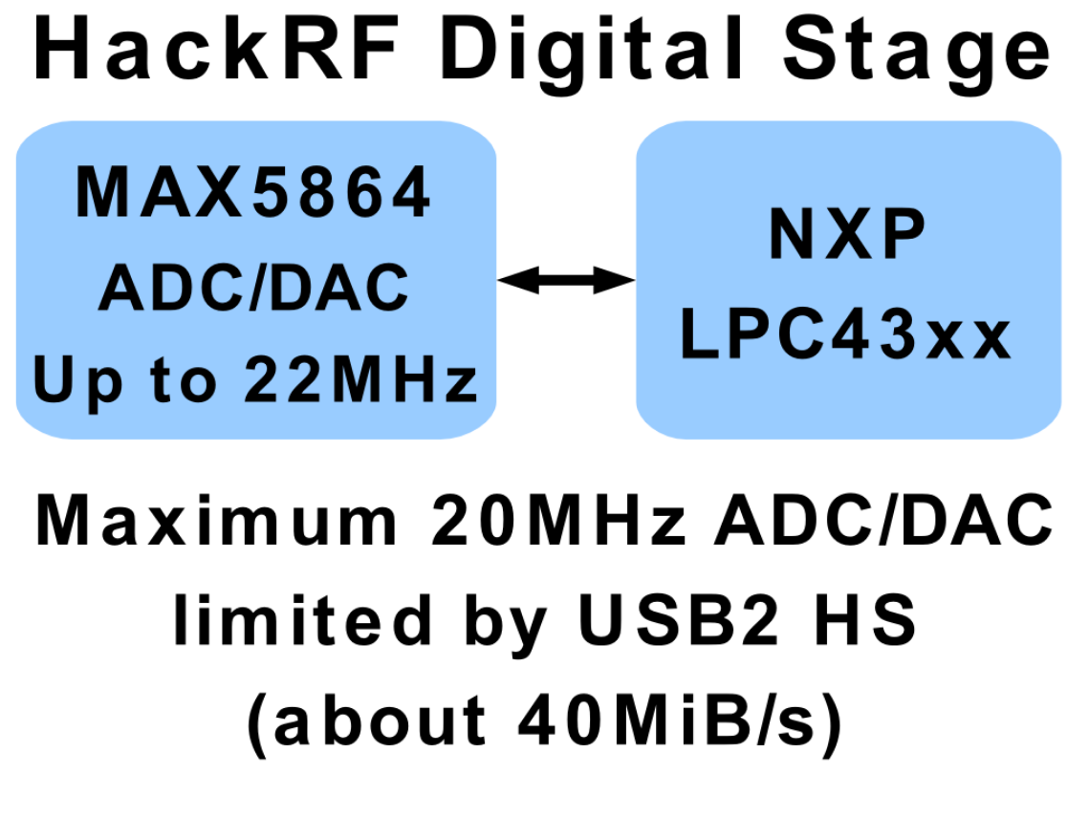
17. HACKRF One

Slide 38
Conclusions
17 SDR platforms studied
  Cost: 26-30,000 €
  Space proven: 2
  Weights: 95 g-1.2 Kg (most of them don’t include cases)
  Power consumption: 3 W (idle)-40 W
  Processing units
    4 Xilinx Zynq
    2 Altera Cyclone IV
  Transceiver chips
    4 AD4361
    3 Lime chips

