Slide 1
The Adressa Dataset for News Recommendation
Jon Atle Gulla, Lemei Zhang, Peng Liu, Özlem Özgöbek, Xiaomeng Su
{jag, lemei.zhang, peng.liu, ozlem.ozgobek, xiaomeng.su}@idi.ntnu.no
Web Intelligence and Semantics Lab

Slide 2
BACKGROUND
Readers prefer online news rather than traditional paper-based newspapers, and many news companies have started personalized services

Slide 3
News Recommendations are more complex
  Unstructured data
    Incomplete, inconsistent, overlapping in content and hard to interpret
  Time and geographical limitations
    Short life spans and often of interest to a modest geographical area
  Users’ intentions vary unsystematically
    Personal interests, friends’ reading and public’s attention
  Lack of rating of online news
    Users are usually unwilling to rate online news, and we have to interpret various implicit signals to second-guess their interests and satisfaction

Slide 4
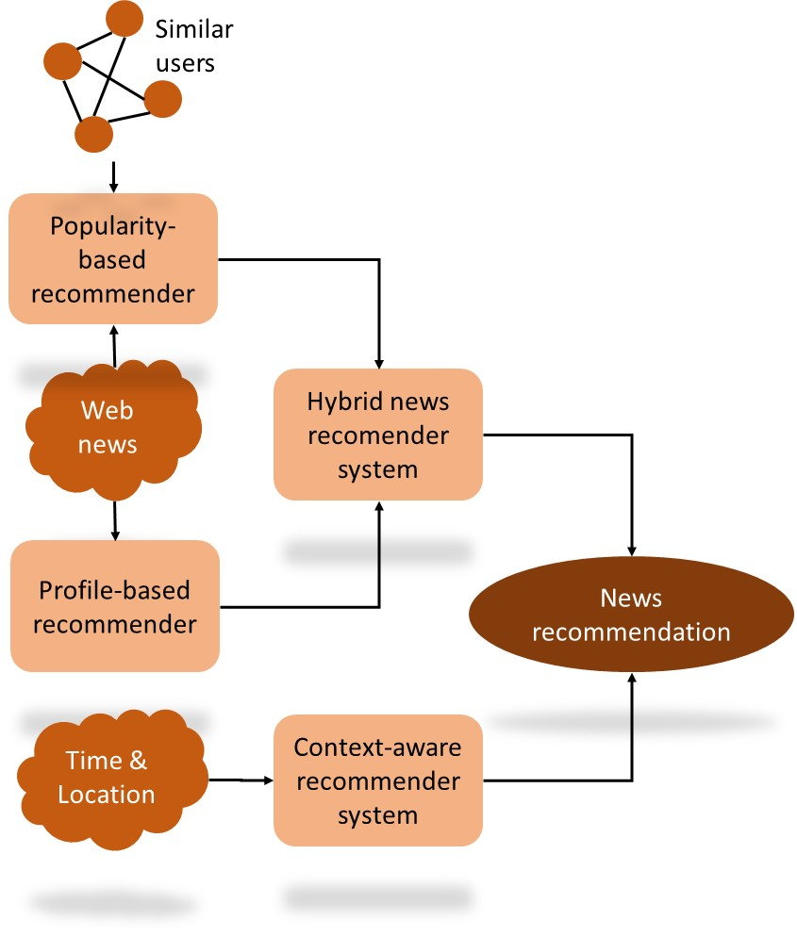
Modern Recommender System
Hybrid solutions (CF + Content-based Recommendations)
Fresh news
Popular news
Neighborhood news
Figure 1. Architecture of advanced news recommender systems

Slide 5
Online Dataset
Table 1. Comparison of some well-known datasets
Dataset | Items | Users | Ratings | Density (%) | Ratings scale
MovieLens 1M | 3,883 movies | 6,040 | 1,000,209 | 4.26 | [1-5]
MovieLens 10M | 10,682 movies | 71,567 | 10,000,054 | 1.31 | [1-5]
MovieLens 20M | 27,278 movies | 138,493 | 20,000,263 | 0.53 | [1-5]
Netflix | 17,770 movies | 480,189 | 100,480,507 | 1.18 | [1-5]
MoviePilot | 25,058 movies | 105,137 | 4,544,409 | 0.17 | [1-5]
Last.fm 360K | 294,015 artists | 359,347 | 17,559,530 | 0.017 | [1, 5]
Yahoo Music | 624,961 | 1,000,990 | 262,810,175 | 0.042 | [1, 5]
Jester | 150 jokes | 124,113 | 5,865,235 | 31.5 | [-10, 10]
Book-crossing | 271,379 books | 92,107 | 1,031,175 | 0.004 | [1, 10] + implicit
YOW | 5,921 articles | 28 | 10010 | 6.0 | [1, 5] + implicit
Plista | 70,353 articles | 14,897,978 | 84,210,795 | 0.008 | Click counts
Adressa 1.3G compact | 923 articles | 15,514 | 2,717,915 | 0.19 | Click counts, reading times
From January 1996 to March 2015
Users rated at least 20 movies are included
Movies that have at least one rating was included
Movie title and genres
Too little context features to support content-based or context aware recommendations

Slide 6
Online Dataset
Table 1. Comparison of some well-known datasets
Dataset | Items | Users | Ratings | Density (%) | Ratings scale
MovieLens 1M | 3,883 movies | 6,040 | 1,000,209 | 4.26 | [1-5]
MovieLens 10M | 10,682 movies | 71,567 | 10,000,054 | 1.31 | [1-5]
MovieLens 20M | 27,278 movies | 138,493 | 20,000,263 | 0.53 | [1-5]
Netflix | 17,770 movies | 480,189 | 100,480,507 | 1.18 | [1-5]
MoviePilot | 25,058 movies | 105,137 | 4,544,409 | 0.17 | [1-5]
Last.fm 360K | 294,015 artists | 359,347 | 17,559,530 | 0.017 | [1, 5]
Yahoo Music | 624,961 | 1,000,990 | 262,810,175 | 0.042 | [1, 5]
Jester | 150 jokes | 124,113 | 5,865,235 | 31.5 | [-10, 10]
Book-crossing | 271,379 books | 92,107 | 1,031,175 | 0.004 | [1, 10] + implicit
YOW | 5,921 articles | 28 | 10010 | 6.0 | [1, 5] + implicit
Plista | 70,353 articles | 14,897,978 | 84,210,795 | 0.008 | Click counts
Adressa 1.3G compact | 923 articles | 15,514 | 2,717,915 | 0.19 | Click counts, reading times
From December 1999 to December 2005
Movie IDs are included
Text content such as titles and genres, are not included
Suitable for CF, but not for content-based recommendation strategies

Slide 7
Online Dataset
Table 1. Comparison of some well-known datasets
Dataset | Items | Users | Ratings | Density (%) | Ratings scale
MovieLens 1M | 3,883 movies | 6,040 | 1,000,209 | 4.26 | [1-5]
MovieLens 10M | 10,682 movies | 71,567 | 10,000,054 | 1.31 | [1-5]
MovieLens 20M | 27,278 movies | 138,493 | 20,000,263 | 0.53 | [1-5]
Netflix | 17,770 movies | 480,189 | 100,480,507 | 1.18 | [1-5]
MoviePilot | 25,058 movies | 105,137 | 4,544,409 | 0.17 | [1-5]
Last.fm 360K | 294,015 artists | 359,347 | 17,559,530 | 0.017 | [1, 5]
Yahoo Music | 624,961 | 1,000,990 | 262,810,175 | 0.042 | [1, 5]
Jester | 150 jokes | 124,113 | 5,865,235 | 31.5 | [-10, 10]
Book-crossing | 271,379 books | 92,107 | 1,031,175 | 0.004 | [1, 10] + implicit
YOW | 5,921 articles | 28 | 10010 | 6.0 | [1, 5] + implicit
Plista | 70,353 articles | 14,897,978 | 84,210,795 | 0.008 | Click counts
Adressa 1.3G compact | 923 articles | 15,514 | 2,717,915 | 0.19 | Click counts, reading times
A small dataset contains both explicit ratings and implicit signals such as mouse and keyboard scrolling
News categories are also included
The contextual part is too small to allow full-fledged user profiles to be extracted

Slide 8
Online Dataset
Table 1. Comparison of some well-known datasets
Dataset | Items | Users | Ratings | Density (%) | Ratings scale
MovieLens 1M | 3,883 movies | 6,040 | 1,000,209 | 4.26 | [1-5]
MovieLens 10M | 10,682 movies | 71,567 | 10,000,054 | 1.31 | [1-5]
MovieLens 20M | 27,278 movies | 138,493 | 20,000,263 | 0.53 | [1-5]
Netflix | 17,770 movies | 480,189 | 100,480,507 | 1.18 | [1-5]
MoviePilot | 25,058 movies | 105,137 | 4,544,409 | 0.17 | [1-5]
Last.fm 360K | 294,015 artists | 359,347 | 17,559,530 | 0.017 | [1, 5]
Yahoo Music | 624,961 | 1,000,990 | 262,810,175 | 0.042 | [1, 5]
Jester | 150 jokes | 124,113 | 5,865,235 | 31.5 | [-10, 10]
Book-crossing | 271,379 books | 92,107 | 1,031,175 | 0.004 | [1, 10] + implicit
YOW | 5,921 articles | 28 | 10010 | 6.0 | [1, 5] + implicit
Plista | 70,353 articles | 14,897,978 | 84,210,795 | 0.008 | Click counts
Adressa 1.3G compact | 923 articles | 15,514 | 2,717,915 | 0.19 | Click counts, reading times
Collect logs from 13 German news portals for 4 weeks in June 2013
More than 84 million article views (contextual data)
No explicit ratings and reading times
Publication date are included but no geographical locations

Slide 9
Online Dataset
Table 1. Comparison of some well-known datasets
Dataset | Items | Users | Ratings | Density (%) | Ratings scale
MovieLens 1M | 3,883 movies | 6,040 | 1,000,209 | 4.26 | [1-5]
MovieLens 10M | 10,682 movies | 71,567 | 10,000,054 | 1.31 | [1-5]
MovieLens 20M | 27,278 movies | 138,493 | 20,000,263 | 0.53 | [1-5]
Netflix | 17,770 movies | 480,189 | 100,480,507 | 1.18 | [1-5]
MoviePilot | 25,058 movies | 105,137 | 4,544,409 | 0.17 | [1-5]
Last.fm 360K | 294,015 artists | 359,347 | 17,559,530 | 0.017 | [1, 5]
Yahoo Music | 624,961 | 1,000,990 | 262,810,175 | 0.042 | [1, 5]
Jester | 150 jokes | 124,113 | 5,865,235 | 31.5 | [-10, 10]
Book-crossing | 271,379 books | 92,107 | 1,031,175 | 0.004 | [1, 10] + implicit
YOW | 5,921 articles | 28 | 10010 | 6.0 | [1, 5] + implicit
Plista | 70,353 articles | 14,897,978 | 84,210,795 | 0.008 | Click counts
Adressa 1.3G compact | 923 articles | 15,514 | 2,717,915 | 0.19 | Click counts, reading times
Collected from 1st January 2017 to 31st March 2017
1.3G dataset covers only one week data within February 2017
Contains a lot of contextual attributes, e.g. named entities, title, category etc.

Slide 10
The RecTech Project
The Adressa dataset is part of the RecTech project on recommendation strategies (from 2016)
Project owner and partner
Objective: develop the next generation recommender systems for online news recommendation.

Slide 11
The Dataset
Collected from Cxense platform
Users: subscribers and non-subscribers:
  Subscribers can access articles behind the pay wall, and their sessions can be followed consistently
  Non-subscribers :
    The articles behind the pay wall are not available, and there is no reading or clicking session for them
    A new user ID will be allocated to them whenever they start a new session
Article views: 2,717,915
  Density: 0.19%
  Density per day varies from 0.21% to 0.11%

Slide 12
The Structure of Dataset
Raw data is saved in three separate folders and contains a wide range of attributes
Compact dataset consists 2 parts:
  A table of reading events
  Additional data about the article, e.g. keywords, Named Entities.

Slide 13
The Structure of Dataset
Table 2. Fields of the Adressa compact dataset
Attribute | Description | Example
eventID | Id of reading event | 1082287123 (integer)
Time | The time of the event | 1487572383 (Unix time)
sessionStart | Indicates if the event is the first event in the session | False
sessionStop | Indicates if the event is the last event in the session | False
activeTime | The active time spent on a page | 23 (seconds)
canonicalURL | URL of the visited page | “http://adressa.no”
referrerURL | The URL of the referrer page | “www.facebook.com”
documentId | Internal ID of page | “9757814edc2d346dfcf6f54e349f404c4e9775cf”
Title | Title of the article | “Test av 19 grovbrød”
Category | News category | “sport”
wordCount | Number of words on page | 545 (words)
publishTime | Date of publication | “2017-02-20T09:45:47.000Z”
userID | The cross-site user identifier | “cx:i8i85z793m9j4yy0:cv8ghy3v45j8”
City | City inferred from user’s IP address | “Verdal”
Region | Region inferred from user’s IP address | “Nord-Trøndelag”
Country | Country inferred from user’s IP address | “no”
os | Operating system | “Windows”
deviceType | The type of device | “Desktop”
The time spent reading the particular article;
Could be used as implicit signal of interest of users

Slide 14
The Structure of Dataset
Table 2. Fields of the Adressa compact dataset
Attribute | Description | Example
eventID | Id of reading event | 1082287123 (integer)
Time | The time of the event | 1487572383 (Unix time)
sessionStart | Indicates if the event is the first event in the session | False
sessionStop | Indicates if the event is the last event in the session | False
activeTime | The active time spent on a page | 23 (seconds)
canonicalURL | URL of the visited page | “http://adressa.no”
referrerURL | The URL of the referrer page | “www.facebook.com”
documentId | Internal ID of page | “9757814edc2d346dfcf6f54e349f404c4e9775cf”
Title | Title of the article | “Test av 19 grovbrød”
Category | News category | “sport”
wordCount | Number of words on page | 545 (words)
publishTime | Date of publication | “2017-02-20T09:45:47.000Z”
userID | The cross-site user identifier | “cx:i8i85z793m9j4yy0:cv8ghy3v45j8”
City | City inferred from user’s IP address | “Verdal”
Region | Region inferred from user’s IP address | “Nord-Trøndelag”
Country | Country inferred from user’s IP address | “no”
os | Operating system | “Windows”
deviceType | The type of device | “Desktop”
Identify the web page that the user came from

Slide 15
The Structure of Dataset
Table 2. Fields of the Adressa compact dataset
Attribute | Description | Example
eventID | Id of reading event | 1082287123 (integer)
Time | The time of the event | 1487572383 (Unix time)
sessionStart | Indicates if the event is the first event in the session | False
sessionStop | Indicates if the event is the last event in the session | False
activeTime | The active time spent on a page | 23 (seconds)
canonicalURL | URL of the visited page | “http://adressa.no”
referrerURL | The URL of the referrer page | “www.facebook.com”
documentId | Internal ID of page | “9757814edc2d346dfcf6f54e349f404c4e9775cf”
Title | Title of the article | “Test av 19 grovbrød”
Category | News category | “sport”
wordCount | Number of words on page | 545 (words)
publishTime | Date of publication | “2017-02-20T09:45:47.000Z”
userID | The cross-site user identifier | “cx:i8i85z793m9j4yy0:cv8ghy3v45j8”
City | City inferred from user’s IP address | “Verdal”
Region | Region inferred from user’s IP address | “Nord-Trøndelag”
Country | Country inferred from user’s IP address | “no”
os | Operating system | “Windows”
deviceType | The type of device | “Desktop”
Identify where the user accessed the news article

Slide 16
The Structure of Dataset
Other attributes on news content:
Author: the author of the news articles
Keywords: keywords or tags annotated with the article
Named Entities: entities and prominent terms from news article
Body: the entire test of the news articles in Norwegian

Slide 17
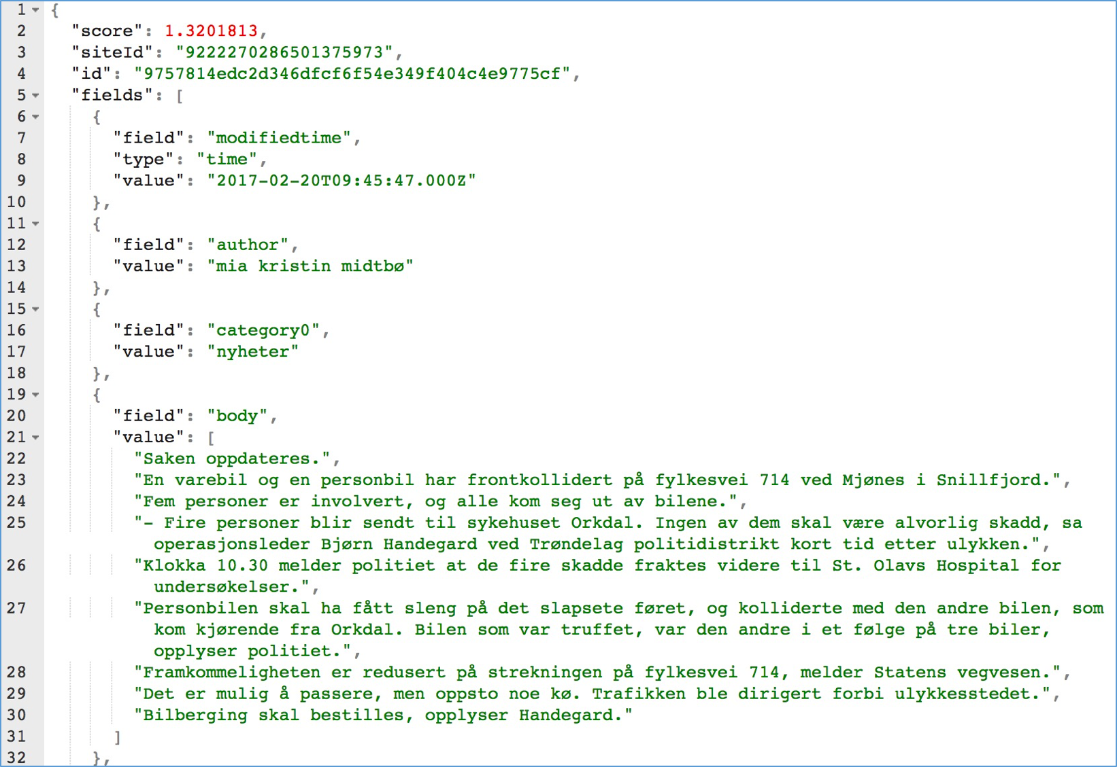
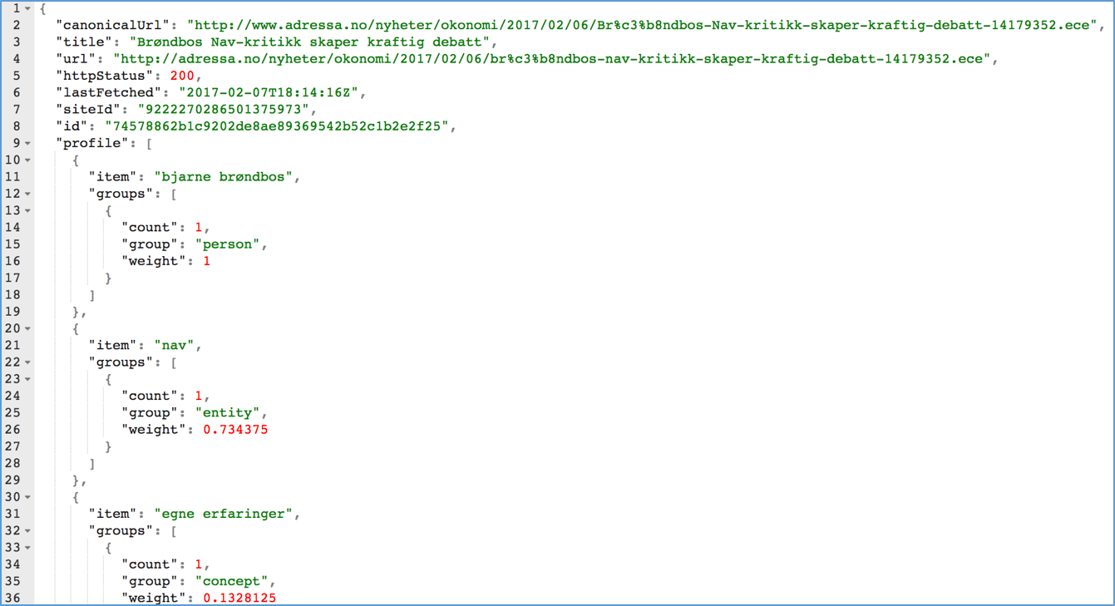
The Structure of Dataset

Slide 18
Table 3. Number of articles per news category and average number of entities per article per category
Category | No. of articles | % of articles | Average no. of entities
“Nyheter” (news) | 397 | 43.0 | 5.86
“100sport” (100sport) | 136 | 14.7 | 7.53
“Kultur” (culture) | 91 | 9.9 | 11.0
“Pluss” (paid content) | 60 | 6.5 | 9.59
“Meninger” (opinions) | 56 | 6.1 | 8.84
“Forbruker” (consumer) | 41 | 4.4 | 5.92
“Familie og oppvekst” (family) | 24 | 2.6 | 8.05
“Bolig” (housing) | 23 | 2.5 | 6.3
“Bil” (car) | 19 | 2.1 | 8.63
“Sport” (sport) | 18 | 2.0 | 5.88
“Reise” (travel) | 18 | 2.0 | 11.94
“Været” (weather) | 11 | 1.2 | 7.11
“Digital” (digital) | 8 | 0.9 | 10.38
“Folk” (people) | 6 | 0.7 | 10.83
“Live studio” | 4 | 0.4 | 1.67
“Student” | 2 | 0.2 | 3.0
“Video” | 2 | 0.2 | 1.0
“Tjenester” (services) | 1 | 0.1 | 2.0
“Kamera” (camera) | 1 | 0.1 | 9.0
“Nyttig” (useful) | 1 | 0.1 | 14.0
“Jobb” (job) | 1 | 0.1 | 3.0
“Tema” (theme) | 1 | 0.1 | 4.0
“Migration catalog” | 1 | 0.1 | 2.0
“Incoming” | 1 | 0.1 | 1.0
Average per category | 38.5 | 4.2 | 6.6
Normal news articles take up about 43% of the articles in dataset
Sports and culture articles have more entities then normal news, but a little less than travel articles
“Pluss” represents the articles are behind the pay wall

Slide 19
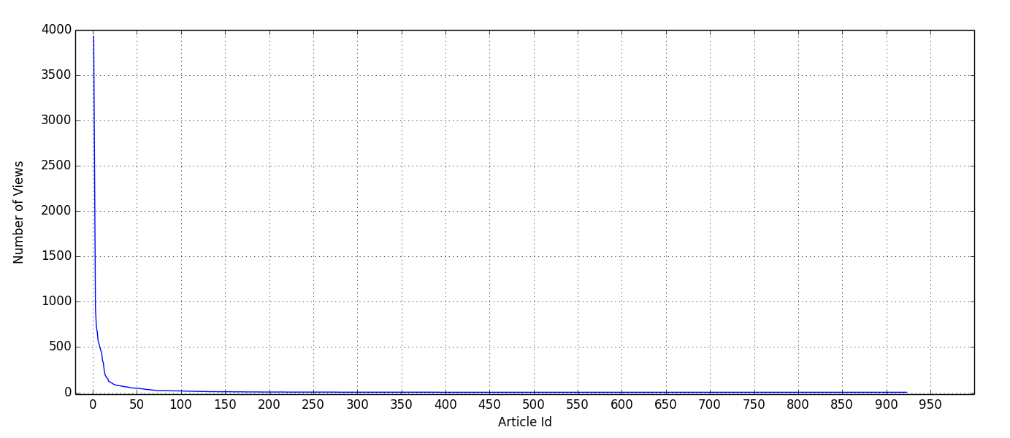
Figure 2. Number of article views per article
Some articles are very popular, but a very large share of the articles have been viewed only a handful times.
Only 392 articles (32.34%) are viewed more than one time, and no more than 22 articles (18.15%) are viewed more than 100 times.
The two most popular articles are viewed 3,929 and 2,436 times within 7 days, and they all come from “news” category.
Unbalance problem: reading times per article, the number
  of articles per category

Slide 20
Analyzing the Dataset
Subscriber and non-subscriber:
  Can be differentiated through CanonicalURL
  Example 1 (non-subscribers or subscribers): http://www.adressa.no/meninger/kronikker/2017/02/06/Nav-og-velferdsordningene-er-livsviktige.-Systemet-har-bare-%c3%a9n-stor-feil-14174815.ece
  Example 2 (subscribers): http://www.adressa.no/pluss/magasin/2017/02/06/Fjellseter-1907-og-2017-14156717.ece

Slide 21
Analyzing the Dataset
Location:
  Geographical location attributes identify the location of the users according to their IP address;
  Some entities in articles may indicate the location where the news stories happened.
City: “bjugn”
Region: “sor-trondelag”
Country: “no”

Slide 22
Analyzing the Dataset
Time:
  The life span of news articles is much shorter than that of books, movies and other items on online shopping sites;
  Most conventional news stories last only 1-2 days;
  The age of an article is computed by comparing its publication time (publishTime) with the time the user was reading the article (Time)

Slide 23
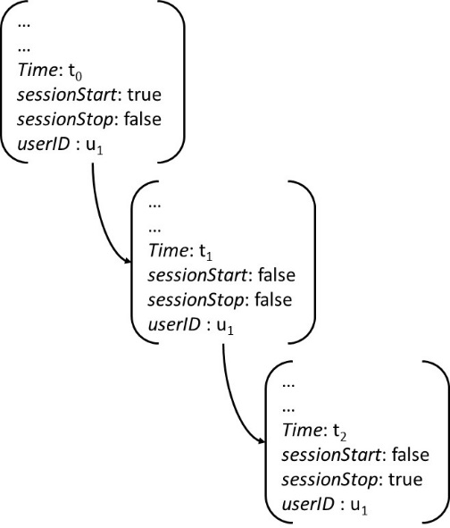
Analyzing the Dataset
Identify a session:
  No explicit information to identify a session, but we can use the attributes userID, Time, sessionStart, and sessionStop to combine events together into a session
Figure 3. Constructing a session form reading events

Slide 24
Analyzing the Dataset
Implicit information:
  Click counts: each event represents a clicking action of the user, and to some extent, reading an article may be interpreted as an interest in the article topic;
  Reading time: the activeTime attribute records the time the user spent on a specific news article

Slide 25
Accessing the Dataset
The dataset (without the body of news articles) can be download http://folk.ntnu.no/ozlemo/one_week.tar.gz--- one_week dataset;
Additional article content data (including the body) can be available on request;
We are in the process of preparing the Adressa 3 month dataset and it will be published very soon.
SmartMedia webpage: https://research.idi.ntnu.no/SmartMedia/

Slide 26
Thank you!
Emerging Topic:
Dallas
police
attack
terror
shooting
ambush
Emerging Topic:
Dallas
police
attack
terror
shooting
ambush

