Slide 1

Do we Speak enough about what we want our Universities to be in the 21st Century?

Slide 2
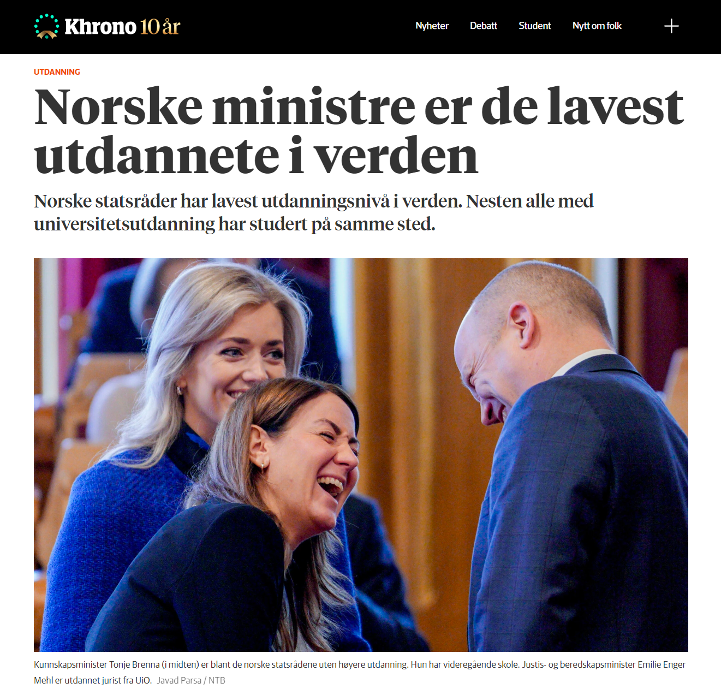
The Present Situation
What is the overall purpose/value of getting a university education in the 21st century?

Slide 3
The Present Situation
What is the overall purpose/value of getting a university education in the 21st century?
From anectdotal experience, the majority of our students view their education process more as an obstacle that must be overcome than as an opportunity for growth.
They want to be educated practically (minimally) to do a specific set of tasks. They are not interested in an expansive education that prioritizes broad understandings, over specific subject knowledge.
Their primary motive for seeking an education is to earn a better salary. If they could do this without taking an education, they would. (There are multifactorial explanations for this attitude.)

Slide 4
What University model are we building in Norway?
Brian Denman uses the term «sponsorship mobility» (Denman, 2005) to describe the aims of a state that, like Norway, subsidises higher-education costs for its constituents to provide equitable social and economic mobility.
Even so, Norwegian universities appear to be moving in the direction of management strategies and practices that resemble the private sector. We can speculate that university boards are being pressured to conform to a finance-dominated mentality, since this mentality guides government sector as well.
The goal of these strategies is not «profit», in the strictest sense, but financial sustainability. University boards are increasingly guided by a central aim: cut costs and increase income. From a simple budgetary view, this implies a strategy of attracting more students (more subsidies) and of lowering overhead by paying fewer/lower salaries (think online courses and more administrative tasks!).
Denman argues that «universities have also become increasingly business and customer-oriented, resulting in a transition from collegial decision-making to a kind of corporate management. The university that has become a quasi-marketplace is now comeptition-driven […]» (Denman, 2005).
The overall result is the «commodification of knowledge» (Denman, 2005), where universities exist as service-providers for individual student stakeholders, and not as fundamental contributors to the common good of society as a whole.
Brian Denman. (2005). «What is a university in the 21st century?.» Higher Education Management and Policy, 17(2), 9-26.

Slide 5
The Present Situation
What is the overall purpose/value of getting a university education in the 21st century?
Key Questions:
What matters more within this new paradigm: Traditional academic excellence, or mass-production? In which of these directions do individual universities move themselves; and how do these moves affect institutional decision-making?
What type of «product» must we offer to compete in a crowded market? What are the domains in which we strive to innovate, as a brand, when financial sustainability is a primary aim? (What knowledge contributions have the greatest market value?)
Do answers to these questions always have to prioritise the financial sustainability of universities? Are there ways to satisfy academic and financial concerns simultaneously, or are these concerns irrevocably juxtaposed?

Slide 6
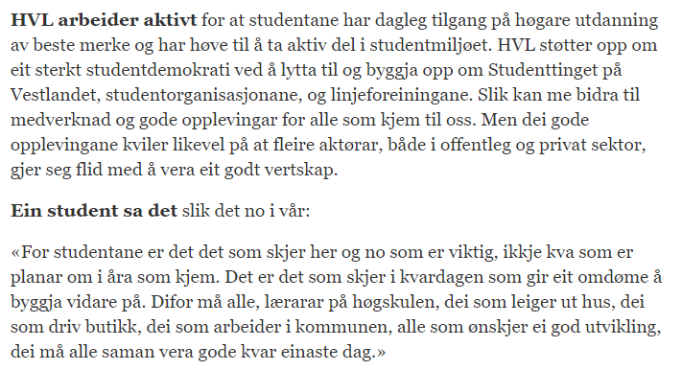
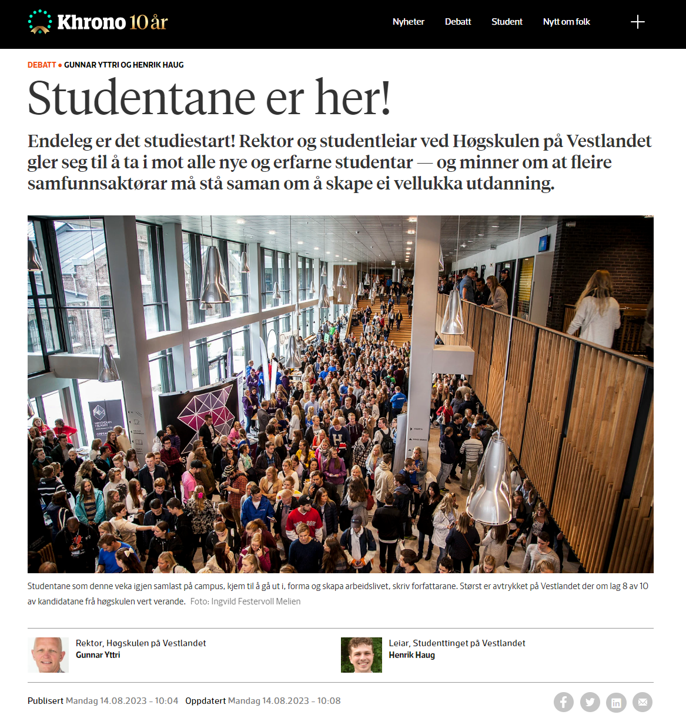
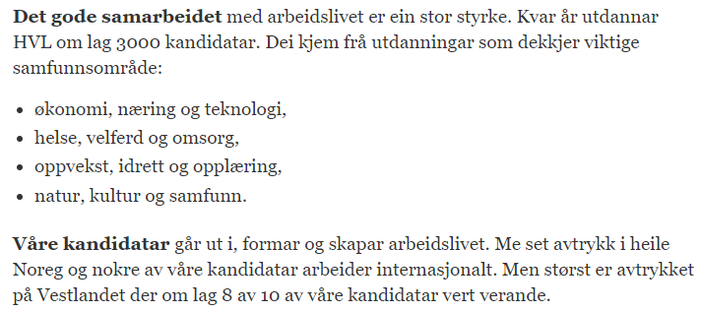
What does this have to do with loyalty?
If you are managing a brand in a competitive market, the success of your company depends largely on how customers perceive your brand.
1
2
Market value
3
4

Slide 7
What does this have to do with loyalty?
If you are managing a «brand» in a competitive market, the success of your company depends largely on how customers perceive your brand.
If knowledge is the commodity that universities are ‘selling’ to students (and to the governments that subsidise those universities), what is the ‘market value’ of research within this scheme? In other words, how do researchers «justify the costs of what they do, how they do it, and what results they obtain» (Denman, 2005)? What are the market values of different kinds of knowledge?
When teaching and research have been commodified (reduced to products), the main function of all teaching and research will be to contribute to the growth (or financial sustainability) of the «brand». All other knowledge contributions, including those made for the good of society, are seen as ‘unproductive’ contributions (little, or no market value), unless they somehow build the «brand».
Most importantly, knowledge contributions that actively, or passively undermine the market competitivity of the «brand», even if they promote the general good of society, can be reinterpreted as acts of disloyalty within this management model.

Slide 8
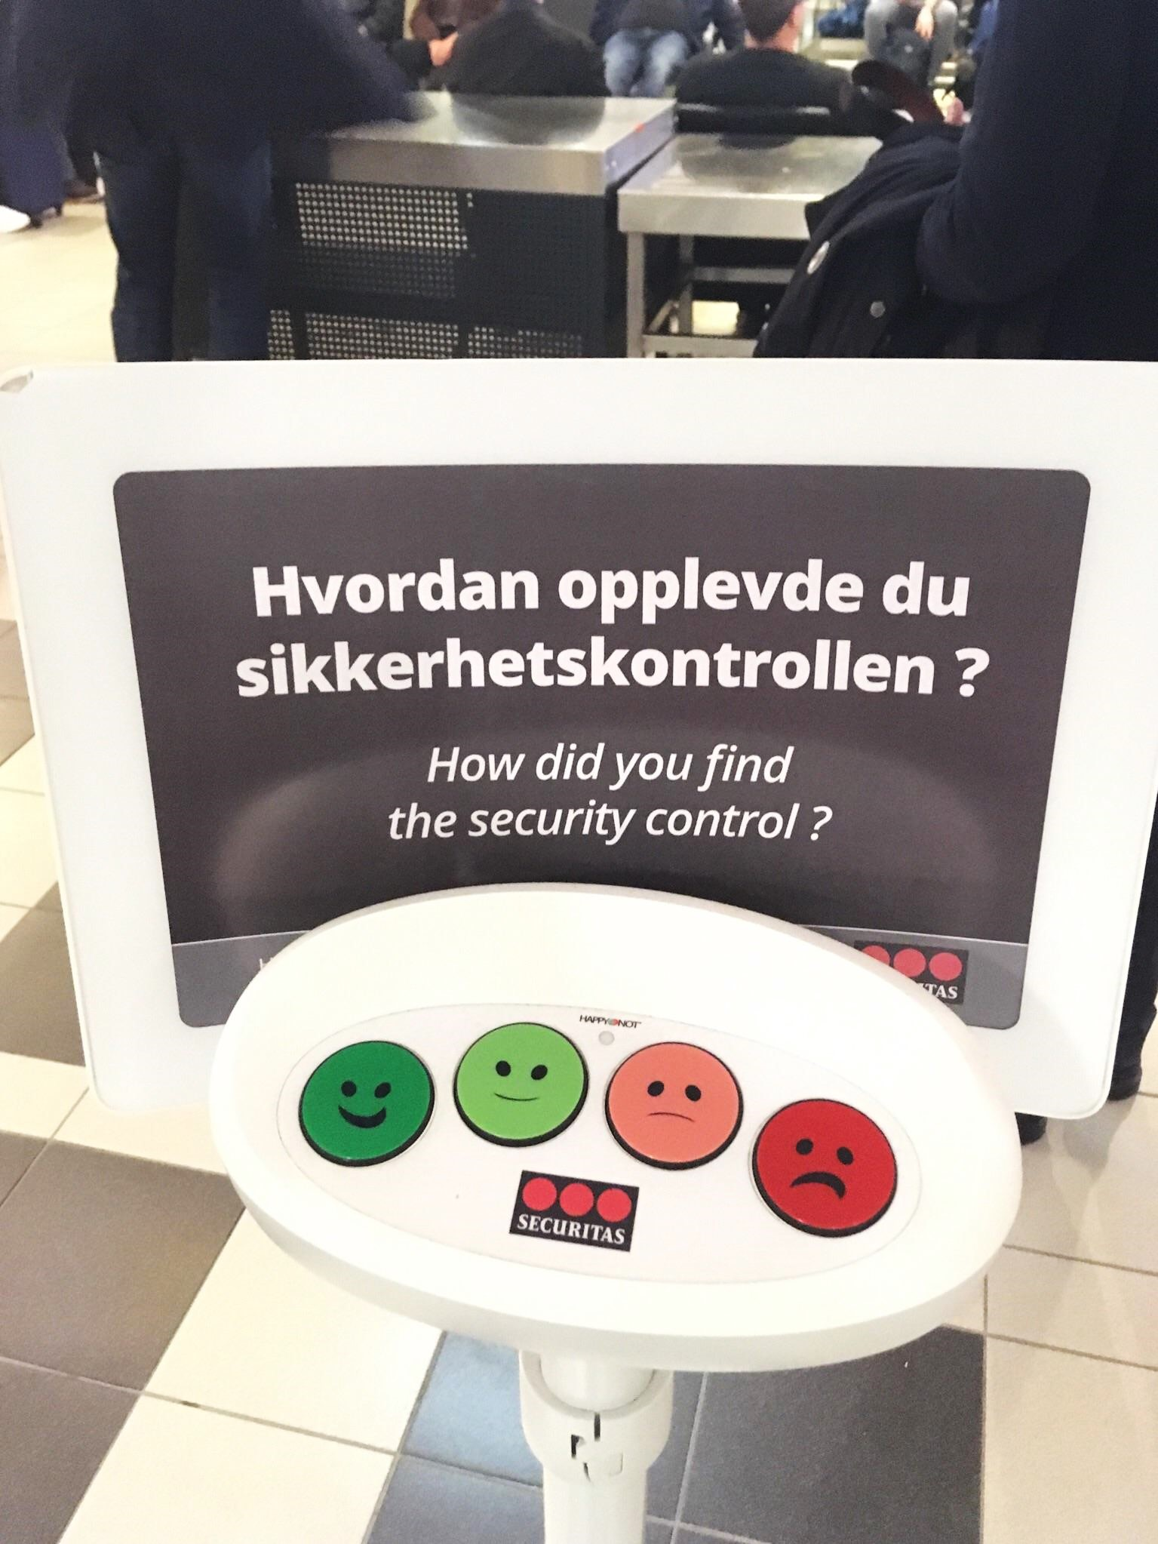
How should we define loyalty in Academia?
I argued in my Khrono article that academic loyalty is pledged to society first, and to the institution second. These two pledges should not be viewed as mutally exclusive. If our university leadership shares a commitment to society, we should be able to debate the nature, structure, and content of that commitment together, in a democratic manner.
I believe that most good leaders do share an abstract commitment to the good of society; but this commitment, which academics see as fundamental, is increasingly strained by competing financial commitments.
Competing interests are a normal feature of democratic societies. However, leadership models that elevate one interest above others, while systematically disenfranchising competing perspectives (actively and passively), can only be described as anti-democratic.
In democratic societies, loyalty is a two-way street built on a foundation of mutual trust. One cannot require undying support from a group to whom undying support is not given. It would be better to avoid using the word loyalty, when what one really means is compliance.
Survey ‘Democracy’: feedback does not equate to co-determination.

