Slide 1
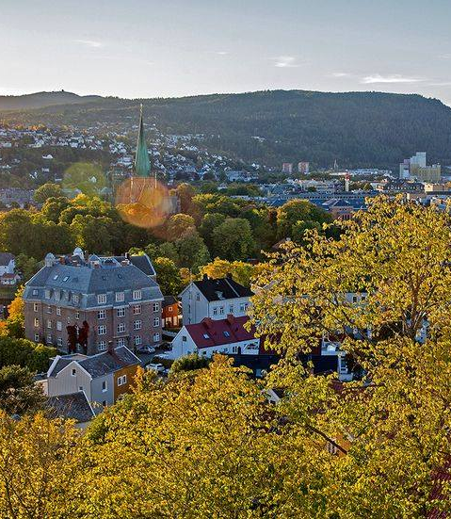
BUILDING TOGETHER UNIVERSITY COMMUNITY RESILIENCE
Roxanna Morote,
Associate Professor in Community Psychology
Resilience Centre NTNU
https://www.ntnu.edu/psychology/resilience-centre
Ann-Elen Leithaug
Research assistant
Department of Psychology

Slide 2
Project description
This is an interdisciplinary, multiple-case research project which investigates the organizational sustainability of the NTNU Campus of the Future in terms of systemic resilience.
A premise of the unification of NTNU Campus of the Future is that the assembly of the diverse units of the university, will “promote interaction, and a culture of sharing spaces with others”*
In this project :
  A sustainable university relies on its resources and capacity to respond as a community to internal or external challenges.
  Working hypothesis:
  When/if Universities are experienced as a community, the resilience of the university as a community is the existence, and engagement of community systems and resources to thrive in contexts of change and uncertainty; and that is an indicator of university’s social sustainability (Magis, K 2010), social capital, and economic development (Norris, FH, 2010).
* PRINSIPPLAN FORNTNU CAMPUS. NTNU Campussamling. Versjon 0.1 2019; Fremtidens campus: Utlysning av midler – en ny organisasjon i nye bygg?

Slide 3
Project description
Objective:
Exploration, operationalization, and testing of five collective resilience systems acting together to foster well-being in educational settings (Morote, et al 2020).
Research questions:
What is university community resilience?
Which practices, values, and policies develop the university’s resilience in contexts of adversity or change?
Can university community resilience be operationalized and evaluated?
Can university’s collective resilience predict individual, group, organizational, and social positive outcomes in the members of the university community?
Quality of the Relationships
Sense of belonging
Diversity and inclusion
Meaningful participation
Mental health awareness
Morote R, Anyan F, …. Hjemdal O., & On behalf of UPRIGHT (2020) Development and validation of the theory-driven School Resilience Scale for Adults: preliminary results. Children and Youth Services Review 119. Elsevier. DOI: https://doi.org/10.1016/j.childyouth.2020.105589

Slide 4
Research design
Mixed methods (sequential) – Ql, Qt, participatory
Model development ad instrument testing
Qualitative Phase
Quantitative Phase
Conceptualization
Case 1: University policy analysis
Case 3: University → Community Intervention. U. Brighton -UK
Case 2: NTNU Students
Organization - Workshops
Survey Study
3-4 Norwegian Universities

Slide 5
Case 1: University policy analysis
Five international universities that define the university as a community and implement actions to build resilience with diverse actors, within and outside the university campuses.
  Secondary sources of information:
    policy documents,
    resources for students and instructors,
    dissemination of actions,
    blogs.
Reflexive thematic analysis
(Braun &Clark, 2013 )
Deductive (five dimensions model)
– inductive process
University of Washington
Penn State University
University of California Irvine
University of Virginia
Maastricht University

Slide 6
RESULTS
The university as a community
Thematic synthesis:
The university exists in concrete and virtual spaces, serves individuals, and fulfills goals in society (e.g., learning, research, innovation, sustainability), but the university is experienced as a community when its members acknowledge it as a safe and inclusive environment that nurtures their individual and collective growth and wellbeing and supports their meaningful contribution to society.
…. is “a dynamic entity that develops and is continually re-created through social interaction … in which collective actions are directed purposively to the creation and maintenance of the social system of which they are a part” (Penn U., 2016).

Slide 7
What is University Community Resilience?
Resilience against what?
Who is involved in building university community resilience?
What are the main challenges in the future of the University?

Slide 8
University Community Resilience
Resilience against what?
Individualistic values in society, in education, and in wellbeing
  “… society today is increasingly less civically engaged, with fewer shared interactions, more divergent values, a lessening of community bonds, and a loss of social belongingness” (Penn U.).
  The university should “… encourage curiosity and identify opportunities for students to support each other rather than put down or compete against each other” (U. Washington).
Reproduction of social systems of exclusion and oppression within the university campus
  “Most of us were socialized into dominant cultural norms and values that privilege some identities and cultural practices above others. We are all impacted by this socialization and by systems of power” (U. Washington) that are reproduced in the university, in classrooms, and in relationships as microaggressions, exclusion, and harm.

Slide 9

University Community Resilience
Each member of the community has a role to play in building resilience and a healthier future: “academic units, colleges, administrative structures, service providers, and, of course, students and teachers” (U. Penn), “postdoctoral fellows, and graduate students” (U. Washington).
The university as a community is defined in a close connection with the extended society that serves and whose characteristics incorporates as part of its identity.
  The extended community engages in social or environmental justice actions with students, teachers, or researchers. Although they have learning or research purposes, their core is “fostering community-driven and equity-focused solutions” and involvement (U. California Irvine).
Who is involved in building university community resilience?

Slide 10

University Community Resilience
Social Justice
“We work from a shared understanding that the problems of climate change, racism and all social injustice, economic inequality, and our challenged democracy are connected, and so are the solutions” (U. California Irvine).
Uncertainty and change
“…we have to take the steps that prepare us for the challenges that our global way of living still has in store for us” (Maastricht U.).
Pandemic and response to disasters
“The events of 2020 underscore the importance of building resilience as a community” (U. Washington).
“ …address the Covid-19 pandemic as a stress test to see if our local, regional and global networks are functioning” (Maastricht U.).
Digitalization and hybrid education
“Our hope is that together, we can utilize our interdisciplinary expertise to harness dynamic, equitable remote learning and research experiences for all our students” (U. Washington).
What are the main challenges in the future of the University?

Slide 11
What builds university resilience?
Quality of the Relationships
Sense of belonging
Diversity and inclusion
Meaningful participation
Mental health awareness

Slide 12
Diversity and Inclusion:
Inequality, stereotypes, and bias are “in the air we breathe. They are part of our societal fabric” we all “have to become culturally aware and self-aware in order to make our campus community more inclusive and just” (U. Washington)
Diversity & inclusion
Sense of belonging
Quality of the Relationships
Meaningful participation
Mental health awareness
“To build a sense of belonging takes active effort and practice. Rather than focusing on the ways that you are different … look for ways you are similar and celebrate your differences” (U. Virginia).
“Wellness and well-being practices are about grounding and fortification in ourselves and our relationships. They can sustain us as we pursue policy and systems change” (U. Washington)
“Community implies the presence of people who share and participate in a field of social interaction …. … This awareness is developed by creating linkages among groups that otherwise would not interact… interest groups” (Penn U.)
Meaningful participation both on and off campus through initiatives that “are driven by teams that come together for meaningful exchange, education, research, and action for social transformation” (U. California) Irvine).

Slide 13

Case 2: NTNU Students Organization - ROBUST
and the Campus of the Future
ROBUST
  New NTNU organization of students with disabilities (2023).
  Ambassador Intervention for Students with Disabilities in Higher Education (2020 - 2022)
  Participatory Action Research Process conducted in the Faculty of Medicine and Health Sciences, Department of Neuromedicine and Movement Science (PhD. Anita Blakstad Bjørnerås).
  Co-creation – empowerment – commitment to actions – inclusion.
Invited to “Building Together” to reflect about their organization (SwD): in in the context of
  CAMPUS OF THE FUTURE
  “Building Together a Sustainable University Community” (Resilience theory)
Bjørnerås, A. B., Langørgen, E., Witsø, A. E., Kvam, L., Leithaug, A. E., & Horghagen, S. (2023). Aiming for inclusion: processes taking place in co-creation involving students with disabilities in higher education. International Journal of Inclusive Education, 1-17. https://doi.org/10.1080/13603116.2023.2230198

Slide 14
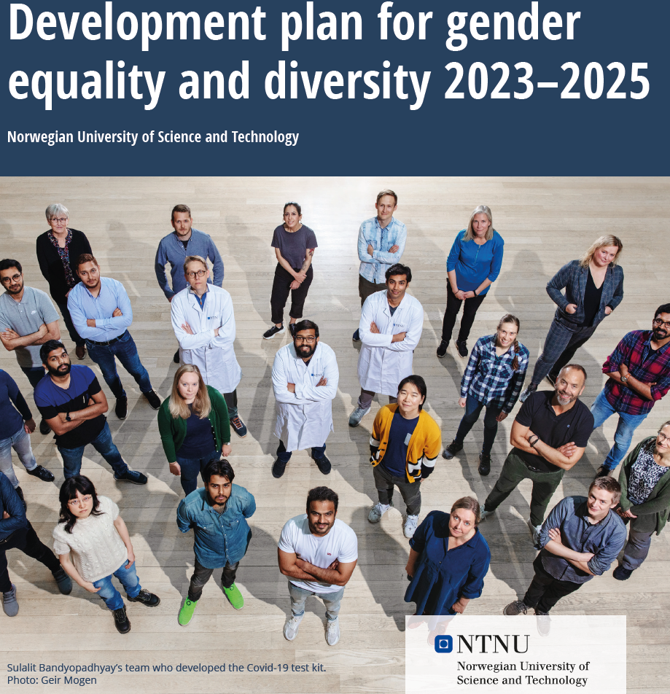
Method:
Two workshops – 5 participants – Diverse health and mental health conditions.
  Researcher/participant.
  Analysis and proposals:
  (1) NTNU Equality and Diversity Policy document
  (2) University Resilience model.
Development plan for gender equality and diversity 2023–2025

Slide 15
RESULTS
Development plan for gender equality and diversity 2023–2025
5 dimensions of collective resilience
NTNU policy document .
  Students with disabilities are not included in the process of making the policies.
    They say they are not being represented in the policy document.
  They feel that document developers don’t know and cannot show and respond to the experience of students with disabilities.
    For instance, experiences of limited mobility, lack of social interaction, effort and challenges in education, lack of flexibility in procedures and education, the need to ask for help/support constantly, etc.
Five relevant resilience factors, but stands out that the NTNU needs to work on inclusion
  If not included, students with disabilities cannot relate positively, feel belonging, participate meaningfully, and
  the lack of inclusion has negative consequences in their daily lives, education, and mental wellbeing.
How could things get better? Campus of the Future ►

Slide 16
How could things get better?
Responsibility
Shared responsibility, but NTNU should acknowledge power relations.
The University is in the capacity to respond to the needs of students with disabilities.
Inclusive communication strategy (not as a “separated topic”)
Physical environment
Politics and values of the university, with short- and long-term actions.
In teaching and evaluation practices (for instance, professors do not understand the importance of having materials in advance for students with learning disabilities).
Willingness
To respond to constant changes and challenges.
To respond to complaints or requests of support (for instance, students' complaint about the use of the handicap parking lot to storage the snow – no response, no action)
Opportunity - CAMPUS OF THE FUTURE
Students with disabilities are hopeful, “this could be a new beginning”, it is an opportunity that NTNU must take.
The best moment to do changes, to include their vison, because “something new is happening”.
This project has given an opportunity.
Awareness -At all the levels of university policies and communication
Students wan to be called in the design of the new campus.
Work with a community-based approach (participatory, co-creation).

Slide 17
To conclude …
University community resilience.
Organizational sustainability of new Campus of the Future.
Inter-transdisciplinary work: psychology, pedagogy, health, management and organizational sciences.
The identification of collective protective systems in the university setting is a first step to strengthen…
the human, social, and organizational resources of the NTNU.
the connection of the NTNU with the extended local community and the global world (research, innovation, and education).
The Campus Unification is an opportunity for Building Together a Sustainable University Community in terms of systemic resilience.
Students should be included as co-creators of new educational environments and organizational processes.
the university community in times of change and uncertainty.

Slide 18
BUILDING TOGETHER UNIVERSITY COMMUNITY RESILIENCE
Roxanna Morote,
Associate Professor in Community Psychology
Resilience Centre NTNU
https://www.ntnu.edu/psychology/resilience-centre
Ann-Elen Leithaug
Research assistant
Department of Psychology

