Slide 1
Livslångt lärande @ KTH
Anders Johansson

Slide 2
Livslångt lärande
Uppdrags-utbildning
Vidare-utbildning
Informellt lärande
Juridisk person köper utbildning för anställda
Andra utbildningsaktiviteter som bidrar till individers lärande
Anslagsfinansierad utbildning för fysiska personer

Slide 3
Lifelong learning (VP2021)
2.3.2 Lifelong learning: Increased resources
Lifelong learning at KTH refers to appropriation funded continuous education and commissioned education.
Of KTH's education volume, 20 percent shall be within the field of lifelong learning from 2023. To achieve this goal, KTH needs to adapt both core activities and support activities in terms of administration, pedagogical development and resource allocation. In order for the goal to be achieved, the university administration (GVS) needs to work together with the schools’ administrations. The educational offer within lifelong learning must, in the same way as in the above two assignments, focus on the future learning environments and educational models and must to a large extent be offered digitally.
Impact through collaboration
Notes:
Appropriation funded continuous education = anslagsfinansierad vidareutbildning (antagning.se)
Commissioned education = uppdragsutbildning

Slide 4
From approximately 1% 2019 to 20% 2023
Most of our current models, formats and offerings doesn’t scale very well
Much education at KTH and other universities is traditionally conducted almost in terms of craftsmanship
New thinking required to reach goals
Adaptation to target groups
Sustainable model of operation (internal)
New formats and new ways of thinking, structuring and organizing education as a whole!

Slide 5
Livslångt lärande
Uppdrags-utbildning
Vidare-utbildning
Informellt lärande
Juridisk person köper utbildning för anställda
Andra utbildningsaktiviteter som bidrar till individers lärande
Anslagsfinansierad utbildning för fysiska personer

Slide 6
Where do we learn? (1990:ies)
10%
20%
70%
Formal e.g. courses
Social
Cost
Volume
Periodicals
Explorative
Handbooks
Reports
Proceedings

Slide 7
Where do we learn? (2020:ies)
<5%
~20% ?
70+%
Formal, e.g. courses bought by employer
Social
Cost
Online communities
Volume
Online periodicals
Explorative
Handbooks
LinkedIn
University online courses
MOOCs
Podcasts
YouTube
Proceedings
Amazon
Reports
Google

Slide 8
Positioning (2020:ies)
Less active focus on commissioned education
Moving into social, informal learning domain with e.g. Community of practice as a service
<5%
~20% ?
70+%
Formal, e.g. courses bought by employer
Focus on open, appropriations funded flexible digital courses
Social
Marketing
Online communities
Online periodicals
Explorative
Handbooks
LinkedIn
University online courses
MOOCs
Podcasts
YouTube
Proceedings
Amazon
Reports
Google

Slide 9
What has changed?
Before pandemic
During pandemic
Ten:ish appropriations funded continous education courses
Approx 500 applicants
~200 admitted
~20 did anything measurable
~120 appropriations funded continous education courses (spring 2021)
Approx 4.500 applicants
…of which 500 each on three courses (ethical hacking etc, designed for online), 100 admitted on each course
Analysis to verify attractive and successfull content and formats now
Targets and try outs (sort of agile)
Target 10.000+ admitted to and active in attractive, flexible, short online courses (1,5 – 4 hp), appropriations funded, sustainable business model
Hybrid participation in program courses or activities as part of modularised design
Easier access for professional course participants (e.g. e-ID instead of KTH-ID)
New business model for informal/social learning, attractive to faculty and partners

Slide 10
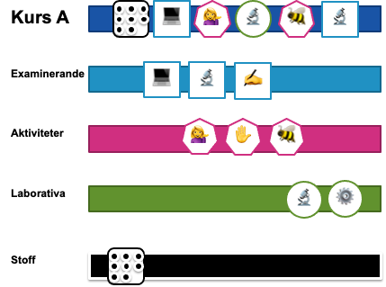
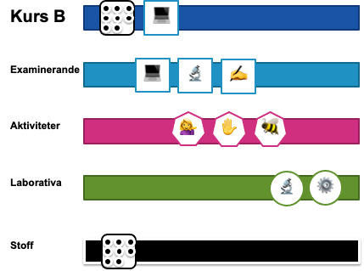
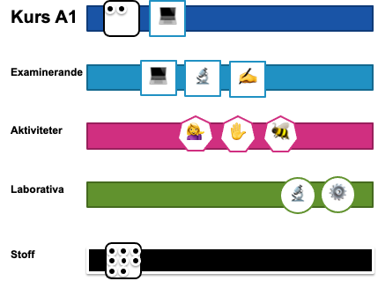
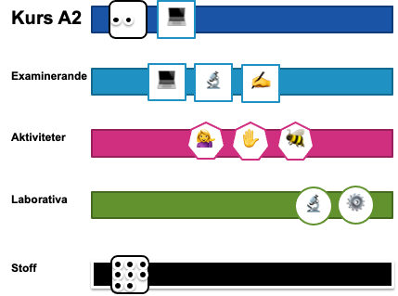

Slide 11
En individorienterad och mer flexibel struktur för ett livslångt och kontinuerligt lärande
60hp 1-årig påbyggn.MSc
Kompletterande kurser
120hp
CivIng
Kompletterande kurser
180hp
Hing
2-årig utbildning på avancerad nivå
MSc
3-årig utbildning på grundnivå inom teknikområde
BSc
Från gymnasiet
Möjlighet att ta ut examen
Påbyggnadskurser (baserade på programkurser?)
KTHs erbjudande inom individens livslånga lärande

