Slide 1

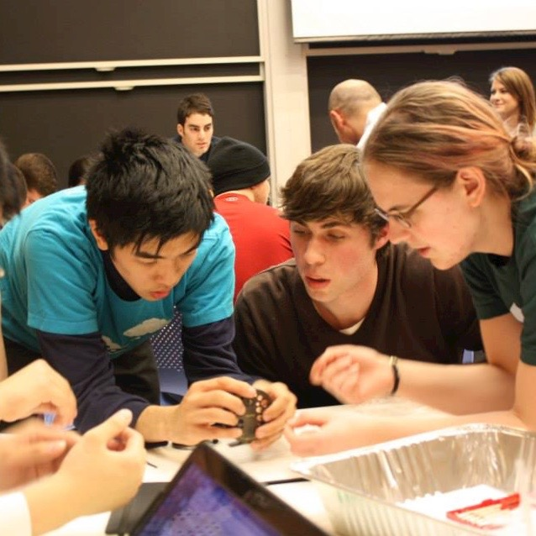

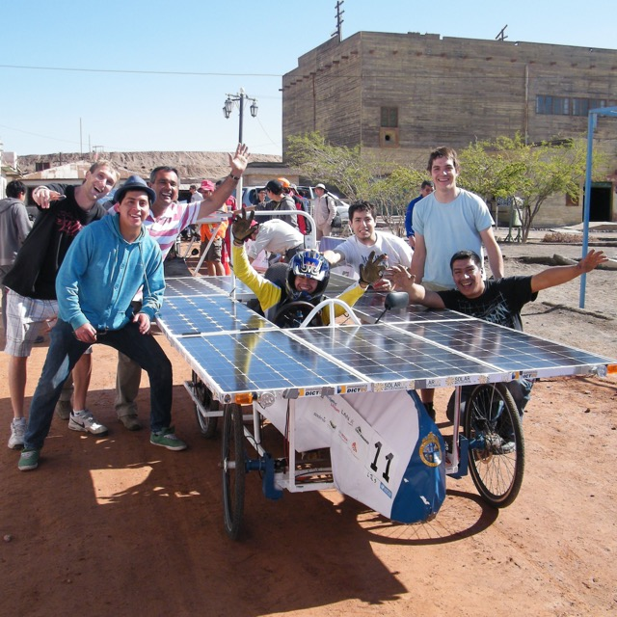
Global state of the art in engineering education:
status, future and impact of COVID-19
14th June 2021
Dr Ruth Graham
Notes:
Update logo

Slide 2
Outline of presentation
1. Who are the current and emerging leaders in engineering education?
2. What distinguishes the emerging leaders?
3. What are the challenges and opportunities facing the sector?
4. What has been the impact of COVID-19 emergency teaching?

Slide 3
Who are the current and emerging leaders in engineering education?
1

Slide 4
The global state of the art in engineering education
Commissioned by MIT
Published March 2018
Notes:
18 month study that drew on interviews with over 180 experts and practitioners in higher education

Slide 5



NEET Program (New Engineering Education Transformation)
Massachusetts Institute of Technology
MENS ET MANUS
hand and mind
Notes:
Looking for best practice to inform NEET

Slide 6
After many decades of discussion within the engineering education community, the report highlighted groundswell for change…
“the study feedback suggested that the engineering education sector is entering a period of rapid and fundamental change”
Notes:
18 month study that drew on interviews with over 180 experts and practitioners in higher education

Slide 7
The 10 institutions most frequently identified as current leaders in engineering undergraduate education
  1
  Olin College (US)
  6
  UCL (UK)
  2
  MIT (US)
  7
  Purdue Uni (US)
  3
  Stanford Uni (US)
  8
  NUS (Singapore)
  4
  Aalborg Uni (Denmark)
  9
  Uni of Cambridge (UK)
  5
  TU Delft (Netherlands)
  10
  Chalmers Uni (Sweden)
Notes:
Same as the list I complied at Imperial almost 15 years ago…

Slide 8
The 10 institutions most frequently identified as emerging leaders in engineering undergraduate education
  1
  SUTD (Singapore)
  6
  NUS (Singapore)
  2
  Olin College (US)
  7
  TU Delft (Netherlands)
  3
  UCL (UK)
  8
  Charles Sturt (Australia)
  4
  PUC (Chile)
  9
  Tsinghua (China)
  5
  Iron Range (US)
  10
  Arizona State (US)
Notes:
I’ll be coming back to geographical spread
Answer question – why SUTD came top??

Slide 9
What distinguishes the program design of the emerging leaders?
2

Slide 10
Distinguishing programmatic features of the emerging leaders
CURRENT LEADERS
Largely US and Europe based
EMERGING LEADERS
Global spread of institutions

Slide 11
The locations of current and emerging leaders:
Notes:
Patterning of 250 recommendations. – more than 80% in Europe or n america
Tilting of the axis of engineering education leadership

Slide 12
Distinguishing programmatic features of the emerging leaders
CURRENT LEADERS
Largely US and Europe based
Non-traditional practice confined to ‘pockets’ with course often taught in isolation
EMERGING LEADERS
Global spread of institutions
Systemic/unified approach with connectivity across the curriculum

Slide 13
The 10 institutions most frequently identified as emerging leaders in engineering undergraduate education
  1
  SUTD (Singapore)
  6
  NUS (Singapore)
  2
  Olin College (US)
  7
  TU Delft (Netherlands)
  3
  UCL (UK)
  8
  Charles Sturt (Australia)
  4
  PUC (Chile)
  9
  Tsinghua (China)
  5
  Iron Range (US)
  10
  Arizona State (US)
Notes:
I’ll be coming back to geographical spread
Answer question – why SUTD came top??

Slide 14
The 10 institutions most frequently identified as emerging leaders in engineering undergraduate education
  1
  SUTD (Singapore)
  2
  Olin College (US)
  3
  UCL (UK)
  8
  Charles Sturt (Australia)
  4
  PUC (Chile)
  5
  Iron Range (US)
  10
  Arizona State (US)
Notes:
I’ll be coming back to geographical spread
Answer question – why SUTD came top??

Slide 15

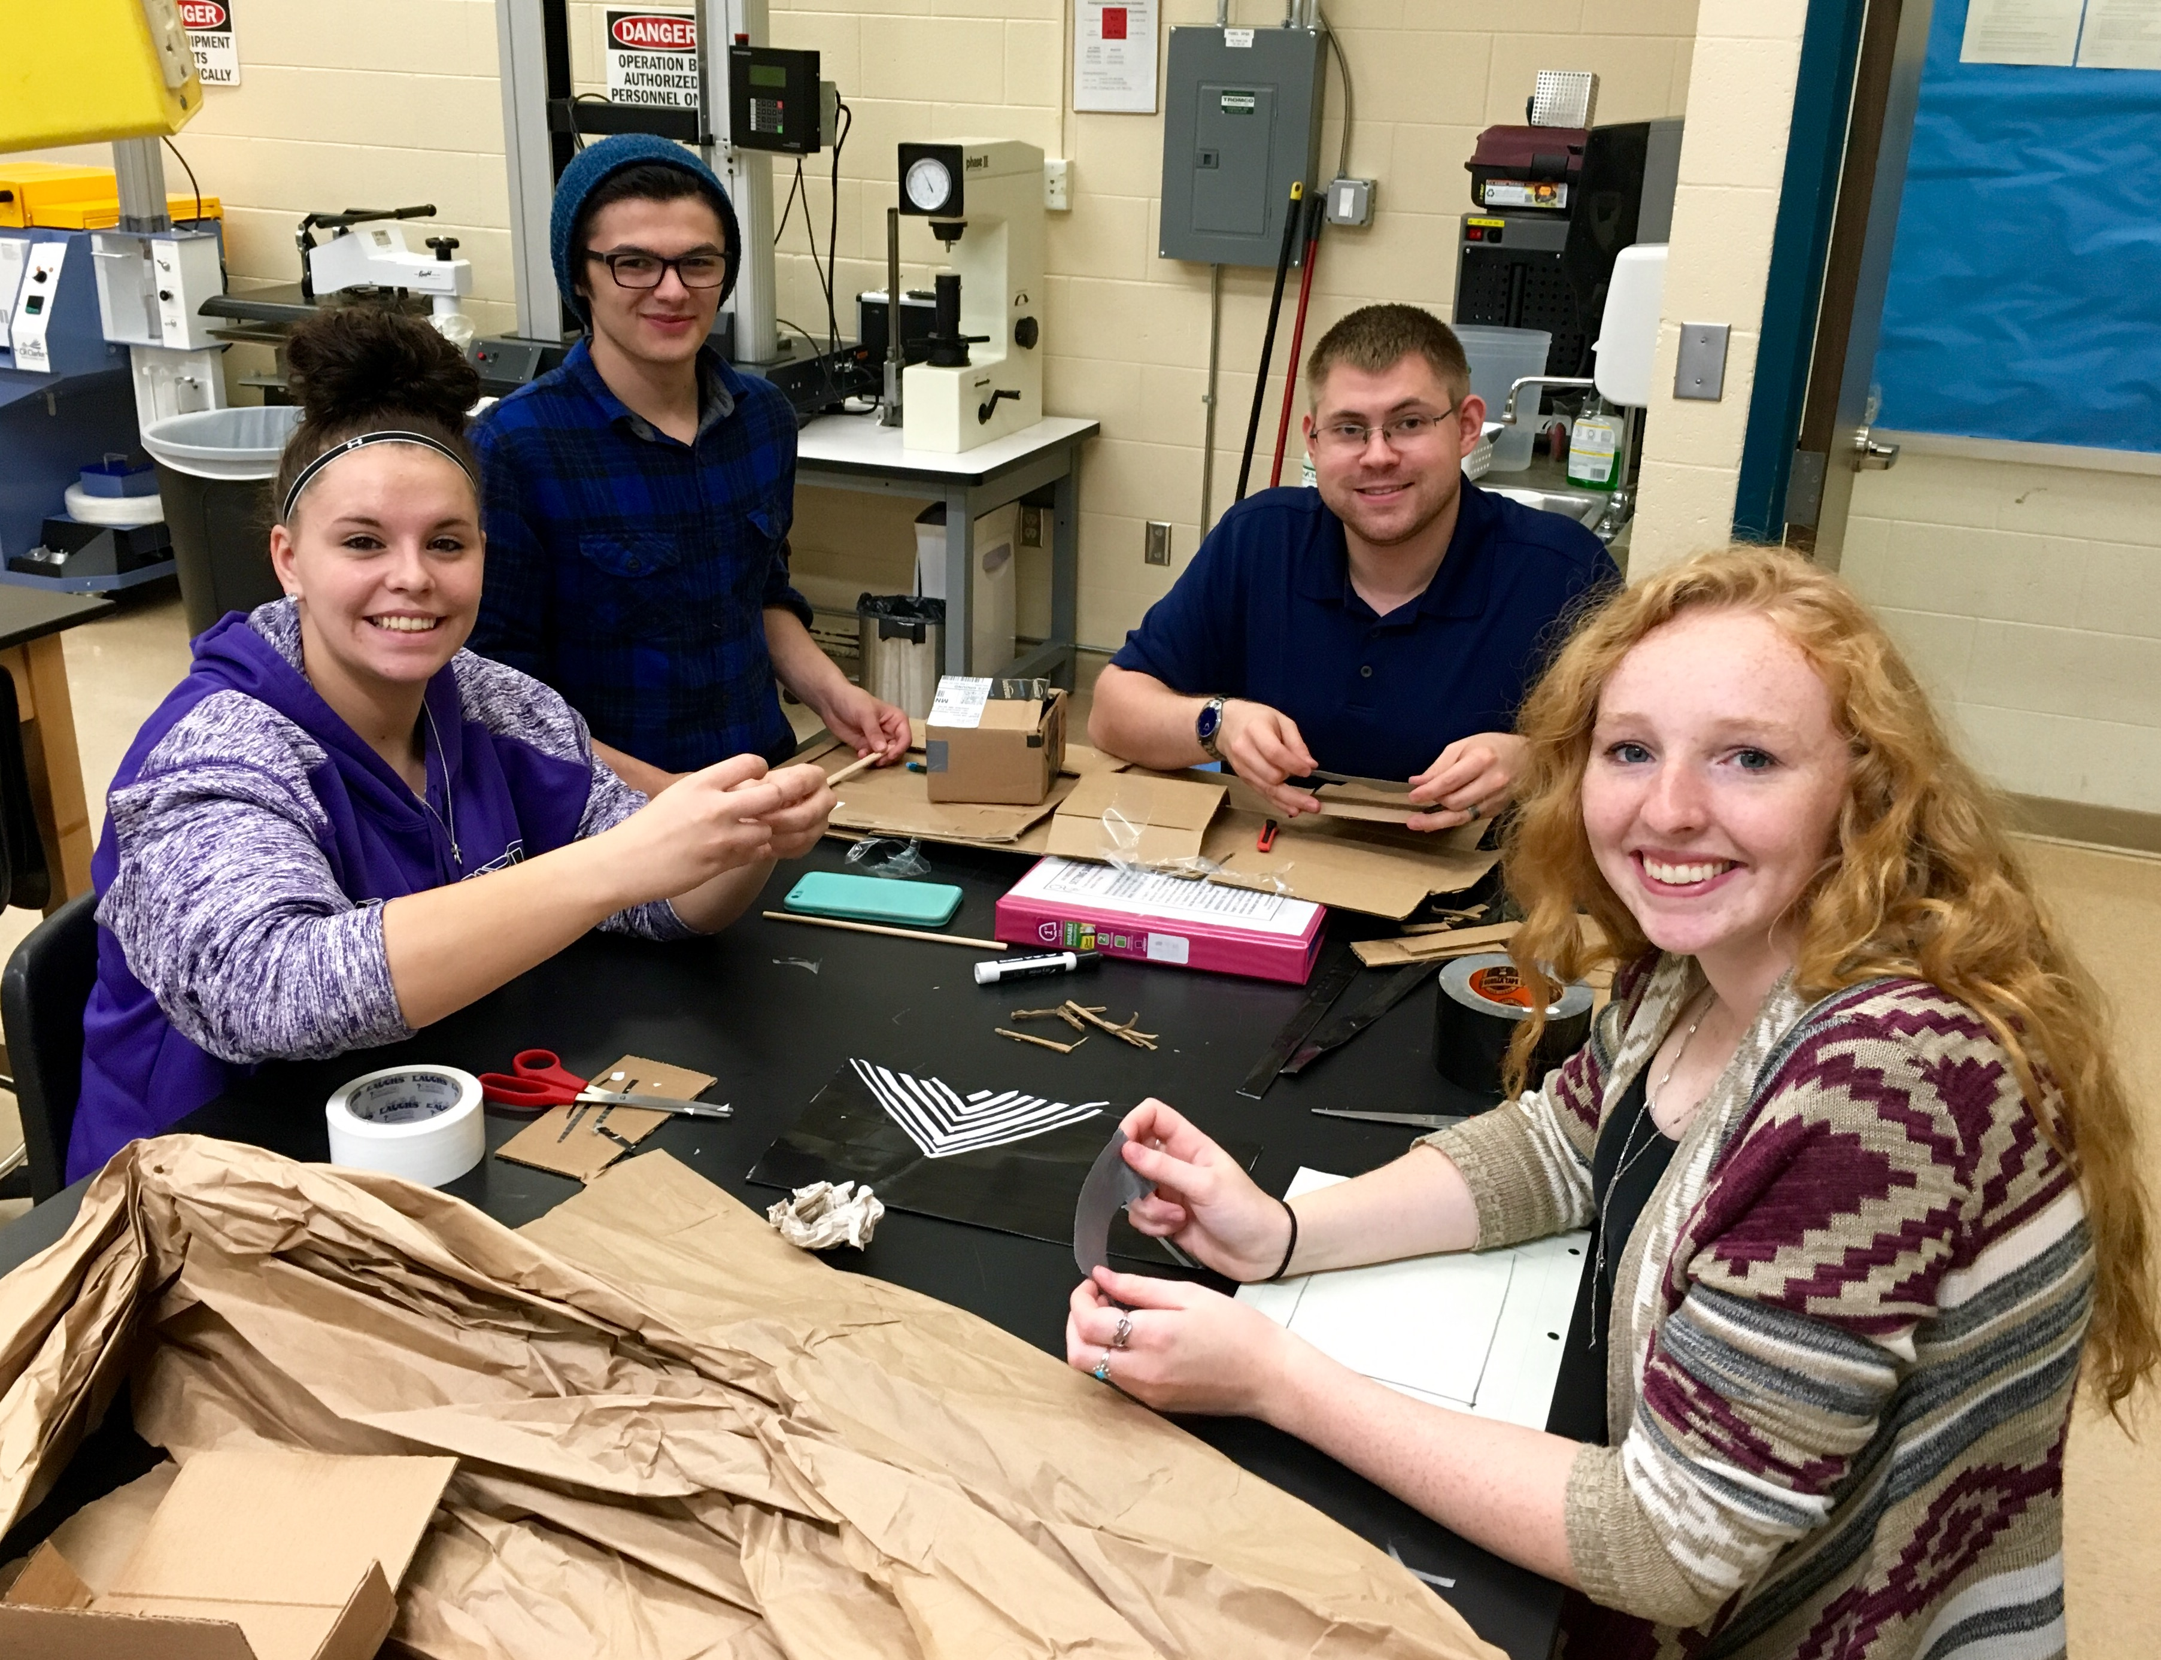
Systemic/unified approach – Iron Range Engineering (US)
IRE (US)

Slide 16
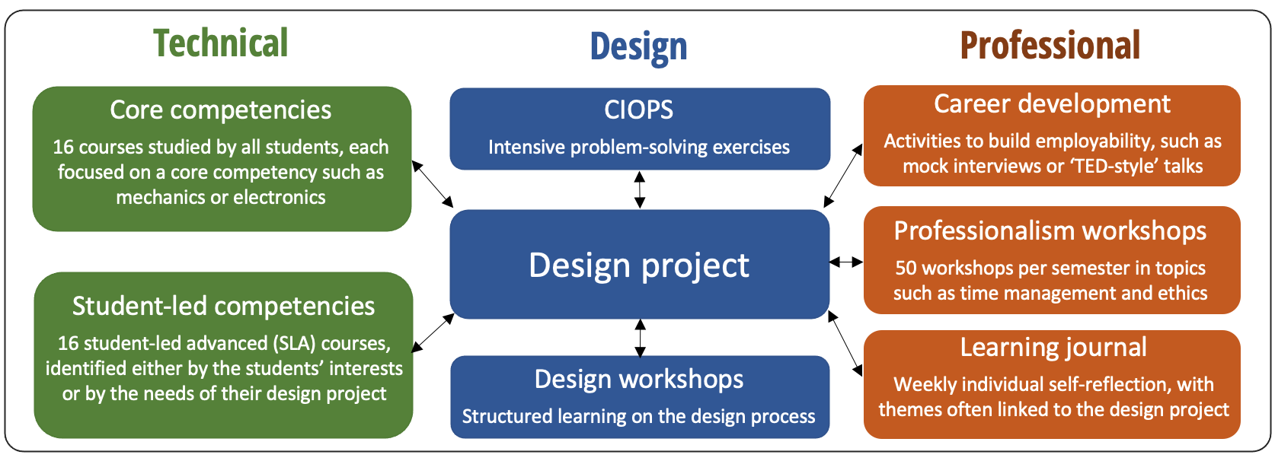
IRE curriculum structure

Slide 17
Distinguishing programmatic features of the emerging leaders
CURRENT LEADERS
Largely US and Europe based
Non-traditional practice confined to ‘pockets’ with course often taught in isolation
Teacher-centred approach with limited external connectivity
EMERGING LEADERS
Global spread of institutions
Systemic/unified approach with connectivity across the curriculum
Culture of student empowerment and cross-community collaboration
Notes:
Difficult to get right – difficult to fake. Immediately apparent on campus
Transformation from students waiting to be taught – to taking control of their own education

Slide 18
Distinguishing programmatic features of the emerging leaders
CURRENT LEADERS
Largely US and Europe based
Non-traditional practice confined to ‘pockets’ with course often taught in isolation
Teacher-centred approach with limited external connectivity
Development shaped by variety of drivers, with much of curriculum unchanged for decades
EMERGING LEADERS
Global spread of institutions
Systemic/unified approach with connectivity across the curriculum
Culture of student empowerment and cross-community collaboration
Development is typically shaped by regional needs or priorities, enabling a more visionary approach
Notes:
Difficult to get right – difficult to fake. Immediately apparent on campus
Transformation from students waiting to be taught – to taking control of their own education

Slide 19
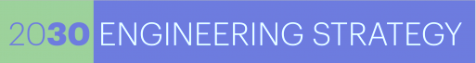
Investment by the Chilean Ministry for Finance
Established in 2014, the Chilean government’s National Agency for Innovation and Development (CORFO) launch Engineering 2030.
Aiming to drive economic growth through technology innovation, the initiative targets Chilean engineering schools as an incubator for this talent. Over $200m (US) has already been invested, must of which is focused on educational reform.

Slide 20
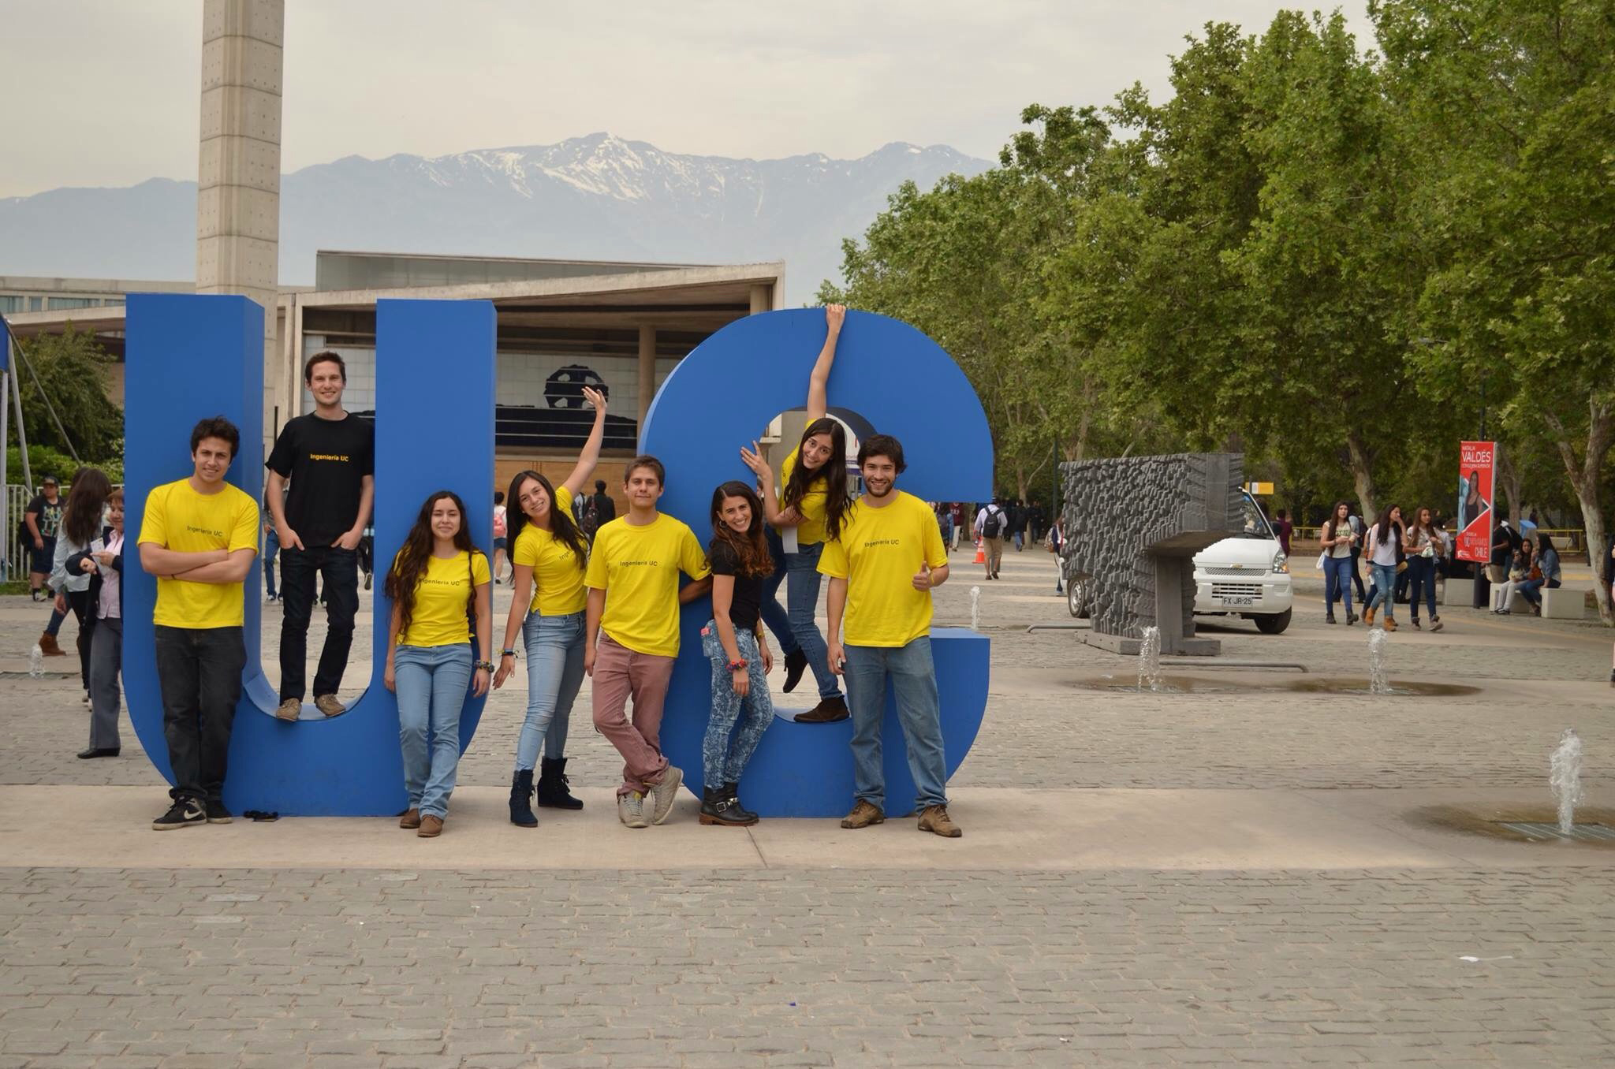
Case study – PUC (Chile)
UC (CL)

Slide 21
Hallmarks of future leaders:
Student choice and flexibility
Multi-disciplinary learning
The role, responsibilities and ethics of engineers in society
Global outlook and experiences
Experiential open-ended problem solving that is rooted in real industrial and societal challenges
Development of skills and mindsets: critical thinking, adaptability, team-working, creativity, innovation and entrepreneurship
Notes:
EMERGING CHALLENGES

Slide 22
What are the challenges and opportunities facing the sector?
2

Slide 23
Challenges and opportunities to institutional change:
  Adapting to larger and more diverse student cohorts
  the ability of large publicly-funded institutions to deliver student-centered, active learning at scale
  Disciplinary and educational siloes
  the discipline/department-based structure of many engineering schools and universities was seen to inhibit collaboration and cross-disciplinary learning
  Reward and recognition of teaching in higher education
  supporting a world class education when institutional reward systems primarily incentivize research achievements
Notes:
R&R is a big issue, but university management has now caught on
Most significant issues – across countries and institutional contexts. Always highlighted in studies. Imperial

Slide 24
What will be the impact of COVID-19 emergency teaching on engineering education?
3

Slide 25

Collaborative Engineering
Education in the Digital Age
Launched September 2020
Supported by university consortium (including NTNU)
Notes:
Clear that the he sector is at a turning point.
Increasingly seeing changes to u/g education in universities across the world

Slide 26
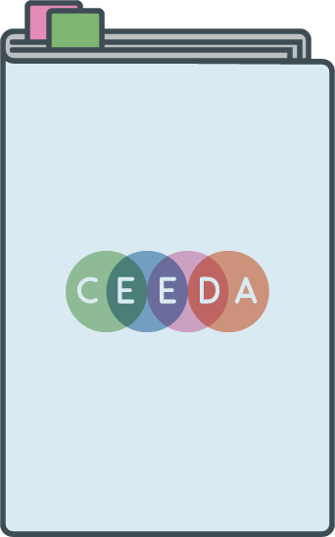

Summary of study. Two project outputs, both open-source:
report charting the lessons learnt from the current period of ‘emergency teaching’ due to the COVID-19 pandemic, and how this experience might impact the trajectory of engineering education in the future.
website showcasing examples of best practice in engineering collaborative and/or project-based learning that are delivered partially or fully online during this period of ‘emergency teaching’ taken from the leaders identified in the MIT 2018 report.
Notes:
Report: drawing on 40-50 one-to-one thought leaders from across the world
Website: drawing on interviews with stakeholders. Including videos on each

Slide 27
Early outcomes
Notes:
Clear that the he sector is at a turning point.
Increasingly seeing changes to u/g education in universities across the world

Slide 28
Anticipated future directions for engineering education:
Blended learning: adoption of educational technology
Campus learning spaces: from lecture theatres to project/community spaces
Collaborative teaching teams: greater innovation, prominence of UGTAs
Shared teaching resources: using the best materials globally
Sustainability: more explicit focus on sustainability and climate change
Global and inter-connected projects: bringing together students and external partners from across the world
Broadening of student learning outcomes: resilience, flexibility and identity
Notes:
EMERGING CHALLENGES

Slide 29

Example 1 – Aalborg University (Denmark)
Aalborg University (Denmark)

Slide 30
Example 1 – Aalborg University (Denmark)
Mega-projects
Building in complexity – technical, societal and inter-disciplinary – as students progress.
Nurturing flexibility, problem-solving and collaborative thinking.
PBL competencies
Nurturing and tracking progressive learning outcomes.
Aalborg University (Denmark)

Slide 31
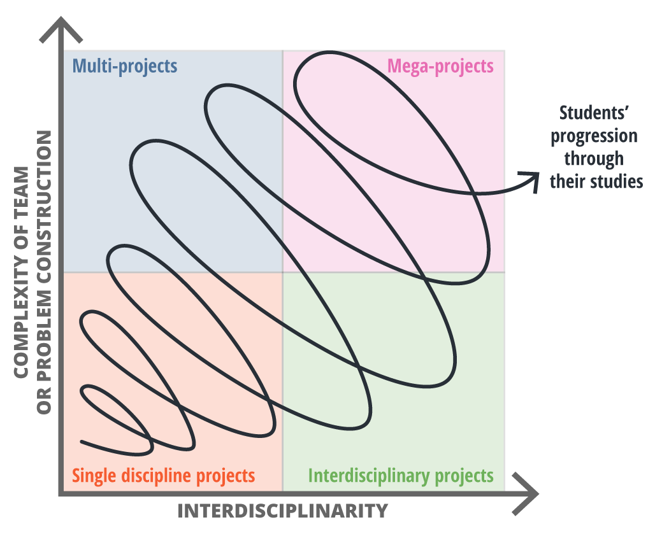
Example 1 – Aalborg University (Denmark)

Slide 32
Challenges facing online collaborative learning:
Student social isolation, anxiety and mental health
Establishing community, connectivity and peer-learning in online delivery
Engaging with and motivating students with web-cams off
Assessing student learning online
Faculty exhaustion and stress from constant ‘state of emergency’
Offering ‘equal’ experiences to all, regardless of internet connectivity
Delivering effective learning while student work across time-zones

Slide 33
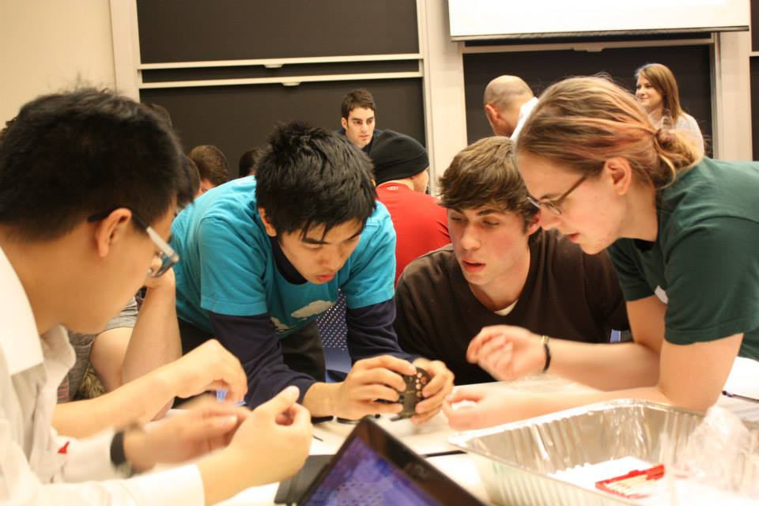
Example 2 – MIT (US)
MIT (US)

Slide 34
Example 3 – MIT (US)
System Design and Management Bootcamp
Fully online one-week program introduction for new students.
Developed by Teaching Assistants.
As well as introduction to the discipline, aims to develop peer-learning and network-building, and combat ‘imposter syndrome’.
Took inspiration from crowdfunding platforms.
MIT (US)

Slide 35
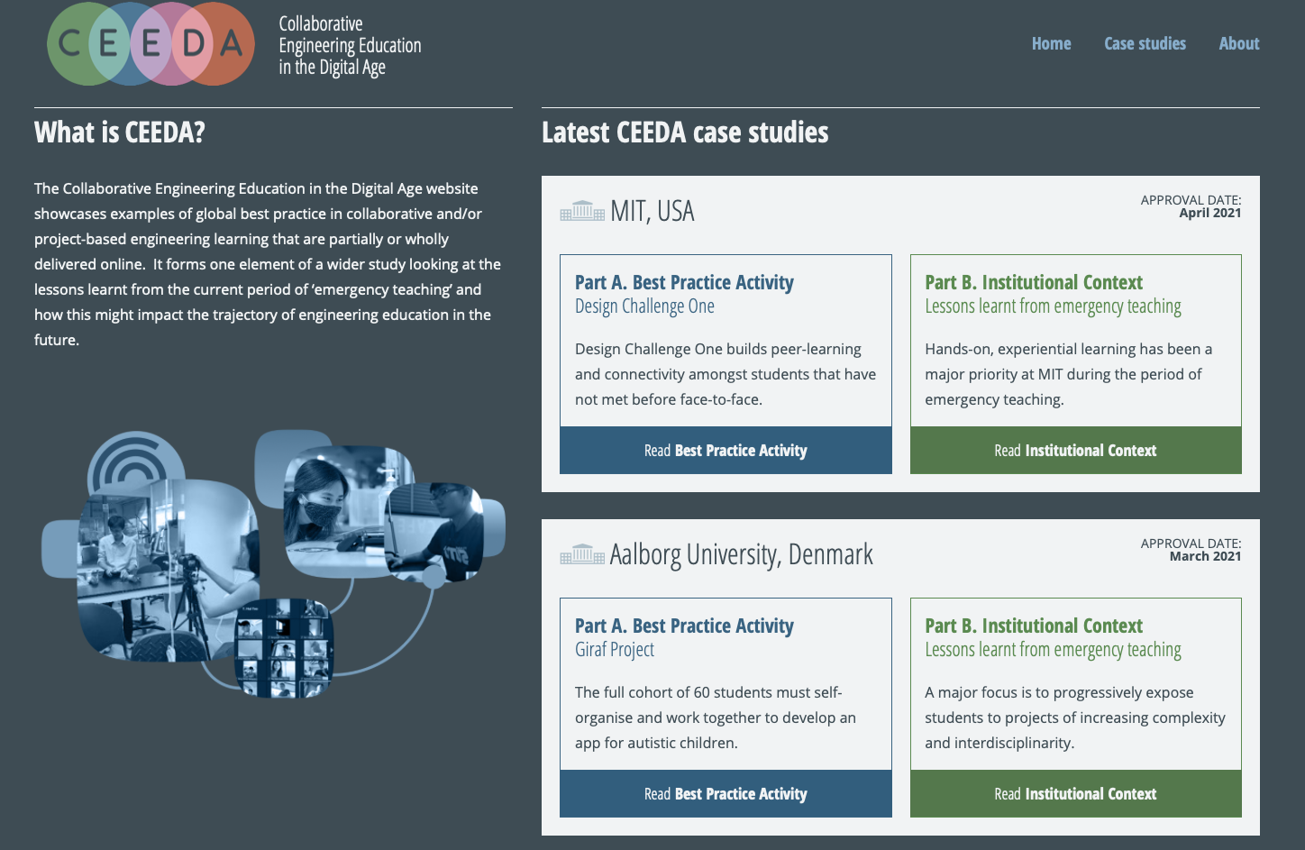
CEEDA website: launched in March 2021 www.ceeda.org

Slide 36
Thank you

