Slide 1
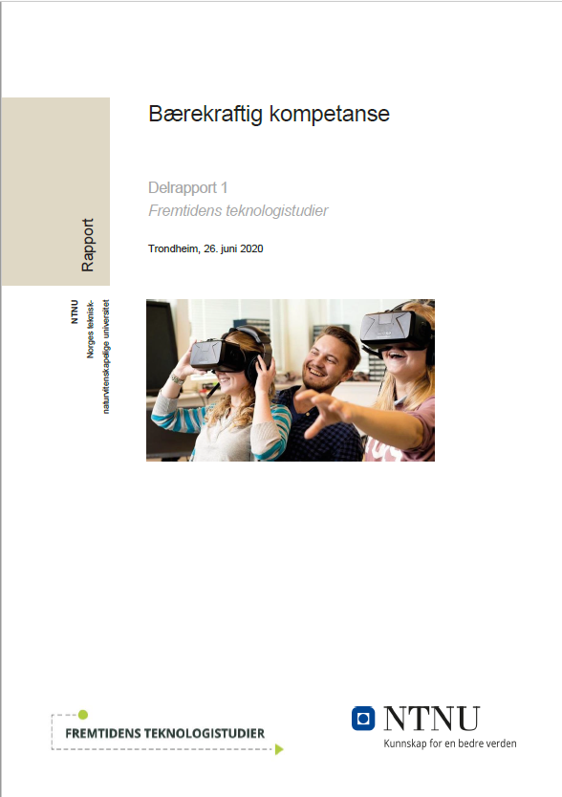
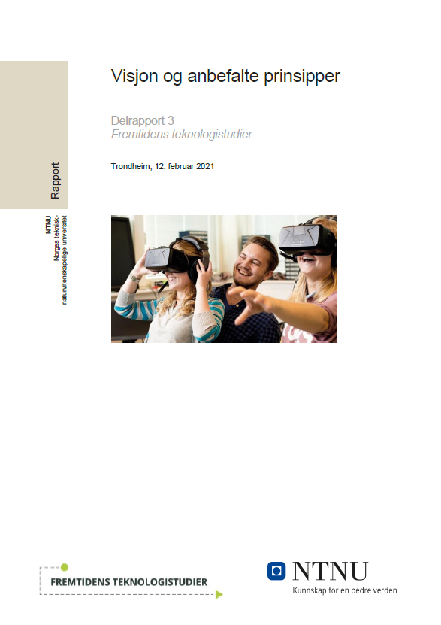
Technology Education of The Future (FTS): Status, current activities, plans ahead
Open FTS webinar,
June 14, 2021
Geir E. D. Øien, project manager FTS
www.ntnu.no/fremtidensteknologistudier

Slide 2
The FTS mandate: Project goals (2019 – 2021)
No. | Project goal
1 | SWOT analysis of current program portfolio in an international perspective
2 | Survey of national framework conditions and society’s expectations and needs
3 | Resource analysis of today’s education portfolio
4 | Proposal on competence profiles for future graduates
5 | Overarching principles to build future program portfolio upon
6 | Suitable instruments and tools – e.g., pedagogical, structural, organizational, technological - for implementing profiles and principles
7 | Consequences of proposed framework w.r.t. resource prioritization, learning environment, internal competence development +++
8 | Advice to NTNU about program portfolio dimensioning
9 | Sketch of future program portfolio and recommended common elements
10 | Recommended future structure for program portfolio governance and support
11 | Sketch of implementation process based on recommended framework
12 | Final report with summary of recommendations
DONE
IN
PROGRESS
REMOVED
IN
PROGRESS
FALL 2021

Slide 3
The FTS deliverables – so far
Sub-report 1 Sustainable competence (June 2020)
1
State-of-the-art survey and knowledge fundament
Proposals for candidates’ competence profiles
17 recommendations
Sub-report 2 Status (SWOT) analysis (February 2021)
2
Primarily on institutional, portfolio, and program type levels
Methodology described – for use in program/faculty/dept level analyses on a need-to-to basis
Sub-report 3 Vision and recommended principles (February 2021)
3
A vision and 10 overarching principles for future development - replacing the original 17 recommendations in Sub-report 1
Includes a «bank of ideas» related to each principle – a proposed starting point for further discussions pertaining to implementation
Open hearing on findings and recommendations

Slide 4
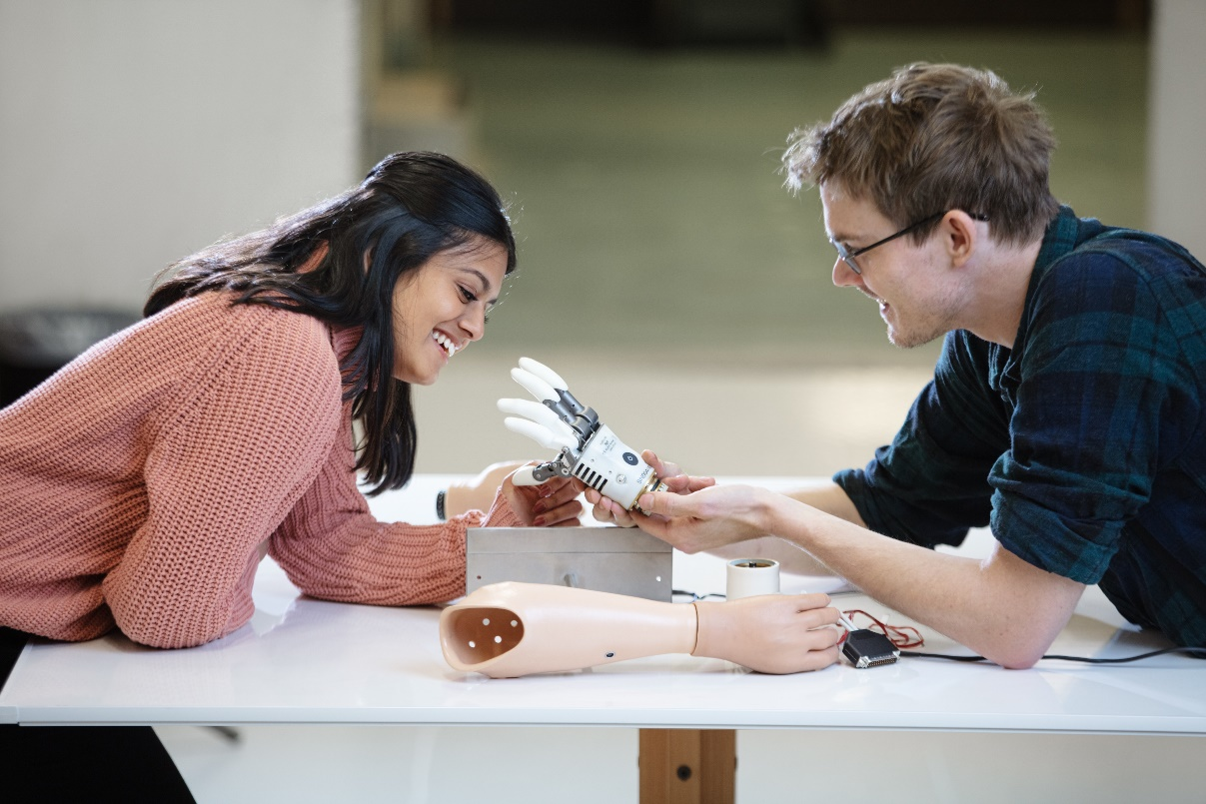
The FTS vision
NTNU's technology programs graduate
creative world-class candidates –
who are able and willing to contribute
to a better world and a sustainable future
Photo: © Kai Dragland

Slide 5
 | The 10 FTS principles (recommended guidelines for future development) | Quality area
I | NTNU's technology studies need to actively facilitate that graduates, based on a solid academic foundation, develop comprehensive and integrated competence, including sustainability competence and digital competence at a high level. | Graduate competence
II | NTNU needs to actively facilitate the technology study graduates’ development of solid interdisciplinary collaboration competence, and to support a diversity of knowledge profiles across the student population, while also ensuring that each individual student achieves sufficient program depth. | Graduate competence
III | Contextual learning is recommended as a general pedagogical principle in NTNU's technology studies. | Pedagogical learning environment
IV | NTNU's technology studies should use knowledge-based, student-active and engaging teaching and assessment forms –that are in line with the educations' overall competence goals, promote a good learning culture, and support effective in-depth learning. | Pedagogical learning environment
V | NTNU needs to set clear expectations for, and provide solid support for, competence development for teaching staff. | Pedagogical learning environment
VI | The quality of NTNU's technology studies is to be developed through a programme-driven approach, in combination with strategic portfolio development and management across programs and program types. | Program design and quality development
VII | NTNU's quality work in the technology studies needs to stimulate the study programs' development towards world-class educational quality, by focusing on continuous improvement and systematic development of quality culture. | Program design and quality development
VIII | NTNU should give high priority to international cooperation on development of technology education, with the aim of also becoming an internationally visible and recognized university in this area. | Collaboration and interaction
IX | NTNU's technology studies need to emphasize systematic interaction with worklife and society, with the aims of promoting work relevance, facilitating lifelong learning, and ensuring that students can gain relevant professional experience throughout their studies. | Collaboration and interaction
X | NTNU needs to develop its learning environment, and in particular its campus and infrastructure - both physical and digital - in a direction that supports FTS principles I – IX, and promotes learning, health and well-being among students and staff. | Physical, digital and psycho-social learning environment

Slide 6
«Compre-hensive and integrated» competence profile (example, bachelor engineering studies)
THE ‘ROOF’: Demonstrate ability to and responsibility for lifelong learning
Embedded across profile:
Sustainability competence
Digital competence
THE SOCIETAL FRAME: Demonstrate
Ability to communi-cate, dis-seminate, discuss
Ability to apply and reflect on ethics and sustainability norms and standards
THE PROFESSIONAL CORE: Demonstrate
ability to design and implement sustainable technical solutions
innovation ability, entrepreneurial thinking, and business understanding
ability to contribute to research and technical development
Skills at consequence analysis, scenario thinking and risk assessment
Determination, collaboration skills and leadership in diverse environments and teams
THE TOOLBOX: Demonstrate
ability to analyze complex problems and systems
ability to apply relevant practical methodologies and tools
ability to find and critically assess relevant information
THE KNOWLEDGE FUNDAMENT: Demonstrate strong knowledge in, and professional perspective based on,
The theoretical tools and disciplinary fundamentals of engineering
In-depth knowledge of own engineering specialization
Supplementary knowledge from other engineering fields
Complementary knowledge from other knowledge fields, giving a broader perspective on engineering and technology

Slide 7
How to implement the vision, principles, and competence profiles?
3 in-project tracks
+ development of
post-project implementation plan

Slide 8
Track 1: Pilot projects – trying out ideas in practice
Operative:
Statistics for engineers
MARTA – MAthematics as a tool foR Thought Assistance
SUPER – Student-active learning through wicked problems
Toolbox for integrating sustainability competence in integrated 5-year technology MSc programs
ELDIG – New bachelor program in Electrification and digitalization
AIS – New engineering program in Automation and intelligent systems
Revision project for program portfolio within mechanical engineering, production, and product development
Integration of sustainability competence and digital competence across program portfolio at The Faculty of Engineering Science
«Under construction»:
Integration of design-thinking competence modules in a technology master program
Cross-disciplinary «minors» on sustainability and digitalization (collaboration with FHS)
The Experts–in-a-Team (EiT) course as arena for fostering student ideas to promote development of NTNU’s future education portfolio (collaboration with FHS)
https://www.ntnu.no/fremtidensteknologistudier/piloter

Slide 9
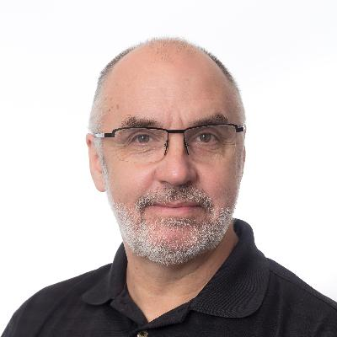
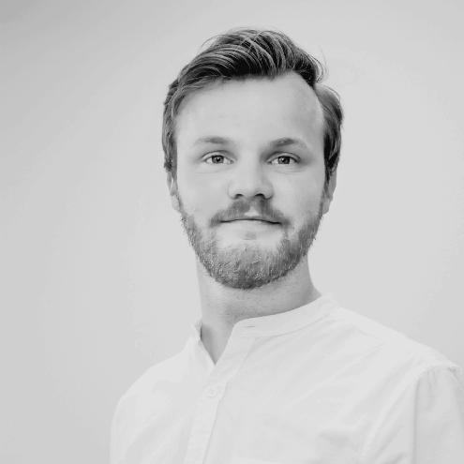
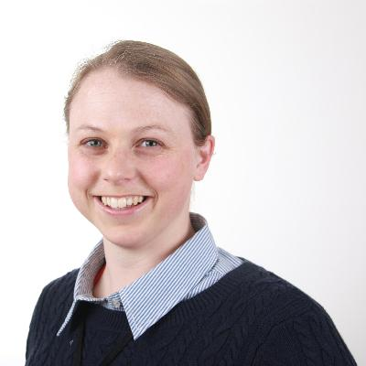
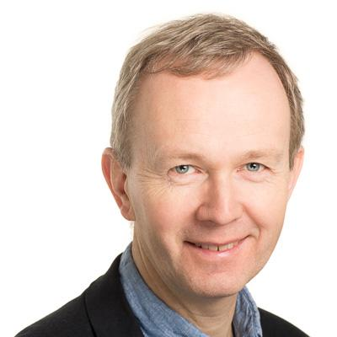
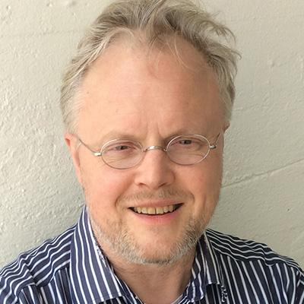
Track 2: Gap analyses, roadmaps, and proposed instruments for implementation
Group 1 – 4: SWOT analysis, gap analysis, and roadmaps for future development -
for four specific program types
Group 5: Practical consequences of, and recommended actions for, a more «programme-driven» approach to education development
Group 6: Menu of pedagogical instruments and tools recommended for realizing the FTS graduate competence profiles
Six working groups - faculty-appointed members
+ student members
(group leaders pictured)

Slide 10
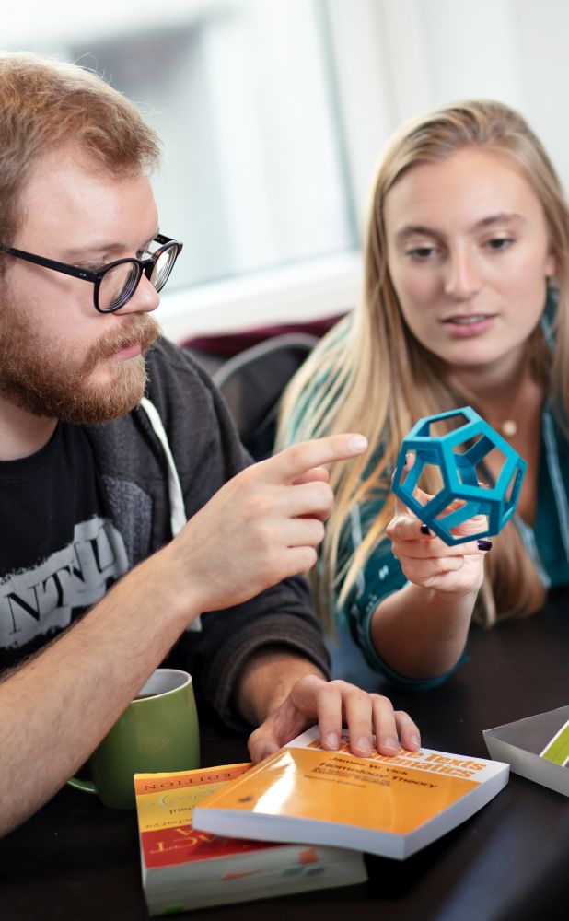
Track 3: Integration of FTS results into central NTNU processes
NTNU campus development: Principles for learning spaces and social hubs
NTNU plan for strengthened, unified educational competence development
NTNU plan for strengthened, unified teaching support
Photo: © Kai Dragland

Slide 11
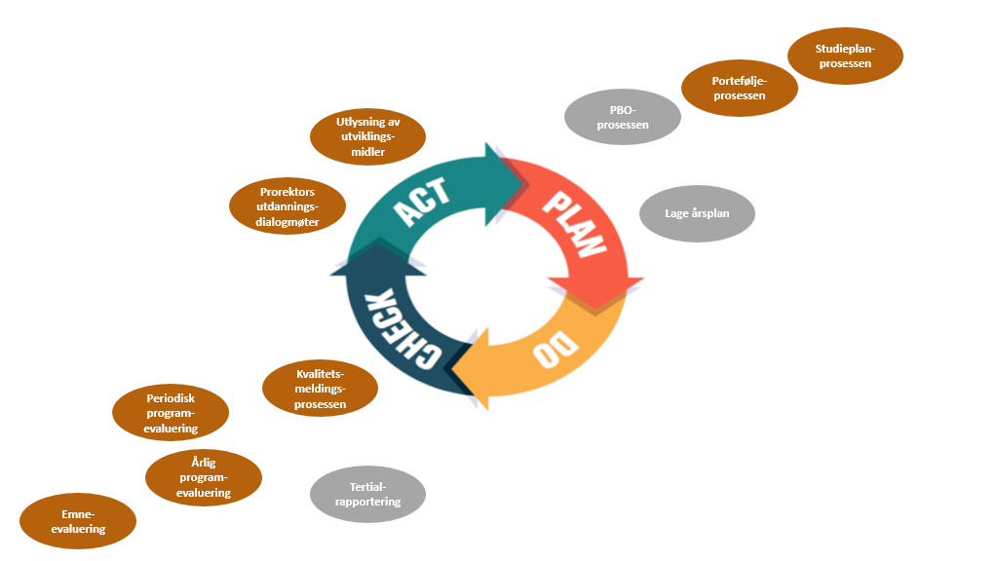
Track 3, cont’d: Ensuring FTS goals are well facilitated also by «regular» quality processes and fora

Slide 12
Other ongoing activities, spin-off results and contributions ...
Conference on work relevance in higher education 2021, Nov. 5
(with FHS + UniversityCity TRD 3.0 + Mid-Norway Chamber of Commerce and Industry)
NTNU think-tank
on lifelong learning
Webinars, workshops, «world cafés»,
internal and external dialogue meetings
Regular newsletters

Slide 13
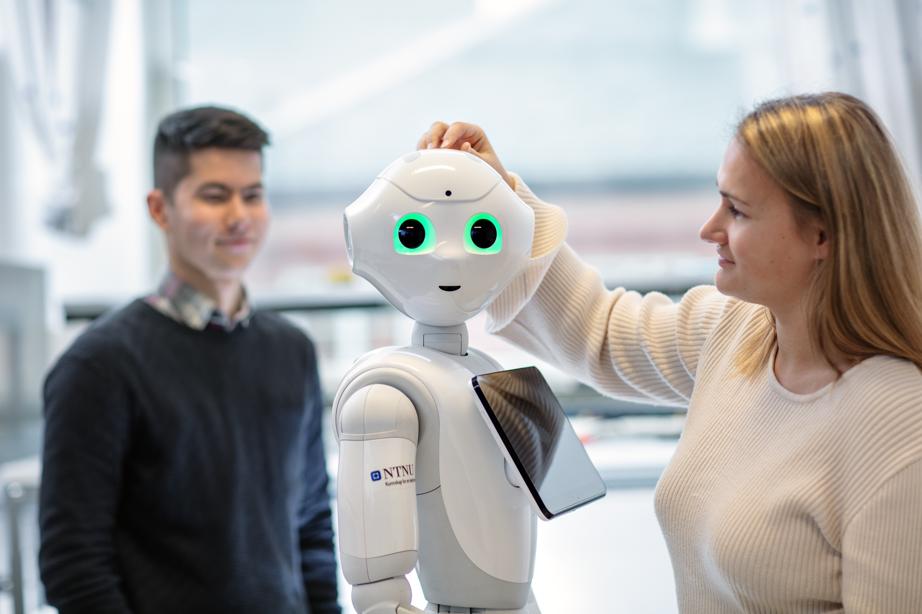
Some FTS events and milestones - Fall 2021
Open FTS (physical) seminar, Friday, September 10 – save the day!
Invited talks from international experts
Presentations of ongoing FTS-related activities from faculties, study programmes, pilot projects, working groups ...
Discussions and interviews on «hot and important topics» - with internal and external participants
Any other wishes/ideas/proposals? Send us an email asap ☺!
External stakeholder seminar with industry and the public sector, December 10
Presentation of almost-ready FTS recommendations, results, and plans for implementation at NTNU
Feedback from and interaction with external stakeholders on results and selected topics
Discussion of road ahead for further collaboration on NTNU’s future technology studies
Final FTS report (with proposal for post-project implementation plan) - ultimo December
Photo: © Kai Dragland

Slide 14
Thank you! Follow FTS (and sign up for newsletters!) at www.ntnu.no/fremtidensteknologistudier
Photo: © Kai Dragland

