Slide 1
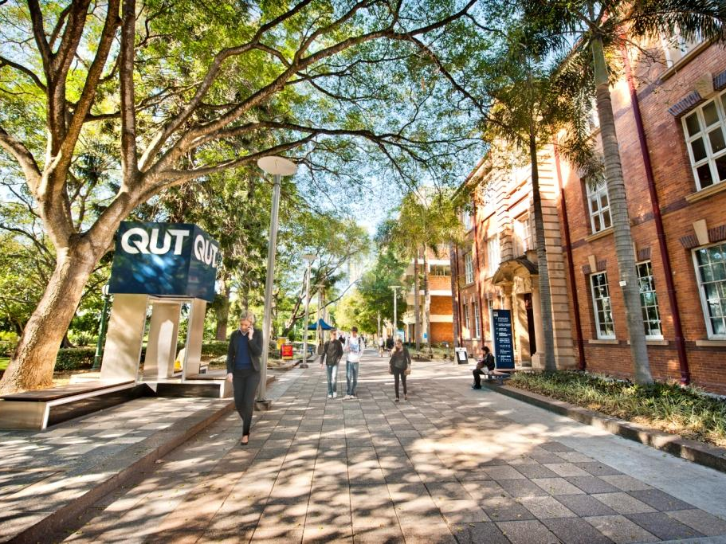

Queensland University of Technology

Slide 2
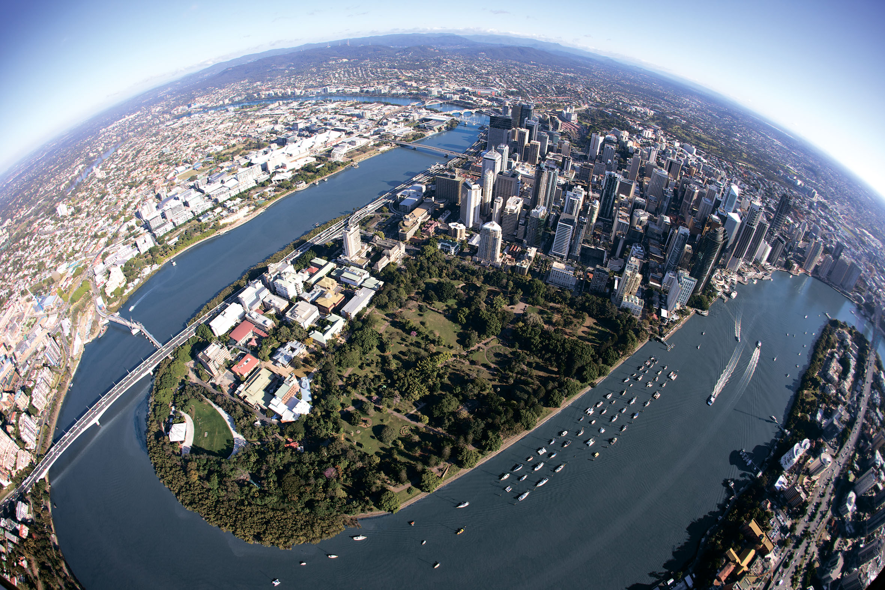

Kelvin Grove campus
Brisbane central business district
Gardens Point campus

Slide 3
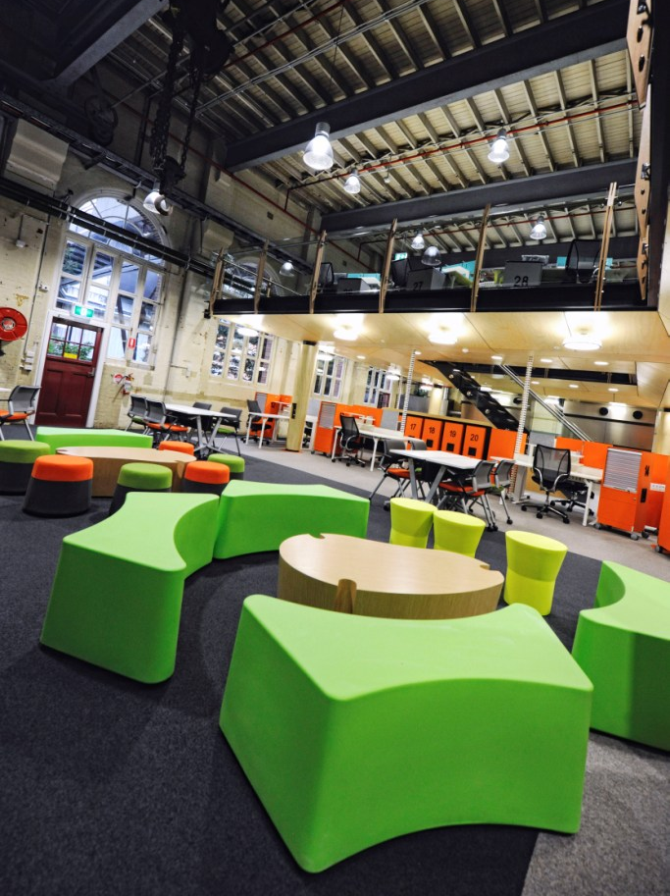
Gardens Point Campus
QUT Gardens Point is located next to the Brisbane River and
the Botanic Gardens in Brisbane’s Central Business District.
Facilities and services at Gardens point include:
library
computer labs
wireless internet zones
a cafeteria and cafes
the Student Guild bar
health services and student counseling
Gardens Theatre
Art Museum
Notes:
Additional notes:
Old Government House, recognised as one of Queensland’s most important heritage sites, is located at Gardens Point
campus. Pedestrian and cycle bridges link which links the campus to South Bank Parklands, Queensland Museum, the Performing Arts Complex, State Library of Queensland and the
Gallery of Modern Art.

Slide 4
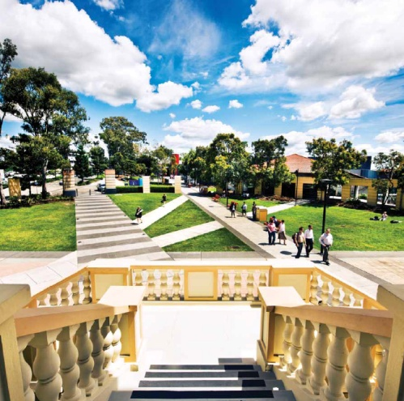
Kelvin Grove Campus
The Kelvin Grove campus is an award-winning urban development,
located only two kilometers north of the Brisbane city centre. Students
can easily walk to the city or University and benefit from purpose-built
student accommodation and a range of facilities within a convenient
village atmosphere.
Facilities and services include:
library
computer labs
wireless internet zones
a cafeteria, shopping and dining
health services and student counseling
fitness and aquatic centre
childcare
optometry, podiatry, and wound healing clinics
dance, drama, music and visual arts studios and
theatres

Slide 5
What QUT offers you
Only university in Queensland with two inner-city Brisbane campuses
A dedicated accommodation support team on both campuses
QUT has 40,000 students, including 6,800 international students from more than 100 countries
Connect with local students through QUT’s buddy program
Largest university career mentor scheme in Australia
Notes:
Additional notes;
40,000 students and nearly 6800 of these are international students from more than 100 countries.
QUT is a member of the Australian Technology Network (ATN)
Ranked in the world’s top 100 universities for employer reputation (QS World Universities 2011)
Fastest growing research university in Australia – in the past six years the University and its supporters have invested more than half a billion dollars in infrastructure
The first Business school in Australia to secure the prestigious ‘triple crown’ of international accreditation – US-based AACSB International, European-based EQUIS and UK-based Association of
MBAs (AMBA).

Slide 6
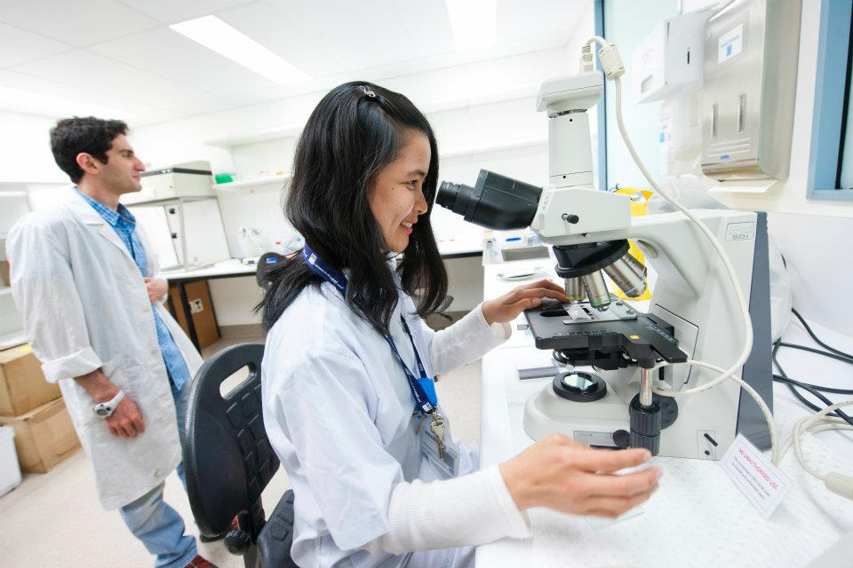
Research strengths
QUT has a ranking of world standard or above in more than 75% of
our research, as assessed under the Australian Government's
Excellence in Research for Australia (ERA) assessment
framework (2010).
Our top-performing research areas included:
Communication and Media
Physical Chemistry
Nursing
Information Systems
Education
Mathematics
Public and Allied Health
Applied Economics
Notes:
Additional Notes:
There are more than 100 current collaborative research projects presently being undertaken with partners like SAP, Shell, Microsoft, Oracle, the World Health Organisation and Infosys, in more than 50 countries.
QUT is ranked 9th nationally in Australia for research block grant government funding awarded based on research performance (2010).
Over the last 5 years, QUT’s research investment attraction has outperformed all other Australian universities

Slide 7
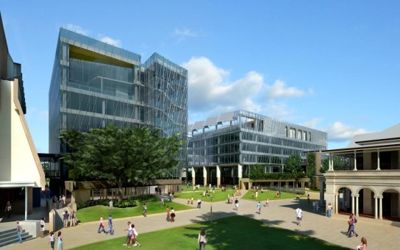
Science and Engineering Centre 2012
A new $230 million Science and Engineering is underway on the
Gardens Point campus which is due for completion in late 2012.
The Centre will be home to QUT’s newest research institute focusing on research themes around science, technology, engineering and maths (STEM) disciplines.
Features of the Centre include:
stimulating work spaces for high impact research
a multi-screen visualisation and simulation facility to interact with researchers,
assist teaching and connect with the wider community
exciting food and retail spaces
50-metre swimming pool and 1000 square
meter gymnasium.
The Centre will become one of the highest
rated ‘green’ buildings in the Brisbane
Central Business District.
Visit www.qut.edu.au/sci-eng-centre

Slide 8

Living in Brisbane
QUT is located in Brisbane, the state capital of Queensland.
With over 1.8 million people, Brisbane is a vibrant, multicultural city.
Brisbane is the third largest city in Australia and is also one of the fastest growing cities in Australia.
It is also the largest in area (1,140km²) of Australia’s six capital cities and third largest in the world.
Visit http://www.studybrisbane.com.au/
Notes:
An average of 16,000 people move to Brisbane every year.

Slide 9
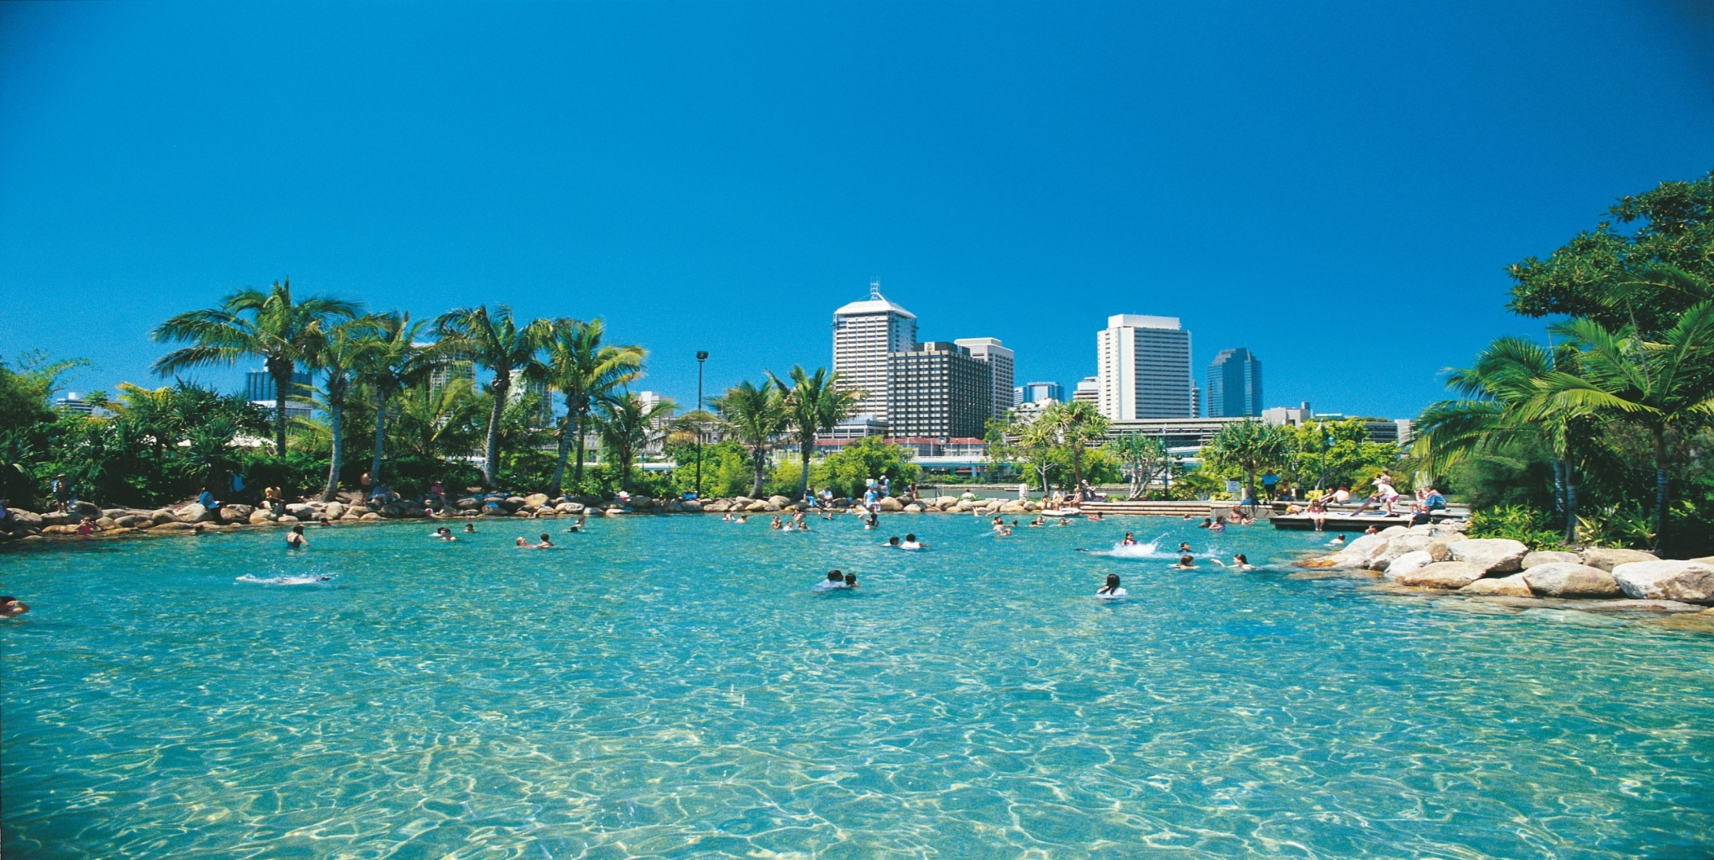
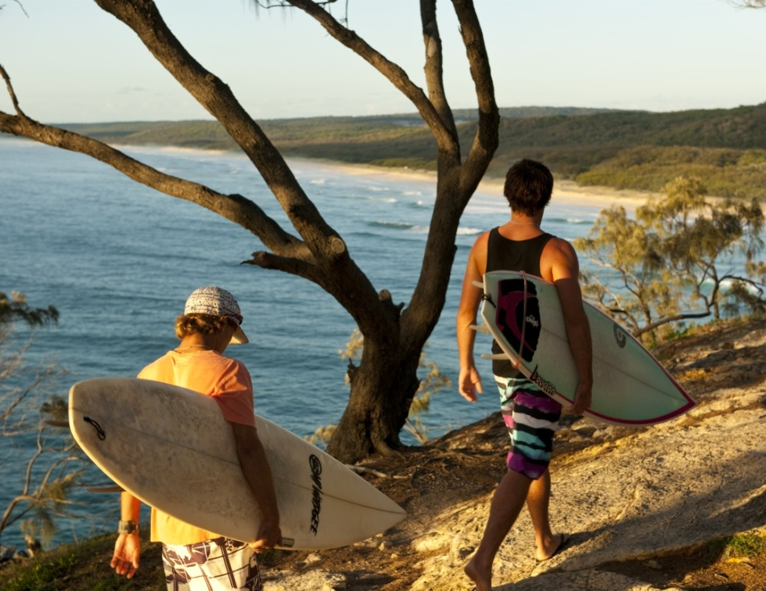
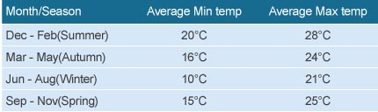
Notes:
Talk about the weather
Proximity to Gold and Sunshine Coasts

Slide 10
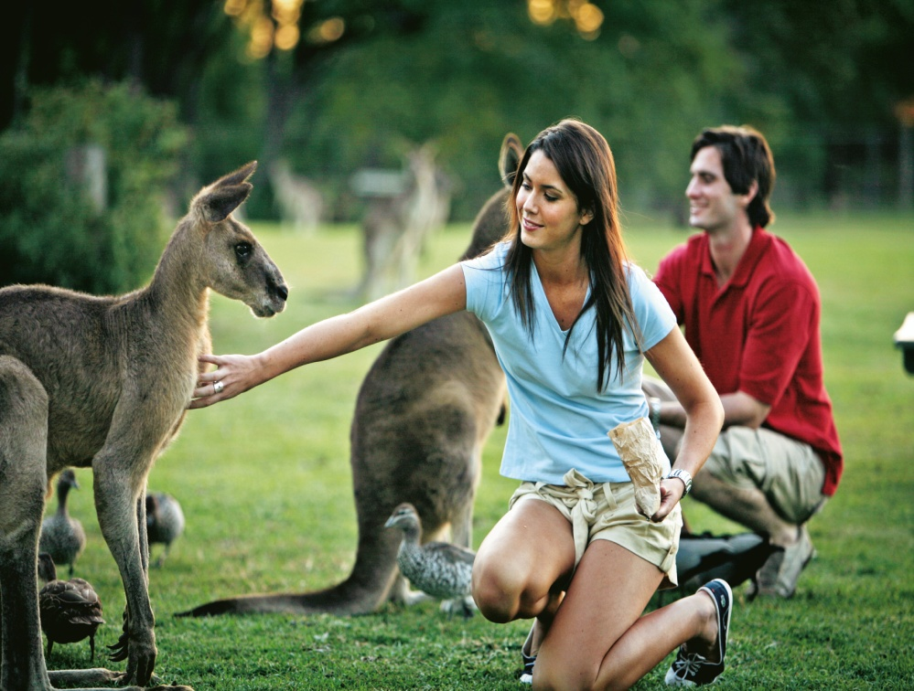
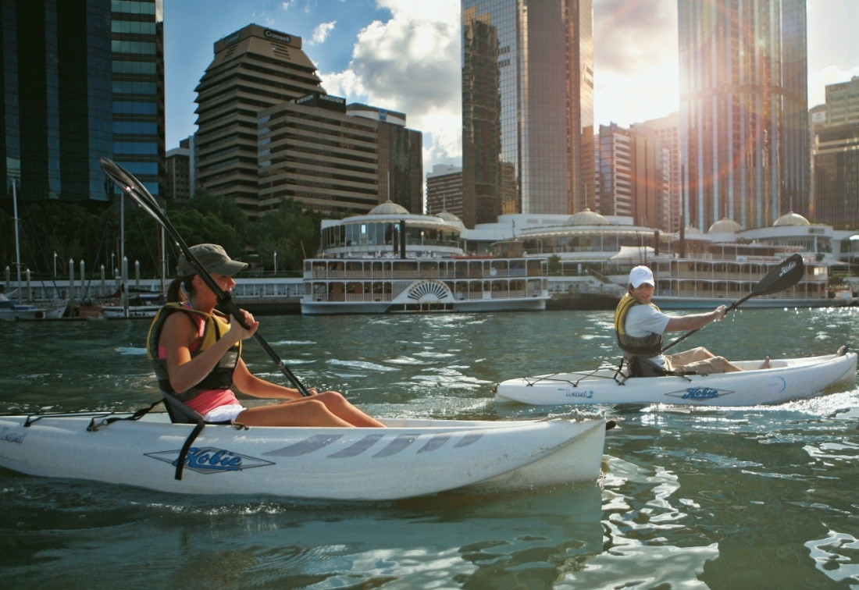
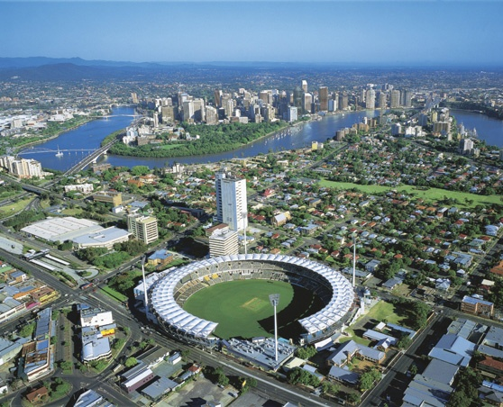

Notes:
outdoor activities- QUT hosts the Brisbane Rockclimbing club which is based at the Kangaroo Pt cliffs just across the river from Gardens Point campus.
Kayaking on the river
Brisbane has one of only 2 bridge climbs in the world at the Story Bridge
20km of riverside bike paths in Brisbane- in 2010 introduced city cycle system to allow cheap usage of bikes in the city. People can pay a subscription fee or use the bikes on a casual basis.
Sports- Brisbane has teams in AFL, Rugby League, cricket and soccer (football). Brisbane is also the home for the QLD Reds, the rugby union team.
There are 2 major sports venues for all football codes and cricket each holding over 40,000 people.

Slide 11
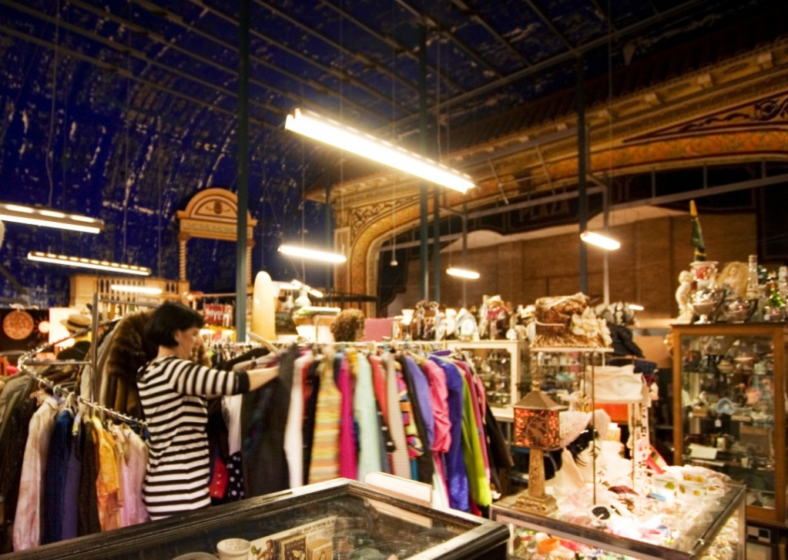
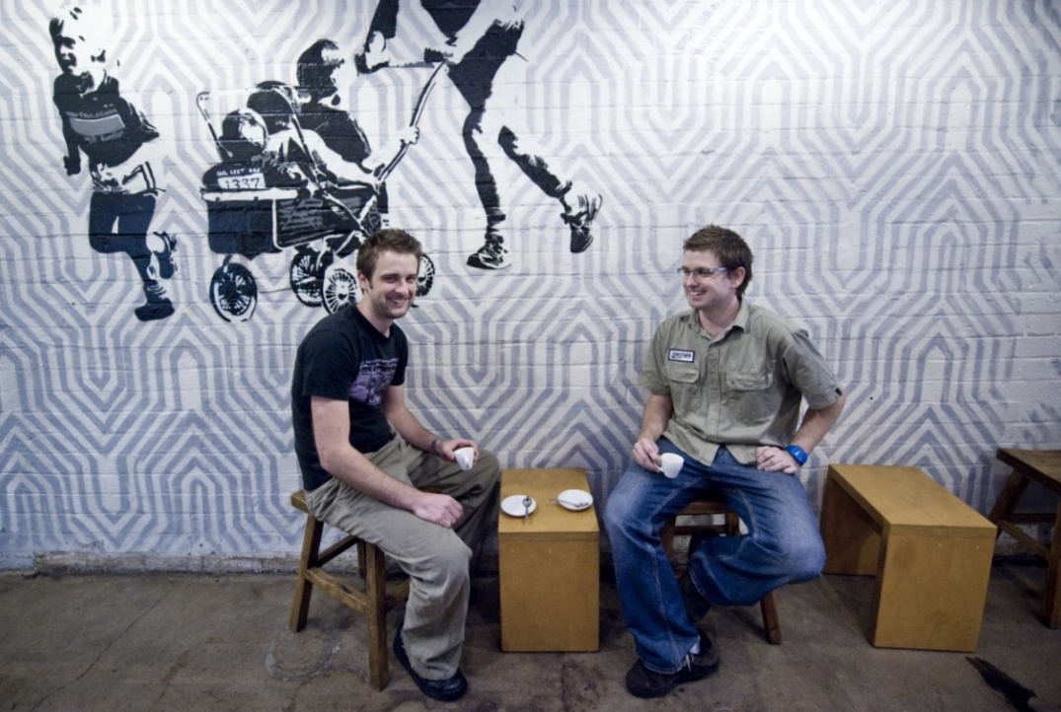
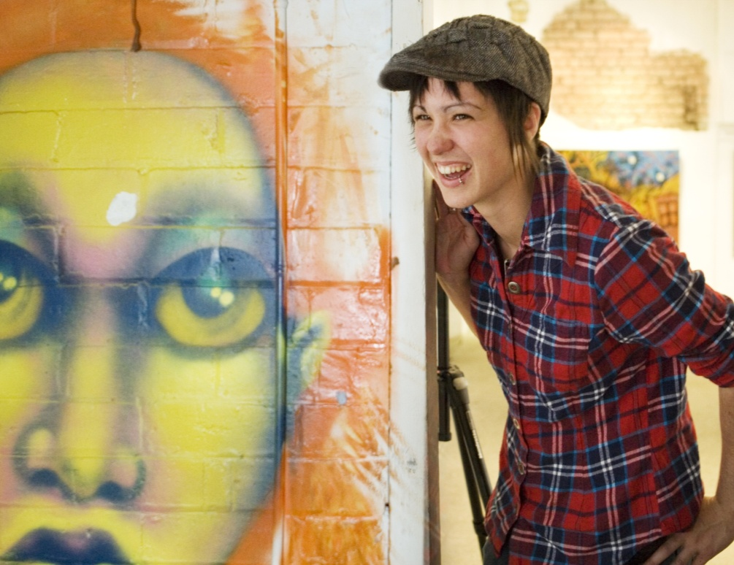
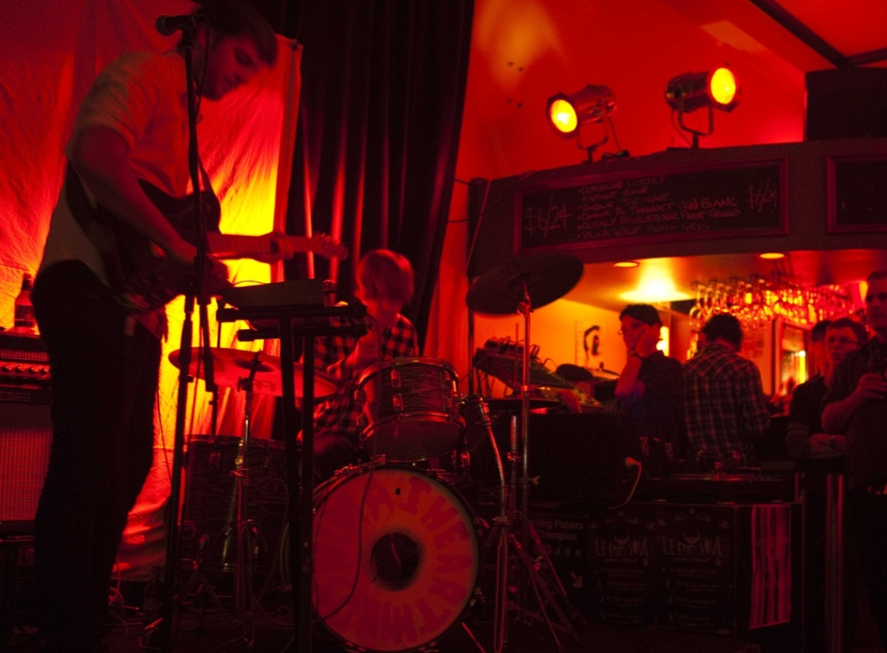
Notes:
Art galleries including second largest collection of art outside of the Qld art gallery right on QUT Gardens Point campus.
Cafe culture with coffee shops all over the city.
Billboard magazine recently named Brisbane as one of the world’s top 5 hotspots for live music.
Brisbane also has Qld Performing Arts complex which hosts Broadway plays and musicals throughout the year.

Slide 12

Flexible study options
QUT Study Abroad program allows students to select subjects from across
all of our faculties. This allows you to custom design your program to suit
your interests and meet the requirements of your home university.
Study Areas include:
Building and planning
Business
Creative, design and performance
Education
Engineering
English language and pathway programs- QUT International College
Health and community
Information technology
Languages
Law and justice
Science and mathematics
Notes:
Additional notes;

Slide 13

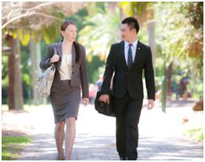
QUT Business School
The first business school in Australia to secure the prestigious ‘triple crown’ of international accreditation –
US-based AACSB International, European-based EQUIS and UK-based Association of MBAs (AMBA). This accreditation, held by less than one per cent of business schools worldwide provides real evidence that our programs are comparable with the best in the world
Our award winning Business Advantage Program
delivers optional personal development modules to
help you gain a competitive advantages in the workplace
Study Areas
  Accounting
  Advertising and Marketing
  Economics
  Finance
  Human Resource Management
  International Business
  Management
  Public Relations
Notes:
Additional Notes:
Areas of study:
Accountancy, Advertising, Economics, Finance, Human Resource management, International Business, Management, Marketing, Public Relations Language, Integrated Marketing Communications (IMC), Electronic Business, International Logistics, Business, Law and Tax, Professional Accounting, Funds Management, Financial Economics
Practical opportunities are available during and after your study such as the Business Advantage Program
88 per cent of QUT Business School research publications are in international journals

Slide 14
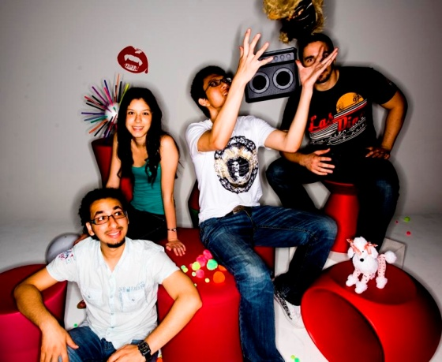
Creative Industries
Located within the Creative Industries Precinct- home to facilities where staff and students collaborate with industry in state-of-the-art performance spaces, production studios, editing suites and design studios.
Both campuses have full theatre facilities which are used for student performances as well as a professional theatre season.
Study Areas
  Animation
  Architecture and Design
  Creative and Professional Writing
  Journalism
  Dance, Drama and Music
  Industrial and Interior Design
  Entertainment Industries
  Fashion
  Film, TV and New Media Production
  Interactive Visual Design
Notes:
Additional Notes:
Areas of study:
Acting, Animation, Creative and Professional Writing, Dance , Drama, Fashion, Film and Screen Production, Interactive and Visual Design Sound Design, Technical Production, Television Producing, Visual Arts, Journalism, Music, Mass Communication, Media and Communication.
Provide you with opportunities to exhibit your work to industry leaders

Slide 15
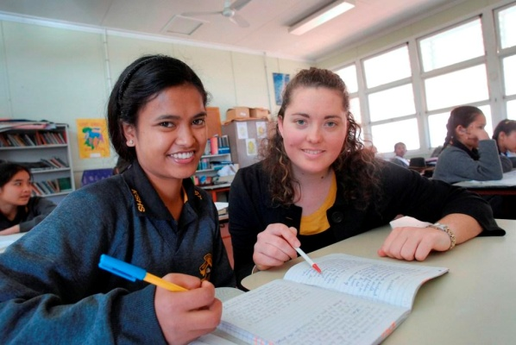
Education
QUT is one of Australia’s largest and most highly respected
education study providers.
Field experiences are an essential part of your education units at
QUT, and working in classrooms alongside practising educators
allows you to implement your learning techniques and gain real
experience.
Study Areas
  Early Childhood
  Field Studies
  Primary
  Secondary
Notes:
Additional Notes:
One of five education faculties in the world to prepare teachers for the Malaysian Government.
Faculty maintains the Centre for Learning Innovation that draws upon the strengths of all its Schools and provides on-going support for our top education researchers.
The Faculty is also home to the Stronger Smarter Institute, an innovative partnership between Education Queensland and QUT which stimulates excellence in all areas where Indigenous
students encounter and engage with education systems.
Areas of study:
Early Childhood Teaching, Junior Years Teaching, Middle Years Teaching, Secondary Teaching, Learning Innovation, Teacher Librarianship, Educational and Developmental, Psychology.

Slide 16
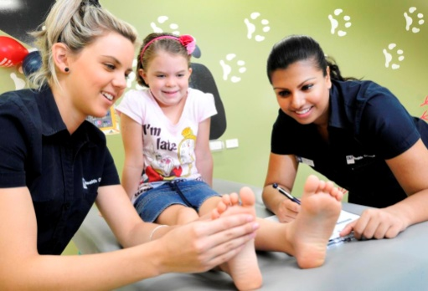
Health
Longest-running School of Nursing in Queensland with many years of industry consultation and experience.
The QUT Health Clinics, located at the Kelvin Grove campus, offer students state-of-the-art training facilities and are fully equipped to deliver professional services in human movement and exercise, nutrition and dietetics, optometry, podiatry, psychology and counselling, and wound healing.
Study Areas
  Human Movement Studies
  Nursing and Midwifery
  Optometry
  Psychology and Counselling
  Public Health
  Social Work and Human Services
Notes:
Additional Notes:
Major partner in the Institute of Health and Biomedical Innovation, a progressive A$70 million research facility, which focuses on research
in cells and tissue, tropical crops and biocommodities, vision improvement, medical devices, human health and well being, and injury
prevention and rehabilitation.
Areas of study:
Behavioural Science (Psychology), Human Movement Studies, Human Services, Nutrition and Dietetics, Exercise and Sports Nutrition, Nursing, Nutrition, Optometry, Podiatry, Public Health.
Acting Head of School, Professor Patsy Yates, said it is a great achievement that the school was judged 5 out of 5 in the world rankings.
QUT is a world leader in research areas including wound healing and cancer and palliative care.
Our programs include hands-on professional placements to give you real-world experience and the opportunity to develop valuable industry contacts.
One of only four universities in Australia to offer Optometry, and Health Information Management

Slide 17
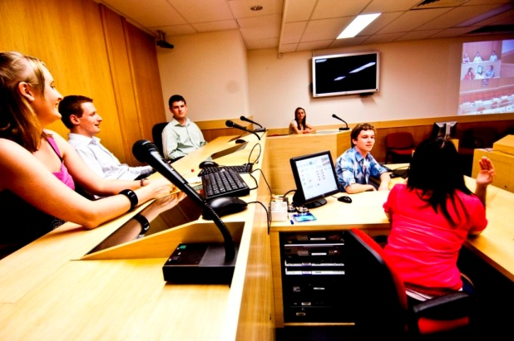
Law and Justice
Features the Electronic Moot Court, one of Australia’s
most advanced electronic courtrooms, containing
state-of-the-art information technology and AV integration.
QUT is the only Australian university to offer a practical hands-on course component based on software used by various government and law enforcement worldwide.
Study Areas
  Law
  Justice
Notes:
Areas of study:
Commercial Law, Corporate law, Environmental Law, International Law, Media and Communications Law, Property Law, Public Law, Technology Law, Justice, Organised Crime and Corruption Investigation, Criminal Justice, Criminology, Intelligence, Policing.

Slide 18
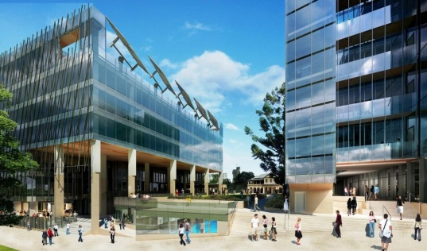
Science and Engineering
Delivers a range of programs across information technology, built environment and the sciences.
QUT’s new Science and Engineering Centre will further integrate teaching
and research in the STEM disciplines (Science, Technology, Engineering
and Mathematics).
Study Areas
  Aerospace Avionics
  Physics, Chemistry and Biological sciences
  Civil, Electrical and Mechanical Engineering
  Information Systems/Technology
  Mathematical Sciences
  Urban and Regional Planning
  Computer Science
Notes:
Additional Notes:
QUT hosts the International Laboratory for Air Quality and Health. It’s the only research facility in Australia specialising in environmental aerosol science
Working with governments in South-East Asia and the WHO, our Infectious Diseases Research Program has identified the sources of the present dengue outbreak in the Pacific and eliminated
the disease in selected communities in Vietnam.
Areas of study:
Business Process Management, Corporate Systems Management, Electronic Business, Games Design and Technology, Information and Communication Technology, Information Systems, IT
Consulting, IT Project Management, Interactive Media and Entertainment, Software Engineering, Web Services and Applications, Air Quality and Health, Applied Optics, Biochemistry, Biomedical Science, Chemistry, Ecology, Environmental Science, Forensic Science, Physics, Infectious Diseases, Inorganic Materials, Mathematics, Medical Imaging Technology, Medical Physics, Microbiology, Pharmacy, Plant Biotechnology, Tissue Bio-regeneration and Integration.
QUT was the only Australian university appointed as a learning partner by Shell in a consortium (four universities) to support its global project academy.

Slide 19

Student support services
QUT’s International Student Services (ISS) has experienced staff and
support options to help you settle in and get the most out of your
university experience.
Services include;
Pre-departure and arrival information
Academic and personal counselling
Workshops and seminars
Accommodation assistance
Language and learning advice
Airport reception
Affordable short trips and activities to explore
Queensland
Notes:
Additional Notes:
ISS provides advice and referrals through issadvice@qut.edu.au as well as a 24 hour emergency number 07 3138 2019

Slide 20
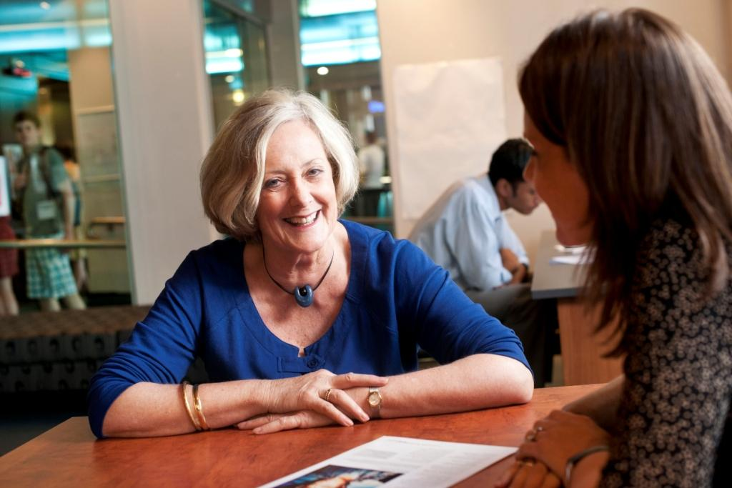
Career and Mentoring support
QUT Careers and Employment provides free advice on career
planning and employment assistance, and is the only university in
Australia with an International Career Counsellor that works exclusively
with international students and employers.
Services include;
Career counselling
Resume and job application checking services
Career Mentor Scheme
International Work Placement Scheme
(vacation internships in home countries)
through Career-Hub
Access to Going Global www.goingglobal.com –
with more than 35 000 country specific career and
employment resources
Career Hub containing job listings, presentations,
workshops and job seeking help
Notes:
Additional Notes:

Slide 21
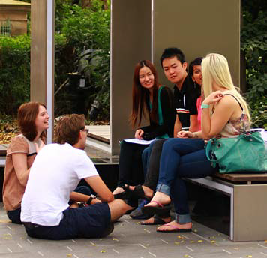
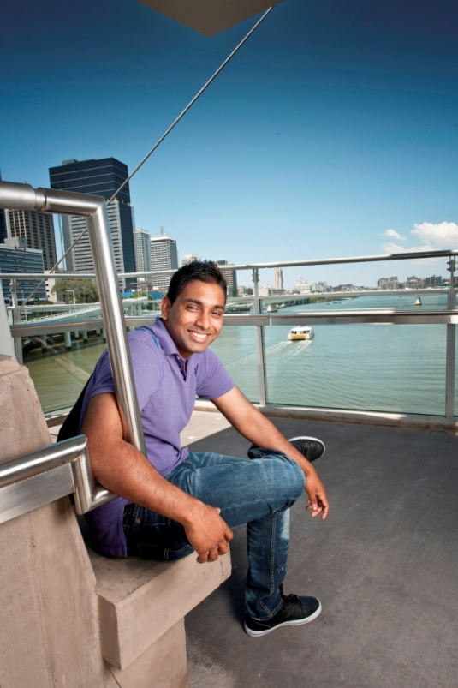
QUT Buddy Program
QUT Study Abroad and Exchange team run a buddy program which pairs up
an Australian student with 1-3 international students.
The idea is that the local student will be able to introduce new students to Brisbane
and help them adjust to life at QUT.
“I became a buddy because I love making new friends from
around the world and interacting with people from different
cultures”
Hannah, current Buddy 2012
Notes:
Additional Notes:

Slide 22



A university for the real world
QUT International
Queensland University of Technology
2 George Street
GPO Box 2434
Brisbane Queensland 4001
Australia
Phone +61 3 9627 4853
Fax +61 3 9627 4863
Australia Freecall 1800 181 848
Online Enquiries www.international.qut.edu.au/contact
Email qut.international@qut.edu.au
QUT International website: www.qut.edu.au/international
CRICOS 00213J

